Slide 1
Transition to Common Core
Text Complexity
Notes:
Have Slide 1 on the screen as participants enter the room. Begin by introducing yourself and a bit of background on your job, role, and engagement with PA Common Core.

Slide 2
PA
Common Core
Text Complexity
Writing
Standards
Overview
Evaluating
Curriculum
Toolbox
Notes:
This is one of four modules designed to assist educators in understanding and transitioning to PA Common Core.

Slide 3
Let’s get acquainted!
Connect to the Internet
Navigate to: http://www.pdesas.org
If a registered user, sign-in.
If not a registered user, join now.
Place your name and school district/organization on your name tent
Your School District/Organization
Your Name
Notes:
Remind participants to sign on to SAS and complete and display their name tents.

Slide 4
Essential Questions
What is text complexity and why it is important?
What considerations need to be made before selecting texts for teaching and students’ independent reading?
How can teachers employ more rigorous text on a regular basis?
Notes:
Today we are focusing on three essential questions related to a key piece of PA Common Core transition. Read each question aloud.

Slide 5
Think About…
Think about the texts you use with your students.
What makes the text appropriate for that particular grade level?
How do you select the texts you use with your grade level(s) of students?
Notes:
Take a look at the two questions on the screen. Choose one of them. On an index card, write a response to it.
What makes a text appropriate for your particular grade level?
How do you select the texts you use with your grade level (s) of students?
Allow a 1 – 2 minute wait time.
After participants have responded, divide the room in half. Have Question 1 respondees move to the left side of the room and Question 2 respondees to the right side. Have each group list (or some of their) ideas on chart paper. Have one member from each group summarize the responses.
Wrap up the activity with this question: What have we discovered?

Slide 6
What/So What??
What? | So What? | Now What?
As the presentation unfolds, list at least five new understandings that resonate with you.
1 2 3 4 5
Notes:
Introduce the graphic organizer “What –So What.” (Handout)
The “What/So What” graphic organizer will be used through the entire text complexity module. Although we will be pausing at certain points throughout this module, if something resonates with you, please quickly jot it down at any point through this presentation. The first column is for new understandings that are important. The second column is to connect that new understanding with why it is important. The last column is for what you can do with that new information and how you can change practice as a result.
We will return to this graphic organizer at the end of the day to share our knowledge gained.

Slide 7
Text Complexity
The Common Core Standards hinge on students encountering appropriately complex texts at each grade level in order to develop the mature language skills and the conceptual knowledge they need for success in school and life (p. 3).
Notes:
Comprehending complex texts is everywhere in the CCSS. This is why text complexity matters and we are spending time talking about it.

Slide 8
Text Complexity
Specifically, for the Range of Reading standard…
Grade 2 PA Common Core Standard:
CC.1.2.2.L Read and comprehend literary non-fiction and informational text on grade level, reading independently and proficiently.
Notes:
As stated in the Standards: Note on Range and Content of Student Reading:
To build a foundation for college and career readiness, students must read widely and deeply from among a broad range of high-quality, increasingly challenging literary and informational texts. Through extensive reading of stories, dramas, poems, and myths from diverse cultures and different time periods, students gain literary and cultural knowledge as well as familiarity with various text structures and elements. By reading texts in history/social studies, science, and other disciplines, students build a foundation of knowledge in these fields that will also give them the background to be better readers in all content areas. Students can only gain this foundation when the curriculum is intentionally and coherently structured to develop rich content knowledge within and across grades. Students also acquire the habits of reading independently and closely, which are essential to their future success.
We are building readers with the end result: college and career in mind.

Slide 9
Making Meaning
Reading is a process in which information from the text and the knowledge possessed by the reader act together to produce meaning.
Anderson, R.C., Hiebert, E.H., Scott, J.A., & Wilkinson, I.A.G. (1985)
Becoming a nation of readers: The report of the Commission on Reading Urbana, IL: University of Illinois
Notes:
Making Meaning Slide- emphasizes the reader as central to understanding text.
The reader is at the heart of how a text is comprehended. A reader’s background, vocabulary understanding, and other variables will all affect how a text is understood and how meaning is made.

Slide 10
Cognitive Skill
Table 3: 2011 NAEP Reading Assessment Distribution of Questions by Cognitive Skill Across the Test
Field of Reading | Grade 4 | Grade 8
Locate and Recall Locating or recalling information from what they have read, student may identify explicitly stated main ideas or may focus on specific elements of the story. | 30% | 20%
Integrate and Interpret When integrating and interpreting what they have read, students may make comparisons, explain character motivation, or examine relations of ideas across the text. | 50% | 50%
Critique and Evaluate When critiquing or evaluating what they have read, students view the text critically by examining it from numerous perspectives or may evaluate overall text quality or the effectiveness of particular aspects of the text. | 20% | 30%
Notes:
Post Slide 10 questions (see below) a chart paper and post in front of room.
The NAEP Reading assessment shows how the national assessment focus on higher Depth of Knowledge (DOK). Interpreting, recalling, critiquing and evaluating text are much more difficult than recall.
Please look at the above chart illustrating the distribution of questions by cognitive skill for reading for the NAEP Reading Assessment. It shows what students are expected to be able to do during the test. Think about how you teach students to interpret, critique, and evaluate.
At your table, take 2-3 minutes to reflect on these questions:
In your classroom, what percentage fall in each of these categories on average? Where do we fall short?
Would students be able to consistently engage in these tasks proficiently?
Where do you think our students measured up to this assessment as a state?
Sample responses from a few tables to share thinking. Summarize the participant’s responses: Here’s what I heard…

Slide 11
Reading Rigor Risk
NAEP Scale Equivalents of State Grade 8 Reading Standards for
Proficient Performance (2009)
Notes:
Here are the summary results for the NAEP Reading assessment showing where different states fall on the proficiency continuum for grade 8. Are any states showing consistent levels of proficiency? Look at where PA falls. What does this data suggest about how well we are all addressing rigor in our reading instruction?

Slide 12
College and Career Ready
How do you know if a student is college and career ready?
“What appears to differentiate those who are more likely to be ready from those who are less likely is their proficiency in understanding complex texts.” (ACT’s Reading Between the Lines)
Notes:
Please take a look at the quote from ACT and what it says about students exemplifying what it means to be college and career ready. Notice that what makes a person who is ready for college or career a stand out is his or her ability to understand complex texts.

Slide 13
Literacy Priorities
Among the highest priorities of the Common Core State Standards is that students must read texts closely and acquire knowledge.
At each grade level, 80 to 90 percent of the reading standards require text-dependent analysis. Questions that expect student responses to be text-dependent and discipline-specific require students to demonstrate that they understand the text details and can provide accurate evidence.
Notes:
The CCSS really emphasize the need to read texts carefully and analyze those texts. Students are now required to cite specific text examples and provide specific evidence from the texts they are reading. The students need to draw out and discern the important information from the less relevant information.

Slide 14
Overview of Text Complexity
Quantitative Measures – Readability and other scores of text complexity often best measured by computer software.
Qualitative Measures – Levels of meaning, structure, language conventionality and clarity, and knowledge demands often best measured by an attentive human reader.
Reader and Task Considerations – Background knowledge of reader, motivation, interests, and complexity generated by tasks assigned often best made by educators employing their professional judgment.
Notes:
This graphic represents the heart and soul of text complexity. The triangle illustrates the 3 components necessary to clearly understand and define text complexity: quantitative, qualitative, and reader and task. We are going to explore deeply all three of these components.
Note: More detailed information on text complexity and how it is measured is contained in Appendix A. http://static.pdesas.org/content/documents/ELA-Appendix_A-Research-Supporting-Key-Elements-of-the-Standards.pdf

Slide 15
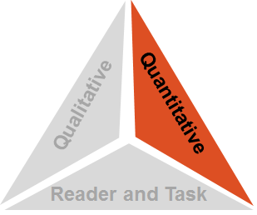
Quantitative Measure
Step 1: Quantitative Measures
Measures such as:
Word length
Word frequency
Word difficulty
Sentence length
Text length
Text cohesion
Notes:
Quantitative focuses on:
Word length
Word frequency
Word difficulty
Sentence length
Text length
Text cohesion (One type of cohesion refers to overlap in content words between sentences within paragraphs or sections of a text.)
This is where the various readability formulas fit. Be knowledgeable in which are best to use for the ages of your students. As part of Microsoft Office Word, you have the Flesch Reading Ease and the Flesch-Kincaid readability formulas.
The Flesch Reading Ease gives a score from 0 to 100. The higher the number, the easier it is to read. A score between 90-100 is considered easily understandable by an average 5th grader. Scores between 60.0 and 70.0 are considered easily understood by 8th and 9th graders. Scores between 0.0 and 30.0 are considered easily understood by college graduates.
The Flesch-Kincaid Grade Level outputs a U.S. school grade level; this indicates that the average student in that grade level can read the text.
The SPACHE Readability Formula is best used to calculate the difficulty of text that falls at the 3rd grade or below.
Unfortunately, this is one you have to purchase to use.
Take 1-2 minutes to turn and talk to your elbow partner about quantitative measures and what your district uses to assess text complexity.
Do a quick debrief to gather feedback from participants.

Slide 16
Quantitative: Fry’s Readability Formula
Notes:
Fry’s Readability formula is one common example of how text complexity was/is determined. If you look up the side of the graph, it requires a person to calculate the average number of sentences per 100 words. Along the bottom of the graph, you can see that the average number of syllables per 100 words is required. You just need to look at the x and y axes and find the appropriate grade level.

Slide 17
Trying it out…an example
The Hunger Games by Suzanne Collins
Apply Fry’s availability formula to the following passage to determine the readability level of The Hunger Games by Suzanne Collins.
Count the number of sentences per 100 words.
Count the number of syllables per 100 words.
Notes:
Hunger Games Activity – Distribute the Hunger Games/Fry Formula handout.

Slide 18
The Hunger Games
The boy from District 1 dies before he can pull out the spear. My arrow drives deeply into the center of his neck. He falls to his knees and halves the brief remainder of his life by yanking out the arrow and drowning in his own blood. Rue has rolled to her side, her body curved in and around the spear. I shove the boy away from the net. One look at the wound and I know it’s far beyond my capacity to heal. The spearhead is buried up to the shaft in her stomach. “
Impulsively I lean forward and kiss him, stopping his words. This is probably overdue anyway since he’s right, we are supposed to madly in love. It’s the first time I’ve ever kissed a boy. “Well, there’s more swelling, but the pus is gone, “ I say in an unsteady voice. “I know what blood poisoning is, Katniss,” says Peeta.
Notes:
Part 1: Ask participants to look at the screen and predict the reading age (grade level) for The Hunger Games excerpt and write it on the index card. Briefly share at tables.

Slide 19
Quantitative: Fry’s Readability Formula
Notes:
Part 2: Have participants determine actual quantitative levels by applying Fry’s Readability formula to 100 words in the paragraph. (The readability of this passage falls around the third grade range.) Have participants share expectations verses their actual findings at their tables.

Slide 20
So what is a lexile?
Lexile units are based on word frequency and sentence length. Word frequency is calculated based on words in Lexile databank (almost one billion).
Lexiles range from 0 (beginning reading) to 2000 (highly technical texts).
www.lexile.com
Notes:
Many districts also use Lexiles to determine appropriate text levels. Lexiles are also addressed in the CCSS as well. Basically lexiles use sentence length (similar to Fry) and word frequency (based on the Lexile databank) to determine a range between 0 and 2000.

Slide 21
Pennsylvania Common Core Standards
Quantitative Measures Ranges for
Text Complexity Grade Bands
Text Complexity Grade Bands | Suggested Lexile Range | Suggested ATOS Book Level Range**
K-1 | 100L – 500L* | 1.0 – 2.5
2-3 | 450L – 790L | 2.0 – 4.0
4-5 | 770L – 980L | 3.0 – 5.7
6-8 | 955L – 1155L | 4.0 – 8.0
9-10 | 1080L – 1305L | 4.6 – 10.0
11-CCR | 1215L – 1355L | 4.8 – 12.0
* The K-1 suggested Lexile range was not identified by the Common Core State Standards and was added by Kansas.
** Taken from Accelerated Reader and the Common Core State Standards, available at the following URL:
http://doc.renlearn.com/KMNet/R004572117GKC46B.pdf
Notes:
What is a text complexity band? It’s a grade band with corresponding text levels assigned to it. If you draw your eye to the first two columns, you’ll see the correspondence.

Slide 22
Pennsylvania Common Core Standards
Quantitative Measures Ranges for
Text Complexity Grade Bands
Text Complexity Grade Bands | Suggested Lexile Range | Suggested ATOS Book Level Range**
K-1 | 100L – 500L* | 1.0 – 2.5
2-3 | 450L – 790L | 2.0 – 4.0
4-5 | 770L – 980L | 3.0 – 5.7
6-8 | 955L – 1155L | 4.0 – 8.0
9-10 | 1080L – 1305L | 4.6 – 10.0
11-CCR | 1215L – 1355L | 4.8 – 12.0
* The K-1 suggested Lexile range was not identified by the Common Core State Standards and was added by Kansas.
** Taken from Accelerated Reader and the Common Core State Standards, available at the following URL:
http://doc.renlearn.com/KMNet/R004572117GKC46B.pdf
Notes:
What is a text complexity band? It is a grade level band that has assigned readability levels. In the grade 4-5 text complexity grade band, the lexile range of a given text should be in the 770 to 980 range. For example, in Accelerated Reader, the book level range is 3.0 – 5.7.

Slide 23
Step 1: Quantitative Measures
Lexile Range (810 L):
4-5
6.2
ATOS Book Level:
Scholastic’s
Book Wizard Level:
5.3
Notes:
Because the Lexile score and the ATOS didn’t seem to be on the same page and we had a book with the AD code, we also ran this title through Scholastic’s Book Wizard leveling system to get more information. Scholastic put this book at a 5.3 grade level.
What is our conclusion? (Solicit from audience!)
Text complexity ranges anywhere from grade 4 through grade 6.
This is only one part of the text complexity triangle. We need more.
Does the content of the book have any impact on the text complexity?

Slide 24
Step 1: Quantitative Measures
Remember, however, that the quantitative measures is only the first of three “legs” of the text complexity triangle.
Our final recommendation may be validated, influenced, or even over-ruled by our examination of qualitative measures and the reader and task considerations.
Notes:
This slide sums up the one triangle component to remind participants that it is only 1/3 and there are other components to consider.
Remember, however, that the quantitative measure is only the first of three “legs” of the text complexity triangle. Our final recommendation may be validated, influenced, or even over-ruled by our examination of qualitative measures and the reader and task considerations. Now the fun begins!

Slide 25
What/So What??
What? | So What? | Now What?
As the presentation unfolds, list at least five new understandings that resonate with you.
1 2 3 4 5
Notes:
Display Slide 25: “What/So What” graphic organizer and ask participants to pause and ponder while taking a 10-minute break.

Slide 26
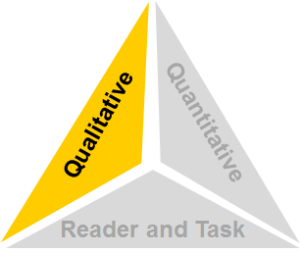
Qualitative Measures
Step 2: Qualitative Measures
Measures such as:
Layers of meaning
Levels of purpose
Structure
Organization
Language conventionality
Language clarity
Prior knowledge demands
Cultural demands
Vocabulary
Notes:
Introduction to qualitative measures
What Are the Qualitative Measures?
Only a human reader can analyze this. It is characterized by:
Layers of meaning
Levels of purpose
Structure
Organization
Language conventionality
Language clarity
Prior knowledge demands
Cultural demands
Vocabulary
How about this metaphor?
Is this an apple book where you can just bite into it?
OR
Is it an onion book that you have to peel back the layers?
Table Talk: At your tables, share titles of apple and onion books with one another.
In 2-3 minutes, ask table to share out titles.

Slide 27
Assessing Text
Where on the continuum?
Notes:
There is a continuum for each of the qualitative measures. Just because a text may be exceeding complex in meaning, it may only require a small amount of knowledge demands. Text complexity requires teachers to be thinking about these elements as they select text and work with students. What is appropriate for the students and what will it require of them cognitively are important considerations.

Slide 28
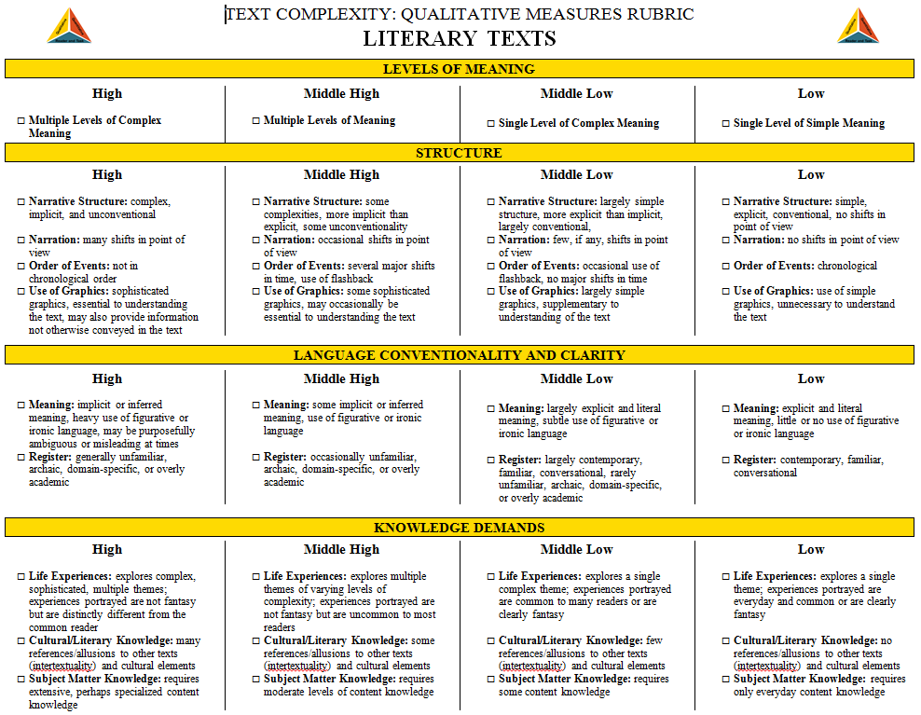
Step 2: Qualitative Measures
The Qualitative Measures Rubrics
for Literary Text
http://www.ksde.org/Default.aspx?tabid=4605
Allow educators to evaluate the important elements of text that are often missed by computer software that tends to focus on more easily measured factors.
Notes:
Text Complexity: Qualitative Measures Rubric for Literary Text (Handout)
As the kids we work with need basically a new book most days to read, the steps here are not feasible for us to do for every book we hand a child. However, if you assign a chapter book that several days will be spent reading and working with it, you may want to consider using some of the following resources to help you match a book to your readers.
The first are the rubrics; one for literary texts and one for informational texts. Since the demand for students to be able to read and critique informational text has increased with the adoption of the PA CCSS, it is imperative for teachers to be thinking about this genre of texts and how to increase time students spend with informational text and the time spent teaching using informational text.

Slide 29
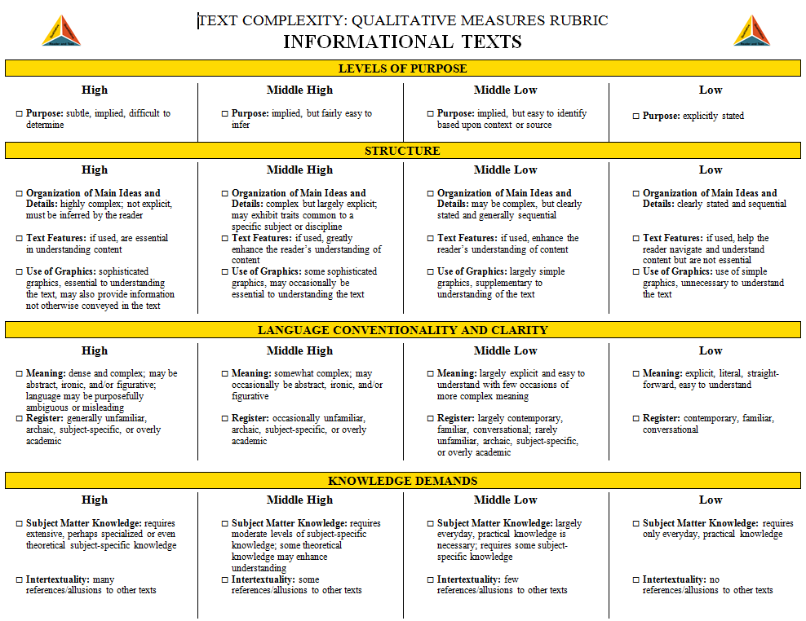
Step 2: Qualitative Measures
The Qualitative Measures Rubrics
for Informational Text
http://www.ksde.org/Default.aspx?tabid=4605
Allow educators to evaluate the important elements of text that are often missed by computer software that tends to focus on more easily measured factors.
Notes:
Text Complexity: Qualitative Measures Rubric for Informational Text (Handout)
TableTalk: Have tables look at both rubrics to determine design, categories, and content. Ask tables to compare and contrast the two rubrics. How are they alike? How are they different?

Slide 30
Step 2: Qualitative Measures
Because the factors for literary texts are different from information texts, these two rubrics contain different content. However, the formatting of each document is exactly the same.
And because these factors represent continua rather than discrete stages or levels, numeric values are not associated with these rubrics. Instead, four points along each continuum are identified: high, middle high, middle low, and low.
Notes:
Literary Rubric Explained
The format is the same for both, but they have different factors that they evaluate.
Because the factors are along a continuum, the points are High, Medium High, Medium Low and Low.
Low does not mean K-2 nor does High mean high school.
Low does not mean “bad.”
Please look at both handouts provided and look across the qualitative measures and think about what makes a text high in each of the areas and low in those areas. What are the differences you notice between literacy texts and informational texts?

Slide 31
Step 2: Qualitative Measures
So…how is the rubric used?
And how would The Hunger Games fare when analyzed through the lens of the Literary Text Rubric?
Notes:
Have participants review the rubric and rate The Hunger Games.
So…let’s apply the literary rubric to The Hunger Games. (Give participants 5 – 10 minutes to complete the rubric independently.)

Slide 32
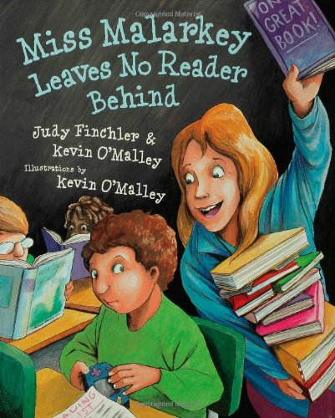
Step 2: Qualitative Measures
Notes:
This is just an example of how one person who read the text determines the qualitative measures for text complexity for this particular book. How did your analysis square with the one on the screen? (Feel free to solicit responses from the audience to generate conversation.)

Slide 33
Qualitative Measures
Qualitative measures of text complexity have been described by the CCSS in Appendix A as:
“best measured or only measurable by an attentive human reader, such as levels of meaning or purpose; structure; language conventionality and clarity; and knowledge demands.”
Notes:
As Appendix A states, “Few, if any, authentic texts will be low or high on all of these measures.” The goal is not for all of the checkmarks to be in a single column; the goal is to accurately reflect these factors of the text.
The marked rubric can then serve as a guide as educators re-evaluate the initial placement of the work into a text complexity band. Such reflection may validate the text’s placement or may suggest that the placement needs to be changed.

Slide 34
Step 2: Qualitative Measures
Our initial placement of The Hunger Games into a text complexity band has changed when we examined the qualitative measures.
Remember, however, that we have completed only the first two legs of the text complexity triangle.
Qualitative
Quantitative
The reader and task considerations still remain.
Reader and Task
Notes:
Summary of the 2 “legs” together; one more to go
Qualitative Results
Our initial placement of The Hunger Games into a text complexity band has shifted the appropriateness of the book. It would not seem realistic to imagine that the content of the book is appropriate for a fourth or fifth grade child.
Remember, however, that we have completed only the first two legs of the text complexity triangle. The reader and task considerations still remain.

Slide 35
What/So What??
What? | So What? | Now What?
1. 2. 3. 4. 5. | If you have not already listed any new understandings, would you please do that now (if you have any). Then take a moment to reflect the importance of how they impact teaching and learning relative to text complexity.
Notes:
“What/So What” activity: Revisit and add new understanding as relating to the qualitative component.

Slide 36
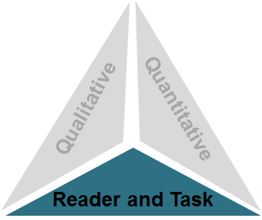
The Reader and Task
Step 3: Reader and Task
Considerations such as:
Motivation
Knowledge and experience
Purpose for reading
Complexity of task assigned regarding text
Complexity of questions asked regarding text
Notes:
Introduction to the Reader and the Task
We must be careful to really look closely at the reader and task considerations when matching a book to the right reader.
This is really important. It is where you as a professional educator use your judgment in matching the right book to the right kid at the right time.
You also need to look at who your readers are. What background experiences do they bring or not bring to the book in question?

Slide 37
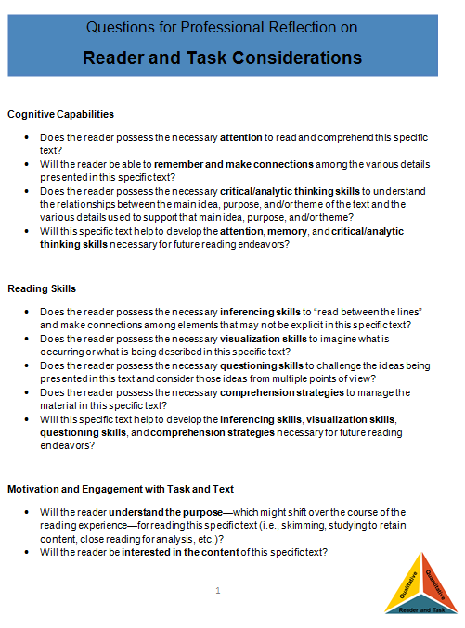
Step 3: Reader and Task Considerations
The questions included here are largely open-ended questions without single, correct answers, but help educators to think through the implications of using a particular text in the classroom.
Notes:
Reader and Task Considerations (Handout)
At our grade levels, we will want to also look at what comprehension skills we are wanting to teach with this text. Please refer to the reader and task handout. Think about what cognitive capabilities, reading skills, and how motivation would be affected or be needed to persist through the text or the task. Take a moment to think of a time when a text was not suitable for a student even though it may have been quantitatively and qualitatively appropriate. Please share out with the members at your table. (Allow 3-5 minutes for discussion. Ask tables to shout out responses.)
If you are introducing a more complex skill, you may want to use a book that will not overly challenge them with the actual reading of it so they have brain space to use applying the skill.

Slide 38
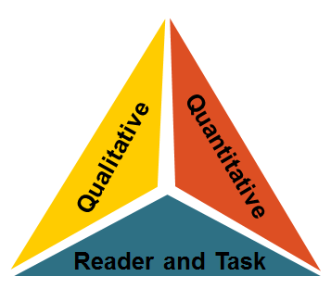
Step 4: Recommended Placement
Step 4: Recommended Placement
After reflecting upon all three legs of the text complexity model, we can make a final recommendation of placement within a text and begin to document our thinking for future reference.
Notes:
Using this protocol, we progressed through each leg of the text complexity model: (1) quantitative measures, (2) qualitative measures, and (3) reader and task considerations. Now we are ready to review all three legs one last time and make a final recommendation for placement of this text into a text complexity grade band.

Slide 39
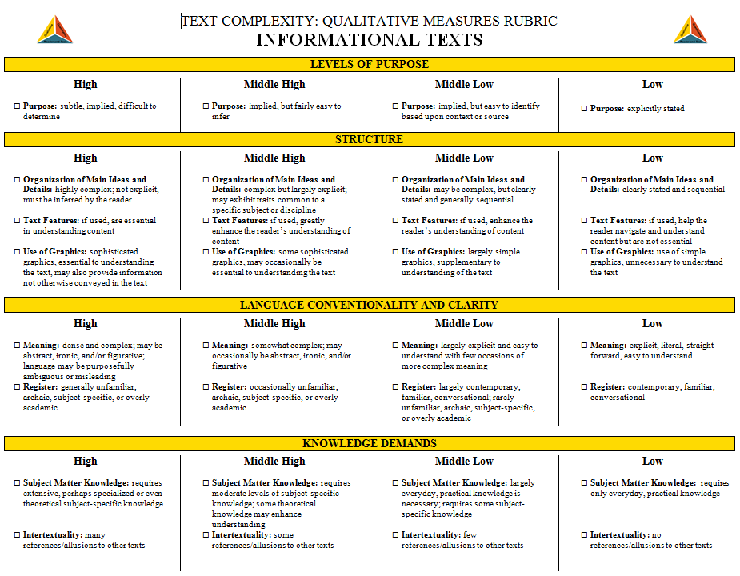
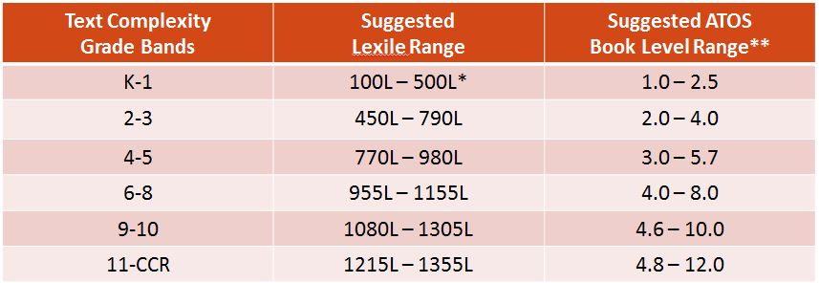
Determining Text Complexity
Four Step Process
Determine the quantitative measures of the text.
Analyze the qualitative measures of the text.
Reflect upon the reader and task considerations.
Recommend placement in the appropriate text complexity band.
Qualitative
Quantitative
Reader and Task
Notes:
Read the four step process on the screen. What is important to note is that we need to re-evaluate and validate what books we do use.

Slide 40
Hunger Games Recommended Placement
Notes:
What you see on the screen is a summary of the quantitative, qualitative, and reader to task considerations for The Hunger Games. Since we did not complete a reader to task (absent having a classroom), note the elements and issues detailed in the reader to task narrative. This is where the spotlight falls upon the student, and the teacher brings his/her teaching expertise to the table to make informed decisions.

Slide 41
Applying the Text Complexity Measures to Informational Text
“Letter From a Birmingham Jail” by Dr. Martin Luther King Jr.
You may well ask: "Why direct action? Why sit ins, marches and so forth? Isn't negotiation a better path?" You are quite right in calling for negotiation. Indeed, this is the very purpose of direct action. Nonviolent direct action seeks to create such a crisis and foster such a tension that a community which has constantly refused to negotiate is forced to confront the issue. It seeks so to dramatize the issue that it can no longer be ignored. My citing the creation of tension as part of the work of the nonviolent resister may sound rather shocking. But I must confess that I am not afraid of the word "tension.”
Notes:
Since one of the major shifts of the PA CCSS is to include more informational text, it is necessary to also evaluate informational text in regard to text complexity to better understand how the three legs coincide when selecting appropriate informational texts. This slide includes an excerpt from “Letter from a Birmingham Jail.”
We will briefly go through each of the measures of text complexity for this text.

Slide 42
Quantitative Analysis of Informational Text
“Letter From a Birmingham Jail” by Dr. Martin Luther King Jr.
Flesch-Kincaid: 9.4
Gunnings Fog Index: 12.5
Automated Readability
Index: 9.6
Notes:
Since “Letter from a Birmingham Jail” was not categorized by a lexile level, we included a few other quantitative readability scale scores for this text. As you can see, according to the Flesch-Kincaid score, the readability level for this piece would be approximately in the middle of 9th grade. The Gunnings Fog index score indicates that the text is above a 12th grade level and the Automated Readability Index identifies the text appropriate for somewhere between 9th and 10th grade. The disparity in this quantitative analysis again illustrates that quantitative lens is not wide enough to capture the level for which this text is appropriate.

Slide 43
Qualitative Analysis of Informational Text
“Letter From a Birmingham Jail” by Dr. Martin Luther King Jr.
Notes:
Text Excerpt from “A Letter from a Birmingham Jail” (handout)
Have participants review the rubric and rate “A Letter from a Birmingham Jail.”
We spent some time analyzing the qualitative components of the literary work, The Hunger Games. Since reading informational text draws on other reader demands so it important to think through the continua of some of the qualitative measures. For this activity you will need your informational text qualitative measures rubric and the handout with the excerpt from “A Letter from a Birmingham Jail.”
(Give participants 5 – 10 minutes to complete the rubric independently.)

Slide 44
Reader/Task Considerations for Informational Text
“Letter From a Birmingham Jail” by Dr. Martin Luther King Jr.
Will the reader be able to remember and make connections among the various details presented in this specific text?
Does the reader possess the necessary comprehension strategies to manage the material in this specific text?
Will the reader be interested and engaged with the style of writing and the presentation of ideas within this specific text?
Does the reader possess the maturity to respond appropriately to any potentially concerning elements of content or theme?
Will the complexity of any before-, during-, or after-reading tasks associated with this specific text interfere with the reading experience?
Notes:
Review some of the questions for the reader and the task and ask the participants to respond to some ways and considerations that may be appropriate for this text.

Slide 45
“Letter of Birmingham” Recommendation
According to the ELA CCSS RL.9-10.9:
Analyze seminal U.S. documents of historical and literary significance (e.g., Washington’s Farewell Address, the Gettysburg Address, Roosevelt’s Four Freedoms speech, King’s “Letter from Birmingham Jail”), including how they address related themes and concepts.
The recommended placement of this piece of informational text is in grade span 9-10.
Notes:
Remind participants that this particular text was included directly in the CCSS within the Informational Text grade 9-10 band. Consult the audience to survey their viewpoints on where this text resides within the standards and its appropriateness for grades 9-10.

Slide 46
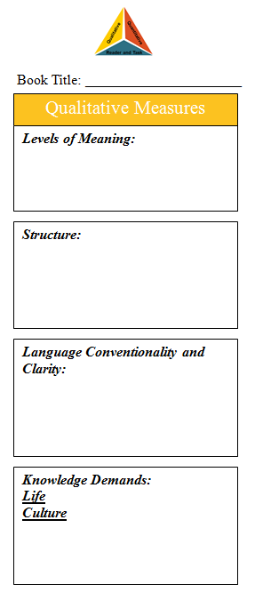
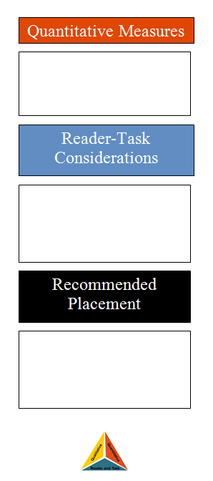
Additional Resources for Text Complexity
Text Complexity Bookmarks
Notes:
Bookmark (Handout)
The form to the right is to be a bookmark. Print it on cardstock. As you read, you can make notes to help you place it.

Slide 47
Determining the Suitability of Text
“Such assessments are best made by the teachers employing their professional judgment, experience, and knowledge of their students and the subject.”
Common Core
State Standards for English,
Appendix A, p. 4
Notes:
It becomes important for teachers to be knowledgeable about text complexity and particularly regarding qualitative measures and reader/task considerations. Teachers are our experts.

Slide 48
PA CCSS Resources
Text Complexity Resources http://www.pdesas.org/
Appendix A: Research Supporting the Key Elements of the Standards
Appendix B: Text Exemplars and Sample Performance Tasks
Notes:
Take the participants to the SAS web site and show them where to find both Appendix A and Appendix B. Discuss that Appendix A is where they would want to go to get more information about text complexity and where they could find appropriate research to support the importance of text complexity. Describe that Appendix B is a resource that provides lists of exemplar texts in different genres and for different purposes (i.e., read alouds). Please also mention that these are texts that are appropriate given the first 2 “legs” of the triangle but that they must also consider the reader and the task.

Slide 49
Implications for Instruction
Begin now to bring more informational text into the curriculum and focus on “disciplinary” reading.
Make an effort to “bridge the gap” for students by making up to 20% of classroom reading grade-level texts with necessary levels of scaffolding.
Provide frequent opportunities to work “across” texts.
Source: KAREN WIXSON, PHD UNIVERSITY OF MICHIGAN/UNC
Notes:
There is an expectation that all students in K-5 should have balanced exposure to literary texts and informational texts. That means students should have 50/50 exposure to both genres and be proficient at understanding the structures and reading them critically. At the secondary level the CCSS requires a 70/30 split with the emphasis on informational text. That is going to be addressed and the gap is going to need to be made up somehow.

Slide 50
Engaging Students with the Texts
Students need to engage with:
Age/grade appropriate materials for exposure to structures, content, vocabulary
Instructional level materials that allow them to progress
“Easy” materials that allow them to practice
Source: KAREN WIXSON, PHD
UNIVERSITY OF MICHIGAN/UNCG
Notes:
Please take a look at this list of types of text. All three types are necessary for students to be able to become proficient at higher level reading skills. If I am a secondary English teacher asking my students to read A Tale of Two Cities or Canterbury Tales, I have to also be considering how I can provide my students with access to materials that are “easy” and allow them to practice. The same is true for a 3rd grade teacher who uses novels or anthologies to teach reading. When do students have a chance to read and practice their craft? Keep in mind the “Matthew Effect” that the rich keep getting richer, meaning that the students who read well are able to and want to read more where our less proficient readers read less and never get better.

Slide 51
Food for Thought
If our district uses an anthology or basal/prescriptive series, how can we balance literary and informational texts?
Is it more important to read class novels/whole class stories or to cut sections of important literary or informational works to offer students opportunities to interact with different types of texts?
Notes:
Please give the participants time to think about and reflect on the following two questions. Allow them time to talk amongst the groups and brainstorm some ideas. Remind them that there are no right or wrong answers but that it is important to think about some of the major (realistic) challenges that face teachers. They can also be thinking about making connections to other subject areas.
Ask participants at their tables to discuss both of these important questions. Allow 5-7 minutes for discussion. Select tables to report out their conclusions and ask questions.

Slide 52
What/So What??
What? | So What? | Now What?
Notes:
Give everyone 5 – 10 minutes to complete their graphic organizers.
Ask each participant to share a Now What to which they can commit.

Slide 53
Essential Questions
What is text complexity and why it is important?
What considerations need to be made before selecting texts for teaching and students’ independent reading?
How can teachers employ more rigorous text on a regular basis?
Notes:
Here are the essential questions that we hoped to be able to address by the end of this module. Since text complexity is such a large part of the PA CCSS, it is important to understand what it is and why it is important. It is also important to think about and reflect on how that will change instruction.
With an elbow partner, respond to the questions with a new learning.

Slide 54
Literacy Achievement for All Students
“The more that you read, the more things you will know. The more that
you learn, the more places you'll go.”
Dr. Seuss
Notes:
Just a final thought

Slide 55
Any Questions?
Notes:
Thank you! I’m here for questions, feedback, concerns…the floor is yours!

