Slide 1
Curriculum Mapping
2022 SHAPE PA Conference
December 1, 2022

Slide 2
Health Education
Part I
Number of classes in health
Part II
Identify Health Topics You Teach
Part III
Identify the health-literacy skills you teach
Part IV
Curriculum Mapping – The Health Education Core Concepts and Health-Literacy Skill Outcomes

Slide 3
Curriculum Mapping: Part I
Part I: Number of lessons in health education
Write the number of lessons in health for each grade level.

Slide 4
Curriculum Map Grid – Part II
Part II: Identify Health Topics You Teach
Use an (X) to mark all areas of the graph below to indicate the health topics you implement (left column for each grade level – yellow column).
Put an (O) to mark all areas you would like to add to address the gaps in your curriculum (Left column for each grade level – yellow column).
List the number of lessons for each topic area in the graph below l (right column for each grade level – white column).

Slide 5
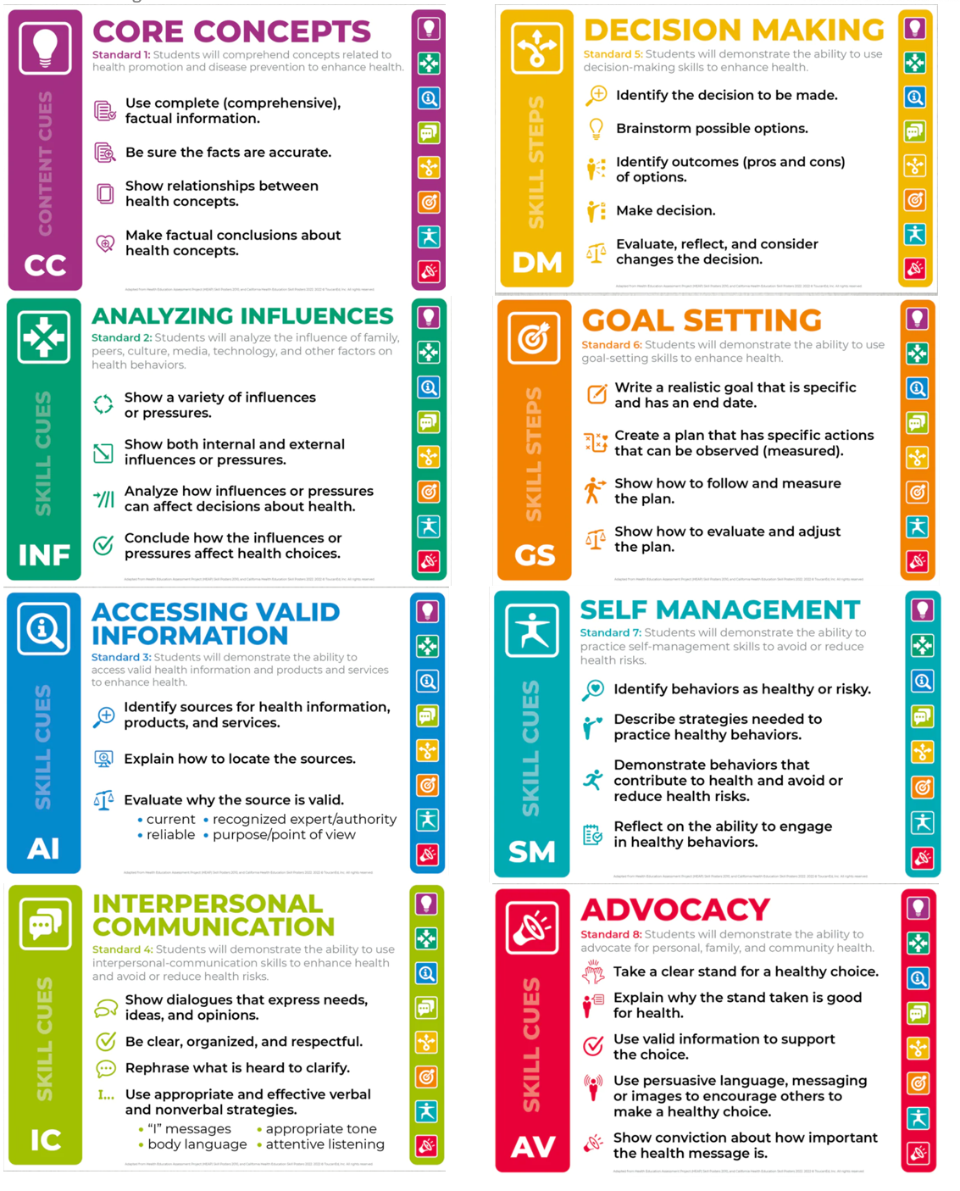

Slide 6
Curriculum Mapping - Part III
What Health Literacy Skills Do You Teach?
Directions: Include the topic number for each grade level (see below) that the health literacy skills below are provided within your curriculum. You may use more than one topic for each grade level.
Alcohol Tobacco Healthy Relationships/Sexual Health Healthy Eating Physical Activity | Violence Safety Mental Health Personal Health

Slide 7
Curriculum Mapping: Part IV
Part IV: Curriculum Mapping – The Health Education and Core Concepts and Health-Literacy Skill Outcomes
Directions: Complete one document per X and O from Part II in the Curriculum Map Grid (yellow column). You can add and subtract rows in the tables as needed.

Slide 8
Curriculum Mapping: Part IV
Choose the core concept outcomes. You can add and subtract rows in the tables as needed

Slide 9
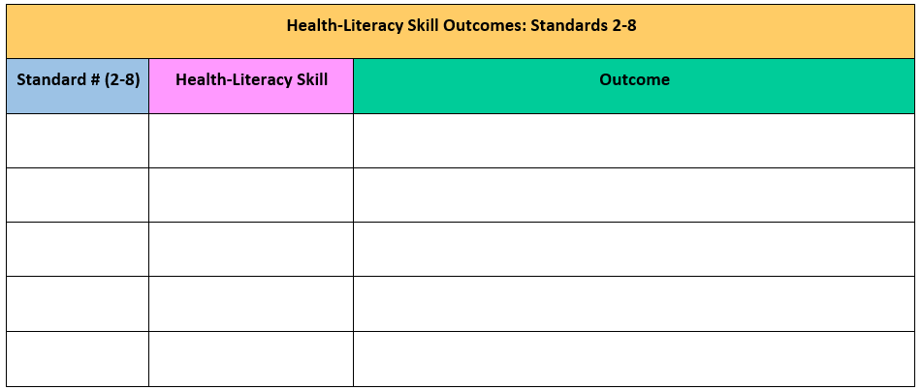
Curriculum Mapping – Part IV
List the health-literacy skill standard number(s) in the blue column.
List the health-literacy skill(s) in the pink column.
List the health-literacy skill outcomes in the green column.
Health-Literacy Skill Outcome Standard Numbers Standard 2: Analyzing Influences Standard 3: Accessing Information Standard 4: Interpersonal Communication Standard 5: Decision-Making Standard 6: Goal-Setting Standard 7: Self-Management Standard 8: Advocacy

Slide 10
Curriculum Mapping – Part IV
List activities that can be used.
List formative assessments you would like to implement.
List summative assessments to measure student achievement.

Slide 11
Block Plan
After Curriculum Mapping Process

Slide 12
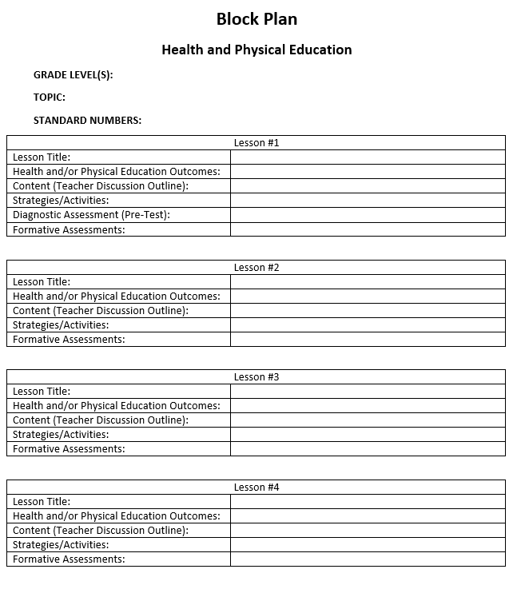
Block Plan

Slide 13
Block Plan
Block Plan Instructions and Examples
1. Grade Level (Decide which grade level will be used to write the unit of instruction)
Health Example: 10th Grade Physical Education Example: 1st Grade
2. Choose the Topic: (Select the name of the health of physical education topic)
Health Example: Alcohol and Other Drug Physical Education Example: Locomotor Movements
3. Standard Numbers: (Health - Select which standards: Be sure to include at least Standard 1 with at least one or two health-literacy skills Standards 2-8) (Physical Education - List the number of the standard statements or list the name of each (Physical Literacy Component)
Health Examples Example 1: Standard Statement 1 or Core Concepts Example 2: Standard Statement 2 or Analyzing Information Example 3: Standard Statement 3 or Accessing Information Physical Education Examples Physical Education Examples Example 1: Standard Statement 1 or Motor Skills Example 2: Standard Statement 2 or Movement Concepts and Performance Example 3: Standard Statement 3 or Levels of Fitness

Slide 14
Block Plan
Block Plan Instructions and Examples
4. Lesson Title (Name your lesson)
Health Example: Bullying Prevention Physical Education Example: Hopping, Skipping, Galloping
5. Health and/of Physical Education Outcomes
Health Example: Core Concept Outcome Describes ways to express anger non-violently. Health Example: Health-Literacy Skill Outcome (Goal-Setting) Sets a realistic personal goal to prevent violence. Physical Education Example: Locomotor Movements Walks, hops, gallops, jogs, skipping, leaping, runs and slides by demonstrating most critical elements with consistency.
6. Content (Teacher Discussion Outline) You can include several questions for discussion such as national and state data, a shared resource (e.g. story of two people who are experiencing a conflict), putting students in scenarios to discuss rules and etiquette, etc.
Health Example: YRBS and PAYS Data and discuss the outcomes Physical Education: Introduce the skill for the day (e.g. skipping), demonstrate, and practice

Slide 15
Block Plan
Block Plan Instructions and Examples
7. Strategies and Activities: These can include teaching strategies (e.g. role-play, case studies, critical incidence, etc.) and activities students will participate in to demonstrate skills.
Health Example: Role-play - Students will participate in the role play activity (scenario, scripts, etc.) Teacher will utilize the scoring rubric to assess the students participating in the role play based on the established criteria. Physical Education Example: Back-to-Back: Move to music using locomotor movements when music stops students must find a new partner. Side-to-Side: Move to music using different locomotor movements when music stops students must find a new partner. Front-to-Front: Move to music using different locomotor movements when music stops students must find a new partner. Front-to-Back: Move to music using different locomotor movements when music stops students must find a new partner
8. Diagnostic Assessment (Pre/Post Test): used to measure student performance. Can also be used to test students on what they learned in previous year(s).
Pre/Post Test Self-Assessment Checklist
9. Formative Assessments: Should align to health and/or physical education outcomes for each lesson.
Bulls-eye, Red/Yellow/Green, 1-5 Rating, Exit Slip, Bell-Ringer, Peer Feedback Evaluation

Slide 16
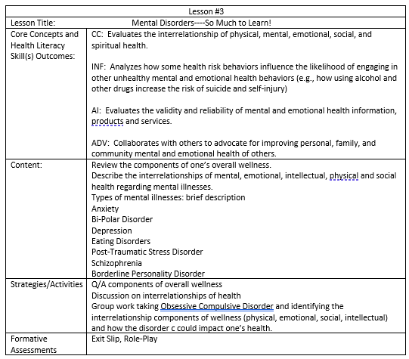
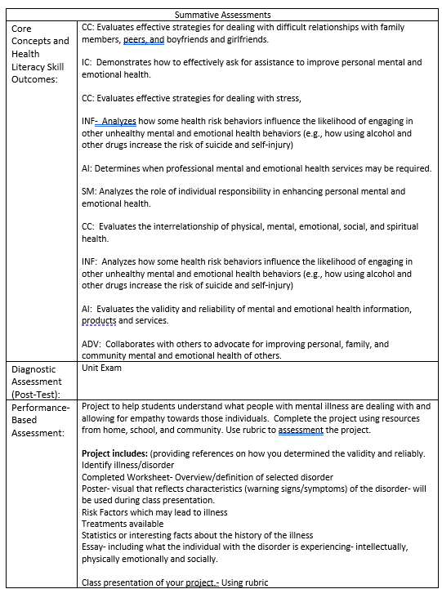
Block Plan Example

Slide 17
Questions
Any questions?

Slide 18
HPED PIC Committee Contact Information
Dr. Kim Razzano Professor East Stroudsburg University krazzano@esu.edu | Nick Slotterback Pennsylvania Department of Education Health and Physical Education Advisor nslotterba@pa.gov
Jeffrey Jacobs Retired HPED Teacher Methacton School District jjacobshpe@gmail.com | Dr. Jennifer Rudella Associate Professor Lock Haven University jlr1147@lockhaven.edu
Dr. Cindy Allen Emeritus Professor Lock Haven University callen2@lockhaven.edu | Dr. Jennifer Butz Elementary Physical Education Teacher Northern Lehigh School District jbutz@nlsd.org

