Slide 1
Curriculum Mapping for Physical Education
2022 SHAPE PA Conference
December 1, 2022

Slide 2
Curriculum Map Template – Physical Education

Slide 3
Physical Education
Part I: Number of classes in Physical Education
Indicate in the box below the grade level how many physical education lessons are taught at each grade per year.
Example Part I:
Grade Levels | K | 1 | 2 | 3 | 4 | 5 | 6 | 7 | 8 | 9 | 10 | 11 | 12
Number of Lessons
Grade Levels | K | 1 | 2 | 3 | 4 | 5 | 6 | 7 | 8 | 9 | 10 | 11 | 12
Number of Lessons | 30 | 30 | 30 | 36 | 36 | 36 | 36 | 30 | 30 | 90 | 90 | 90 | 90

Slide 4
Physical Education
Part II: What Topics do you Teach?
Use an (X) to mark all topics that are taught at each grade level.

Slide 5
Physical Education
Example Part II:
Use an (X) to mark all topics that are taught at each grade level.
x
x
x
x
x
x
x
x
x
x
x
x
x
x
x
x
x
x
x
x
x
x
x
x
x
x
x
x
x
x
x
x
x
x
x
x
x
x
x
x
x
x
x
x
x
x
x
x
x
x
x
x
x
x
x
x
x
x
x
x
x
x
x
x
x
x
x
x
x
x
x
x
x
x
x
x

Slide 6
Physical Education
Part II:
Put an (O) to mark all areas you would like to add to address the gaps in your curriculum.
x
x
x
x
x
x
x
x
x
x
x
x
x
x
x
x
x
x
x
x
x
x
x
x
x
x
x
x
x
x
x
x
x
x
x
x
x
x
x
x
x
x
x
x
x
x
x
x
x
x
x
x
x
x
x
x
x
x
x
x
x
x
x
x
x
x
x
x
x
x
x
x
x
x
x
x

Slide 7
Physical Education
Part II:
Put an (O) to mark all areas you would like to add to address the gaps in your curriculum.
x
x
x
o
x
x
x
x
x
x
o
o
o
o
o
o
o
o
o
o
o
o
o
o
o
o
o
x
x
x
o
o
o
x
x
x
o
o
o
x
x
x
x
x
x
x
x
x
x
x
x
x
x
x
x
x
x
x
x
o
o
o
x
x
x
x
x
x
x
x
x
x
x
x
o
o
o
x
x
x
x
x
x
x
x
x
x
o
o
o
x
x
x
x
x
x
x
x
x
x
o
o
o
o
o
x
x
o
o
o
o
x
x
x
x
x
x
x

Slide 8
Physical Education
Part III: How many lessons of each topic area will you provide to your students using the chart. Please keep in mind the total number of classes that you provided in Part I.
3 3 2 3
2 2 2 2
3 3 2 2 3 3 3

Slide 9
Physical Education
Part IV: Scope and Sequence
Complete one scope and sequence document for either an X and O from Part II in the Curriculum Map Grid. You can add and subtract table lines as needed.

Slide 10
Scope and Sequence for Physical Education

Slide 11
Physical Education
1. Grade Level: (Select the grade level for your Scope and Sequence)
Choose the Content Area: (Select one topic from the colored boxes, these topics areas of various colors and located on the left side of the outcomes document).
3. Choose the Standard(s) (Standard Number): (List the number of the standard statements or list the name of each (Physical Literacy Component)
Example: 10th Grade
Example: Specialized Skills Performance (from Standard Statement 1 Motor Skills 10-12) Example 2: Locomotor Movements (from Standard Statement 1 Motor Skills K-6)
Example 1: Standard Statement 1 or Motor Skills Example 2: Standard Statement 2 or Movement Concepts and Performance Example 3: Standard Statement 3 or Levels of Fitness Example 4: Standard Statement 4 or Cooperative Skills and Positive Behavior Example 5: Standard Statement 5 or Value of Physical Activity

Slide 12
Physical Education
Choose Outcomes (List all Outcomes for each lesson-Be Realistic): (List outcomes from each topics you want to include in your unit. You may choose outcomes from one topic or several topics. It may help to list the topic and the appropriate outcomes together).
Scope & Sequence of Skill-Based Outcomes & Activity for each lesson: Enter the chosen outcomes from number 4 and place them in order to when you would teach them to your students. In the box to the right list skills and/or activities you would teach to align with the outcome selected.
Example 1: Combined movement skills and patterns- Individually performs specialized skills in a variety of movement forms consistently (e.g., outdoor pursuits, recreational activities and individual-performance activities).
Lesson 1 Outcome(s) | Lesson 1 Activity
Example 1: Combined movement skills and patterns- Individually performs specialized skills in a variety of movement forms consistently (e.g., outdoor pursuits, recreational activities and individual-performance activities). | Introduction to Mountain Biking Check equipment 15-minute trail ride

Slide 13
Physical Education
Assessment of Skill-Based Outcomes: How do you know the student was successful? (Provide examples of formative and summative assessments you may use for your selected unit).
Formative:
Checklist, Bell Ringer, Lead up games
Summative:
Fitness Journal, Pre and Post Test on Skills,

Slide 14
Block Plan
After Curriculum Mapping Process

Slide 15
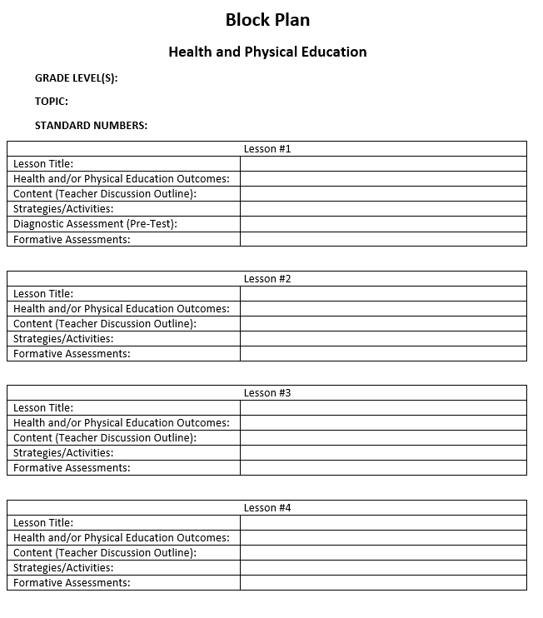
Block Plan

Slide 16
Block Plan
Block Plan Instructions and Examples
1. Grade Level (Decide which grade level will be used to write the unit of instruction)
Health Example: 10th Grade Physical Education Example: 1st Grade
2. Choose the Topic: (Select the name of the health of physical education topic)
Health Example: Alcohol and Other Drug Physical Education Example: Locomotor Movements
3. Standard Numbers: (Health - Select which standards: Be sure to include at least Standard 1 with at least one or two health-literacy skills Standards 2-8) (Physical Education - List the number of the standard statements or list the name of each (Physical Literacy Component)
Health Examples Example 1: Standard Statement 1 or Core Concepts Example 2: Standard Statement 2 or Analyzing Information Example 3: Standard Statement 3 or Accessing Information Physical Education Examples Physical Education Examples Example 1: Standard Statement 1 or Motor Skills Example 2: Standard Statement 2 or Movement Concepts and Performance Example 3: Standard Statement 3 or Levels of Fitness

Slide 17
Block Plan
Block Plan Instructions and Examples
4. Lesson Title (Name your lesson)
Health Example: Bullying Prevention Physical Education Example: Hopping, Skipping, Galloping
5. Health and/of Physical Education Outcomes
Health Example: Core Concept Outcome Describes ways to express anger non-violently. Health Example: Health-Literacy Skill Outcome (Goal-Setting) Sets a realistic personal goal to prevent violence. Physical Education Example: Locomotor Movements Walks, hops, gallops, jogs, skipping, leaping, runs and slides by demonstrating most critical elements with consistency.
6. Content (Teacher Discussion Outline) You can include several questions for discussion such as national and state data, a shared resource (e.g. story of two people who are experiencing a conflict), putting students in scenarios to discuss rules and etiquette, etc.
Health Example: YRBS and PAYS Data and discuss the outcomes Physical Education: Introduce the skill for the day (e.g. skipping), demonstrate, and practice

Slide 18
Block Plan
Block Plan Instructions and Examples
7. Strategies and Activities: These can include teaching strategies (e.g. role-play, case studies, critical incidence, etc.) and activities students will participate in to demonstrate skills.
Health Example: Role-play - Students will participate in the role play activity (scenario, scripts, etc.) Teacher will utilize the scoring rubric to assess the students participating in the role play based on the established criteria. Physical Education Example: Back-to-Back: Move to music using locomotor movements when music stops students must find a new partner. Side-to-Side: Move to music using different locomotor movements when music stops students must find a new partner. Front-to-Front: Move to music using different locomotor movements when music stops students must find a new partner. Front-to-Back: Move to music using different locomotor movements when music stops students must find a new partner
8. Diagnostic Assessment (Pre/Post Test): used to measure student performance. Can also be used to test students on what they learned in previous year(s).
Pre/Post Test Self-Assessment Checklist
9. Formative Assessments: Should align to health and/or physical education outcomes for each lesson.
Bulls-eye, Red/Yellow/Green, 1-5 Rating, Exit Slip, Bell-Ringer, Peer Feedback Evaluation

Slide 19
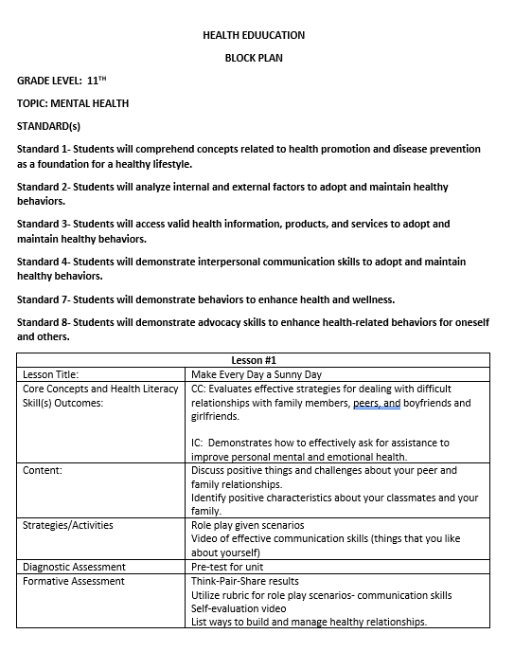
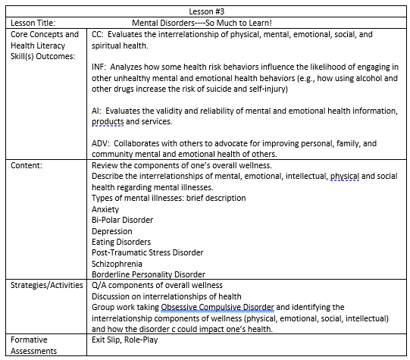
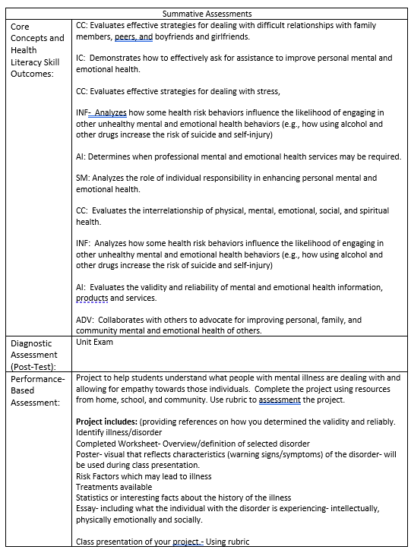
Block Plan Example

Slide 20
Questions
Any questions?

Slide 21
HPED PIC Committee Contact Information
Dr. Kim Razzano Professor East Stroudsburg University krazzano@esu.edu | Nick Slotterback Pennsylvania Department of Education Health and Physical Education Advisor nslotterba@pa.gov
Dr. Jennifer Rudella Associate Professor Lock Haven University jlr1147@lockhaven.edu | Jeffrey Jacobs Retired HPED Teacher Methacton School District jjacobshpe@gmail.com
Dr. Cindy Allen Emeritus Professor Lock Haven University callen2@lockhaven.edu | Dr. Jennifer Butz Elementary Physical Education Teacher Northern Lehigh School District jbutz@nlsd.org

