Slide 1
PA Health and Physical Education PreK-12 Knowledge and Skills-Based Outcomes
Presentation by:
PA Health and Physical Education Program Improvement Committee

Slide 2
Outcomes Brief History
Process began in January of 2016
Group Reviews of Outcomes - edits, spelling, grammar, etc.
Invited State Agencies to review H/PE outcomes
Reviewed comments/suggestions from state department reviews
Reviewed by professionals throughout the state
Added additional content, especially for health, to include mandated and current topics

Slide 3
Tried to Accomplish the Following:
GOALS
Make more up-to-date and relevant | Develop helpful and appropriate resources
Shift from content to developmentally age-appropriate lifelong skills | Supports updates to completing a curriculum framework for health and physical education
Provide greater scope and depth for each outcome | Teacher-friendly- easy to understand and use
Remove outcomes that were no longer relevant | Made accessible for teachers, administrators, parents and students

Slide 4
Health and Physical Education Benchmarks
Learning outcomes for content and skills are listed for each grade but students are required to demonstrate the skills at each benchmark in 3rd, 6th, 9th, and 12th grades
Note for future, especially for Health education, since Health is not taught at every level especially for the elementary level, the outcomes need to be tied into other subject areas…. i.e., literature, language arts, science, etc.

Slide 5
Health Education Changes
Added additional content (for health: Mental health, COVID-19, organ tissue donation awareness, food allergies, diabetes, LGBTQ, Lyme disease, suicide prevention, vaping/ E-Cigarettes/Juuling, Lead poisoning, CPR, etc.)
Shift from content to developmentally age-appropriate life-long skills
Removed outcomes that served no purpose or no purpose at a particular grade level.

Slide 6
Health Education
Health Knowledge and Skills-Based Outcomes:
#1 Core Concepts
#2-8 Health-Literacy Skills
Benchmarks 3, 6, 9, and 12
Planned outcomes for every grade level
Easy to follow the progression of outcomes from grade-to-grade

Slide 7
Content and Health Literacy Skills
Topic Areas | Content | Health-Literacy Skills
Alcohol and Other Drugs | Core Concepts not benchmark years | Analyzing Influences
Tobacco |  | Accessing Information
Healthy Eating |  | Interpersonal Communication
Mental and Emotional Health |  | Decision-Making
Personal Health |  | Goal-Setting
Physical Activity |  | Self-Management
Safety/Injury Prevention |  | Advocacy
Violence Prevention
Healthy Relationships (K-6)/Sexual Health (7-12)

Slide 8
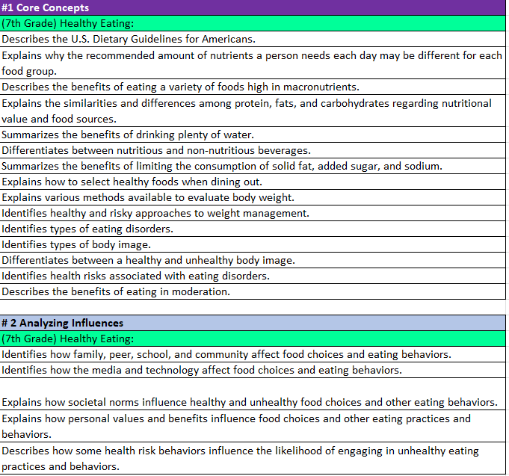
Health Education Outcomes
Dark Purple- Core Concepts
Light Blue-Health Literacy Skills
Rainbow Color – Health Content
White - Outcome

Slide 9
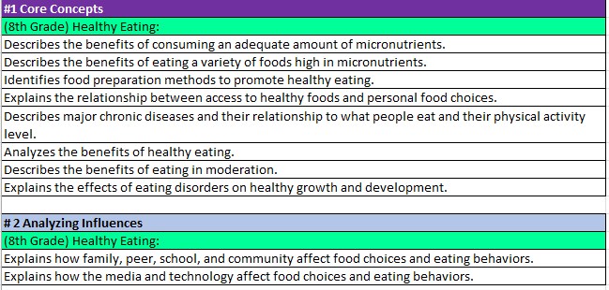
Health Education Outcomes
8th Grade Nutrition Core Concepts & Analyzing Influences
9th Grade Nutrition Benchmark Analyzing Influences

Slide 10
Physical Education
5 Physical Literacy Components
Motor Skills
Movement Concepts
Level of Fitness
Cooperative Skills
Value of Physical Activity
Benchmarks 3, 6, 9, and 12
Planned outcomes for every grade level
Easy to follow the progression of outcomes from grade-to-grade
Does not include aquatics

Slide 11
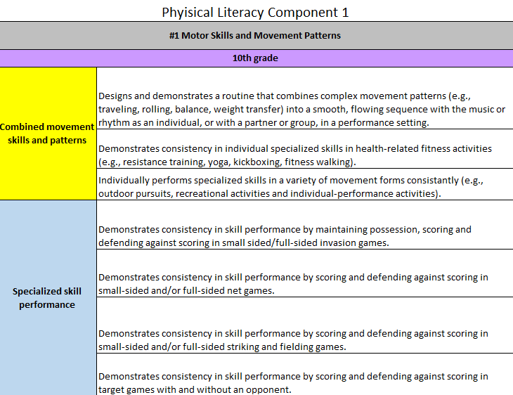
Physical Education Outcomes
Gray – Physical Literacy Component
Purple Box- Grade Level
Rainbow Color (Left Side)
Topics in Bold
Skills-Follow topics in Physical Literacy Skill #1 Motor Skills only in grades K-6.
White - Outcomes

Slide 12
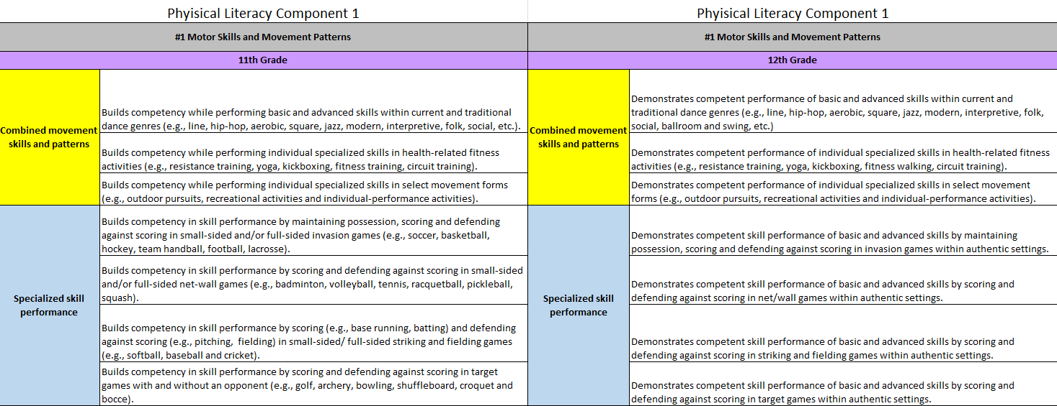
Physical Education Outcomes

Slide 13
Accessing the Outcomes on the SAS Portal
Although not officially adopted, they will be available on the SAS portal on the PDE website.
They may be used as a resource for lessons and curriculum writing. Here are the directions
for accessing them: You will first need to follow the instructions to register. Then.... In your browser go to www.pdesas.org
At top right corner, click on the box that says "MySAS Tools"
Click on "Communities"
Click on "Find a Community“ (right side of page)
Search for "Physical Education Learning Community"
Click on "Health, Safety and Physical Education Learning Community"
Click on "Join this Community"
Click the “Shared Content" button
Scroll to folder of interest
Click on ">" to access files

Slide 14
These are the 3 files you will want to access:
K-12 Physical Education Knowledge and Skills Development Outcomes
K-12 Health Knowledge and Skills Development Outcomes (By grade level)
K-12 Health Knowledge and Skills Development Outcomes (By Health Topic

Slide 15
PIC Trainings and Resources
Prerequisite
PDE SAS Webinar
HPED Outcomes 101
Training Opportunities
Training Modules (Higher Ed/Administrators/PreK-12)
Understanding the Outcomes
Curriculum Mapping/Development
Assessment Development
Follow-up webinars (as needed)
Resources
Assessment Toolkits
Lesson Plan Template
Curriculum Materials

Slide 16
PA Proud
Enhance the delivery of trainings for health and physical educators.
Provide a better education to our youth.
Encourage lifelong physical activity.
Become an advocate for physical and health literacy.
Collaborate with all health and physical education professionals.
Share resources.
Reduce the behavioral risks for our students.

Slide 17
Questions?

Slide 18
Thank You
Dr. Kim Razzano Nick Slotterback
krazzano@esu.edu nslotterba@pa.gov
Jeffrey Jacobs Dr. Jennifer Rudella
jjacobshpe@gmail.com jlr1147@lockhaven.edu
Dr. Cindy Allen Dr. Jennifer Butz
callen2@lockhaven.edu jbutz@nlsd.org

