Slide 1
PA Health and Physical Education PreK-12 Knowledge and Skills-Based Outcomes
Presentation by:
PA Health and Physical Education Program Improvement Committee

Slide 2
Objectives for Trainings
Day 1 | Day 2
Navigate PDE SAS | Explain how the HPE outcomes can be used to build a block plan
Locate the HPE outcomes on PDE SAS | Create a block plan based on the HPE outcomes
Understand how the HPE outcomes are organized | Demonstrate how to navigate and complete a curriculum mapping template for your school and district.
Explain how the HPE outcomes can be used to build a scope and sequence | Explain and create an individual lesson plan for health or physical education.
Create a scope and sequence based on the HPE outcomes | Identify examples of assessments that can be utilized during curriculum writing.

Slide 3
Outcomes Brief History
Process began in January of 2016
Draft of Outcomes was developed by 2017
Group Reviews of Outcomes - edits, spelling, grammar, etc.
Invited State Agencies to review H/PE outcomes
Reviewed comments/suggestions from state department reviews
Reviewed by professionals throughout the state
Added additional content, especially for health, to include mandated and current topics

Slide 4
Tried to Accomplish the Following:
GOALS
Make more up-to-date and relevant | Develop helpful and appropriate resources
Shift from content to developmentally age-appropriate lifelong skills | Supports updates to completing a curriculum framework for health and physical education
Provide greater scope and depth for each outcome | Teacher-friendly- easy to understand and use
Remove outcomes that were no longer relevant | Made accessible for teachers, administrators, parents and students

Slide 5
PIC Trainings and Resources
Prerequisite
PDE SAS Webinar
HPED Outcomes 101
Training Opportunities
Training Modules (Higher Ed/Administrators/PreK-12)
Understanding the Outcomes
Curriculum Mapping/Development
Assessment Development
Follow-up webinars (as needed)
Resources
Assessment Toolkits
Lesson Plan Template
Curriculum Materials

Slide 6
Terms to Remember
Health Terms | Definition
Core Concepts | Concepts that focus on both health promotion and risk reduction. Core Concepts are to be included in every health lesson it provides the content for each health topic area. (They are found in section #1).
Health Literacy Skills | Defined as a person's ability to find, understand and use information and services to make health-related decisions for themselves and others. Adopt and maintain healthy behaviors. (They are found in sections #2-#8).
Outcomes | Student expectations that will be assessed. (Learning Objectives) (White section in the outcome documents).
Health Topic | Topics of health that align with each core concepts and health-literacy skills outcome.

Slide 7
Health and Physical Education Benchmarks
Learning outcomes for content and skills are listed for each grade but students are required to demonstrate the skills at each benchmark in 3rd, 6th, 9th, and 12th grades
Note for future, especially for Health education, since Health is not taught at every level especially for the elementary level, the outcomes need to be tied into other subject areas…. i.e., literature, language arts, science, etc.

Slide 8
Health Education Changes
Added additional content (for health: Mental health, COVID-19, organ tissue donation awareness, food allergies, diabetes, Lyme disease, suicide prevention, vaping/ E-Cigarettes/Juuling, Lead poisoning, CPR, etc.)
Shift from content to developmentally age-appropriate life-long skills

Slide 9
Health Education
Health Knowledge and Skills-Based Outcomes:
#1 Core Concepts
#2-8 Health-Literacy Skills
Benchmarks 3, 6, 9, and 12
Planned outcomes for every grade level
Easy to follow the progression of outcomes from grade-to-grade

Slide 10
Content and Health Literacy Skills
Topic Areas | Content | Health-Literacy Skills
Alcohol and Other Drugs | Core Concepts not benchmark years | Analyzing Influences
Tobacco |  | Accessing Information
Healthy Eating |  | Interpersonal Communication
Mental and Emotional Health |  | Decision-Making
Personal Health |  | Goal-Setting
Physical Activity |  | Self-Management
Safety/Injury Prevention |  | Advocacy
Violence Prevention
Healthy Relationships (K-6)/Sexual Health (7-12)

Slide 11
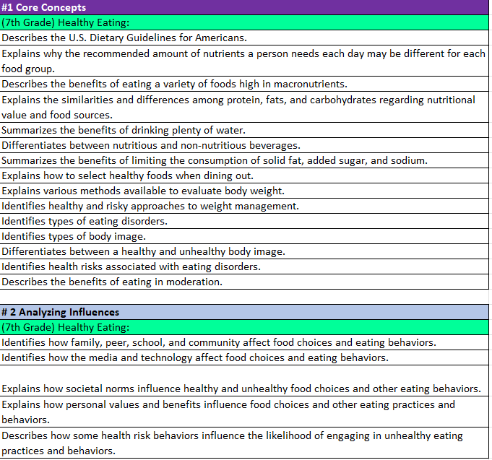
Health Education Outcomes
Dark Purple- Core Concepts
Light Blue-Health Literacy Skills
Rainbow Color – Health Content
White - Outcome

Slide 12
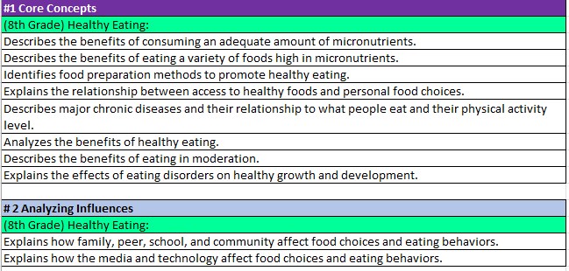
Health Education Outcomes
8th Grade Nutrition Core Concepts & Analyzing Influences
9th Grade Nutrition Benchmark Analyzing Influences

Slide 13
Terms to Remember
Physical Education Terms | Definition
Physical Literacy Components | The physical literacy components are Motor Skills, Movement Concepts, Level of Fitness, Cooperative Skills, and Value of Physical Activity (Physical Literacy Components are written in bold within the gray box)
Physical Education Topic | Content that will help create physical education units. (Physical Education Topics are written in bold within the colored boxes on the left side of each grade level).
Skills | Building blocks in creating curriculum. Skills determine what outcomes will be taught. (Skills are only found in Physical Literacy Component #1 for grades K-6. The skills align to the topic area. They are not bolded after the Physical Education Topic within the colored boxes on the left side of each grade level).
Outcomes | Student expectations that will be assessed. (Learning Objectives) (White section in the outcome documents).

Slide 14
Physical Education Components
Physical Literacy Components | K-3 (PE Topics) | 4-6 (PE Topics) | 7-9 (PE Topics) | 10-12 (PE Topics)
Motor Skills | Locomotor, Nonlocomotor, and Manipulatives | Locomotor, Nonlocomotor, and Manipulatives | Dance and rhythms, Specialized skills and movement patterns, Application of specialized manipulative skills, outdoor pursuits, Individual performance activities | Combined movement skills and patterns, Specialized skill performance,
Movement Concepts and Performance | Space, Pathways, shapes, levels, Speed, direction, force and Strategies and tactics | Space, Pathways, shapes, levels, Speed, direction, force and Strategies and tactics | Tactics and principles and principles and critical elements | Strategies and tactics and Principles and critical elements
Level of Fitness | Physical activity knowledge, Engages in physical activity, Fitness knowledge, and Nutrition | Engages in physical activity, fitness knowledge, nutrition, and assessment of program planning | Physical activity knowledge, Engages in physical activity, Fitness knowledge, Nutrition, Assessment and program planning, and Healthy Habits in relation to fitness | Physical Activity knowledge, Engages in Physical, Fitness Knowledge, Nutrition, Assessment and program planning, Healthy Habits in relation to fitness, and Accessing information
Cooperative skills and positive behavior | Personal responsibility, Accepting feedback, Working with others, Rules and Etiquette, and Safety | Personal responsibility, Accepting feedback, Working with others, Rules and Etiquette, and Safety | Personal responsibility, Accepting feedback, Working with others, Rules and Etiquette, and Safety | Personal Responsibility, Cooperation, Rules and Etiquette, and Safety,
Value of Physical Activity | Health, Challenge, and Self expression and enjoyment | Health, Challenge, Self expression and enjoyment, and Social interaction | Health, Challenge, Self expression and enjoyment, and Social interaction | Health, Challenge, Self expression and enjoyment, and Social interaction

Slide 15
Physical Education
5 Physical Literacy Components
Motor Skills
Movement Concepts
Level of Fitness
Cooperative Skills
Value of Physical Activity
Benchmarks 3, 6, 9, and 12
Planned outcomes for every grade level
Easy to follow the progression of outcomes from grade-to-grade
Does not include aquatics

Slide 16
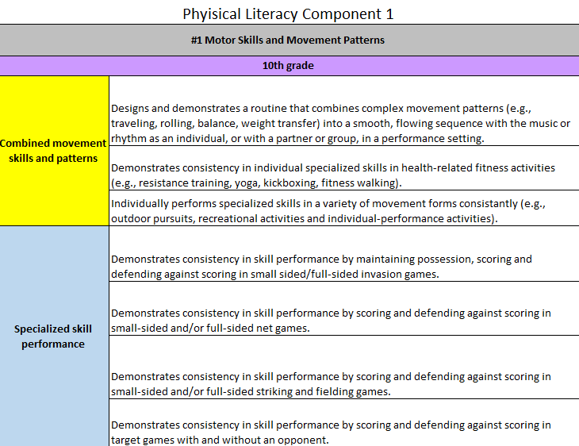
Physical Education Outcomes
Gray – Physical Literacy Component
Purple Box- Grade Level
Rainbow Color (Left Side)
Topics in Bold
Skills-Follow topics in Physical Literacy Skill #1 Motor Skills only in grades K-6.
White - Outcomes

Slide 17
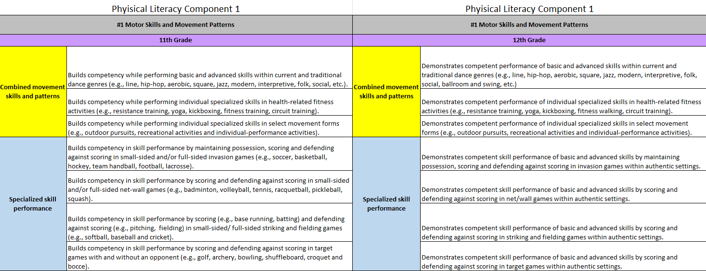
Physical Education Outcomes

Slide 18
*Disclaimer
These outcomes are not the approved standards for PA currently.
We look to share this work with the State School Board Association once we are invited.
They can however be used to help keep your health and physical education programs more current to the forever changing health literacy and physical literacy climate.
PA Code 22, Chapter 4 also encourages the use of materials to expand or improve existing academic standards.

Slide 19
Support from Chapter 4 PA Code 22
§ 4.12. Academic standards.
(a) School entities may develop, expand or improve existing academic standards in the following content areas:
(6) Health, safety and physical education. Study of concepts and skills which affect personal, family and community health and safety, nutrition, physical fitness, movement concepts and strategies, safety in physical activity settings, and leadership and cooperation in physical activities.

Slide 20
Session 2

Slide 21
ENGAGE Health and Physical Education
Pennsylvania Department of Education
PA HPE Program Improvement Committee (PIC)
State Agencies
Higher Education
SHAPE PA
IUs

Slide 22
PA Health/Physical Education Program Improvement Committee (PIC)
Higher Education
State Agencies
K-12 Teachers

Slide 23
State Agency Partners
(DOH) Department of Health
(PCCD) PA Commission on Crime/Delinquency
(OMHSAS) Office of Mental Health and Substance Abuse Services
(PDE) Pennsylvania Department of Education (Office for Safe Schools/Division of Food and Nutrition
(DDAP) Department of Drug and Alcohol Programs
(DOA) Department of Agriculture
(LCB) Liquor Control Board
(PSP) State Police

Slide 24
Higher Education
Department Chair
Edinboro University
Slippery Rock University
Indiana University of Pennsylvania
Lock Haven University
East Stroudsburg University
West Chester University

Slide 25
SHAPE PA
Executive Committee
Health Committee
Physical Education Committee
Advocacy Committee
Active Members

Slide 26
Intermediate Units
Executive Directors
Curriculum Supervisors

Slide 27
ENGAGE Health and Physical Education: Purpose
Develop and share resources, trainings, funding opportunities, and toolkits.
Communicate health and physical education needs and support at a state-wide and local level.
Streamline all health and physical education materials to all Health and Physical Education professionals.

Slide 28
Statewide System of Support Action Steps
Partner with universities, IUs, and school districts to provide free to low-cost trainings throughout the year for health and physical education professionals.
To improve the delivery of health and physical education in Pennsylvania.
To encourage collaboration amongst health and physical education professionals.
To keep all outcomes up to date.
Provide a healthier style of living to all students.
Reduce the rates of high-risk behaviors amongst our youth.

Slide 29
Work Sessions with Intermediate Units (IUs)
For Professional Development opportunities we will begin work sessions with our IUs as it relates to curriculum support.
Health and Physical Education teachers will meet to discuss curriculum, assessments, best practices and share resources.
Surveys and questionnaires may be given to provide feedback at the state level. These documents can also ignite conversations for teachers to discuss.
Mini-Training Series - Offered periodically throughout each school year.

Slide 30
Session 3

Slide 31
Accessing the Outcomes on the SAS Portal
Although not officially adopted, they will be available on the SAS portal on the PDE website. They may be used as a resource for lessons and curriculum writing. You will first need to follow the instructions to register. Then.... In your browser go to www.pdesas.org
Here are the directions for accessing them:
At top right corner, click on the box that says "MySAS Tools"
Click on "Communities"
Click on "Find a Community“ (right side of page)
Search for "Physical Education Learning Community"
Click on "Health, Safety and Physical Education Learning Community"
Click on "Join this Community"
Scroll to bottom of page
Click on “Shared Content" button
Scroll to folder of interest
Click on ">" to access files

Slide 32
These are the 3 files you will want to access:
K-12 Physical Education Knowledge and Skills Development Outcomes
K-12 Health Knowledge and Skills Development Outcomes (By grade level)
K-12 Health Knowledge and Skills Development Outcomes (By Health Topic

Slide 33
PE Activity Elementary
Directions:
Select a topic and Physical Literacy Component #1: Motor Skills and Movement Patterns
(PE topics are stated in bold on the left side of each grade level in the colored boxes).
Choose a list of skills within the topics (Only with elementary K-6 in Physical Literacy Component #1).
(Skills are listed with the PE topics on the left side of each grade level and not bolded within the same-colored boxes).
List the skills in an order of progression.
Choose an outcome (white section) that aligns with each skill from Step 3.

Slide 34
PE Activity 2 Secondary
Directions:
Select one or more topics of interest to create a unit. Topics could cover 1 physical literacy component of multiple physical literacy components.
(PE topics are stated in bold on the left side of each grade level in the colored boxes).
Select outcomes that align with the topics selected.
(white section) that aligns with each skill Step 3.
List topics and outcomes together in a sequential order.

Slide 35
Health Activity
Directions:
Select 3 Core Concepts under #1 (purple section).
Place those 3 Core Concepts in a sequential order (1st taught, 2nd taught, and 3rd taught)
Select 1 Health Literacy Skill from #2-8 that aligns with each core concept.
The outcomes selected could come from the same health-literacy skill or multiple health-literacy skills
One to two health literacy skills is more than enough for one individual lesson.

Slide 36
PA Proud
Enhance the delivery of trainings for health and physical educators.
Provide a better education to our youth.
Encourage lifelong physical activity.
Become an advocate for physical and health literacy.
Collaborate with all health and physical education professionals.
Share resources.
Reduce the behavioral risks for our students.

Slide 37
HPED PIC Committee Contact Information
Dr. Kim Razzano Professor East Stroudsburg University krazzano@esu.edu | Nick Slotterback Pennsylvania Department of Education Health and Physical Education Advisor nslotterba@pa.gov
Jeffrey Jacobs Retired HPED Teacher Methacton School District jjacobshpe@gmail.com | Dr. Jennifer Rudella Associate Professor Lock Haven University jlr1147@lockhaven.edu
Dr. Cindy Allen Emeritus Professor Lock Haven University callen2@lockhaven.edu | Dr. Jennifer Butz Elementary Physical Education Teacher Northern Lehigh School District jbutz@nlsd.org

