Slide 1
Train the Trainers: Physical Education
Presentation by:
Jeff Jacobs, Nicholas Slotterback, and Jennifer Butz
August 2, 2022

Slide 2
Physical Education
5 Physical Literacy Components
Motor Skills
Movement Concepts
Level of Fitness
Cooperative Skills
Value of Physical Activity
Benchmarks 3, 6, 9, and 12
Planned outcomes for every grade level
Easy to follow the progression of outcomes from grade-to-grade
Does not include aquatics

Slide 3
Terms to Remember
Physical Education Terms | Definition
Physical Literacy Components | The physical literacy components are Motor Skills, Movement Concepts, Level of Fitness, Cooperative Skills, and Value of Physical Activity (Physical Literacy Components are written in bold within the gray box)
Physical Education Topic | Content that will help create physical education units. (Physical Education Topics are written in bold within the colored boxes on the left side of each grade level).
Skills | Building blocks in creating curriculum. Skills determine what outcomes will be taught. (Skills are only found in Physical Literacy Component #1 for grades K-6. The skills align to the topic area. They are not bolded after the Physical Education Topic within the colored boxes on the left side of each grade level).
Outcomes | Student expectations that will be assessed. (Learning Objectives) (White section in the outcome documents).

Slide 4
Physical Education Components
(Physical Literacy Components) | K-3 (PE Topics) | 4-6 (PE Topics) | 7-9 (PE Topics) | 10-12 (PE Topics)
Motor Skills | Locomotor, Nonlocomotor, and Manipulatives | Locomotor, Nonlocomotor, and Manipulatives | Dance and rhythms, Specialized skills and movement patterns, Application of specialized manipulative skills, outdoor pursuits, Individual performance activities | Combined movement skills and patterns, Specialized skill performance,
Movement Concepts and Performance | Space, Pathways, shapes, levels, Speed, direction, force and Strategies and tactics | Space, Pathways, shapes, levels, Speed, direction, force and Strategies and tactics | Tactics and principles and principles and critical elements | Strategies and tactics and Principles and critical elements
Level of Fitness | Physical activity knowledge, Engages in physical activity, Fitness knowledge, and Nutrition | Engages in physical activity, fitness knowledge, nutrition, and assessment of program planning | Physical activity knowledge, Engages in physical activity, Fitness knowledge, Nutrition, Assessment and program planning, and Healthy Habits in relation to fitness | Physical Activity knowledge, Engages in Physical, Fitness Knowledge, Nutrition, Assessment and program planning, Healthy Habits in relation to fitness, and Accessing information
Cooperative skills and positive behavior | Personal responsibility, Accepting feedback, Working with others, Rules and Etiquette, and Safety | Personal responsibility, Accepting feedback, Working with others, Rules and Etiquette, and Safety | Personal responsibility, Accepting feedback, Working with others, Rules and Etiquette, and Safety | Personal Responsibility, Cooperation, Rules and Etiquette, and Safety,
Value of Physical Activity | Health, Challenge, and Self expression and enjoyment | Health, Challenge, Self expression and enjoyment, and Social interaction | Health, Challenge, Self expression and enjoyment, and Social interaction | Health, Challenge, Self expression and enjoyment, and Social interaction

Slide 5
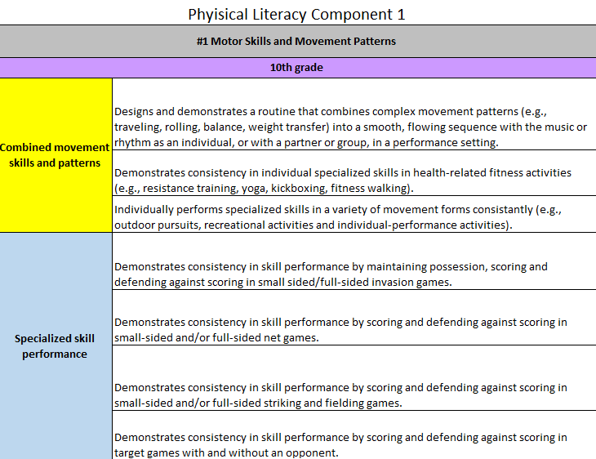
Physical Education Outcomes
Gray – Physical Literacy Component
Purple Box- Grade Level
Rainbow Color (Left Side)
Topics in Bold
Skills-Follow topics in Physical Literacy Skill #1 Motor Skills only in grades K-6.
White - Outcomes

Slide 6
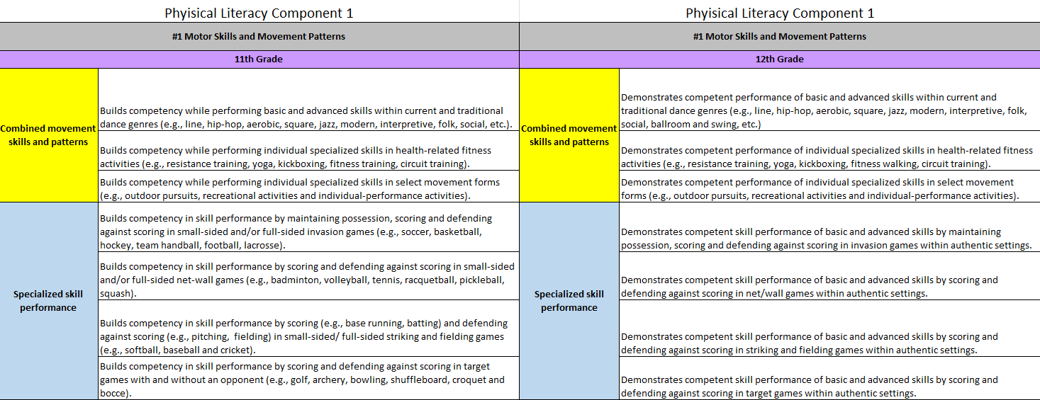
Physical Education Outcomes

Slide 7
Big Picture Chart for Physical Education
CHOOSE Physical Literacy Component
Choose the topic area.
Choose the outcomes under appropriate topic area.
Scope and sequence (including the outcomes from the selected topic area)
Unit Plan
Evaluate student learning after each lesson.
Make ongoing changes and update
Develop Diagnostic and Summative Assessments
Block Plan
Create the lesson plans with formative assessments

Slide 8
Planning and Sequencing
Choose the physical literacy component
Choose the topic area
Choose your outcomes
Scope and sequence (including the outcomes from the Physical Education: Handout 1)

Slide 9
Planning and Sequencing Visual
Choose the physical literacy component
Choose the topic area
Choose the outcomes under appropriate topic area.
Scope and Sequence

Slide 10
Implementation
Develop Diagnostic and Summative Assessments
Block Plan
Unit Plan (Follow School District Requirements)
Create the lesson plans with formative assessments (On Your Own)
Evaluate student learning after each lesson. Make ongoing changes and update

Slide 11
Implementation Visual
Create the lesson plans with formative assessments
Evaluate student learning after each lesson. Make ongoing changes and update
Develop Diagnostic and Summative Assessments
Block Plan
Unit Plan

Slide 12
Questions?

Slide 13
Thank You
Dr. Kim Razzano Nick Slotterback
krazzano@esu.edu nslotterba@pa.gov
Jennifer Rudella
jlr1147@lockhaven.edu
Dr. Cindy Allen
callens2@lockhaven.edu

