Slide 1
Understanding the PA Health and Physical Education PreK-12 Knowledge and Skills-Based Outcomes
2022 SHAPE PA Conference
December 1, 2022

Slide 2
Agenda
Prerequisite
Train the Trainers Workshop in August
Updates on IU Trainings
D2L Training
Understanding the Outcomes
Curriculum Mapping
Block Plan

Slide 3
Objectives
Day 2 | Day 2 HPED Outcomes Training
Identify the steps in completing a curriculum mapping grid for health or physical education. | Explain how the HPE outcomes can be used to build a block plan
Complete a curriculum mapping grid for health or physical education. | Create a block plan based on the HPE outcomes
Understand health and physical education outcomes terminology. | Explain and create an individual lesson plan for health or physical education.
Locate appropriate HPED outcomes for at least one health or physical education unit. | Identify examples of assessments that can be utilized during curriculum writing.

Slide 4
PIC Trainings and Resources
Prerequisite
PDE SAS Webinar
HPED Outcomes 101
Training Opportunities
Training Modules (Higher Ed/Administrators/PreK-12)
Understanding the Outcomes (Day 1)
Curriculum Mapping/Development (Day 2)
Assessment Development (Day 2/3)
Follow-up webinars (as needed)
Resources
Assessment Toolkits
Lesson Plan Template
Curriculum Materials

Slide 5
Train the Trainers Workshop
August 2nd – 3rd
5 Universities
Lock Haven University
Edinboro University
Indiana University of Pennsylvania
Slippery Rock University
West Chester University
East Stroudsburg University
10 Participants were trained representing all locations of the Commonwealth; Eastern, Central, and Western

Slide 6
Updates on IU Trainings
Location | Number of Day 1 Trainings
Western | 4
Eastern | 6
Central | 10
Total - 20 | 20
Number of Participants That Completed Day 1 Training
315
Day 1 Training Evaluation Results
99% Satisfactory Rating
Participant Created Resources
Over 200 Scope and Sequence Examples in Health or Physical Education

Slide 7
Feedback
How to make connections between different topic areas, and how to connect different skills to better meet the topics through different activities.
Understanding how to implement and utilize the new outcomes. It was very helpful to understand the process behind developing plans for the future. This was very beneficial. This would have been helpful before we started our curriculum writing over the summer.
The most useful aspect for the training to me was learning about the most up to date outcomes we are attempting to implement across the state of PA’s educational system.
Creating a plug and play set up for curriculum guidance is very helpful
Being able to access new curriculum ideas and pedagogy.
I can apply it directly to the curriculum I am currently writing
The reworked curriculum and in depth explanation of how we can use and should use this content. Also very useful having liked minded and trained professionals working with and discussing the information.
I thought it was helpful to see the examples of how we can use the outcomes in our own curriculum and lesson planning.

Slide 8
D2L Training
D2L – Desire 2 Learn
Self-Paced Training
Chapter 1-10
Chapter 1-5: Day 1 Training
Chapter 6-10: Day 2 Training
Assessments and Assignments are required to advance to next chapter
Assignments
Scope and Sequence
Block Plan
Curriculum Mapping
Lesson Plan

Slide 9
Terms to Remember
Health Terms | Definition
Core Concepts | Concepts that focus on both health promotion and risk reduction. Core Concepts are to be included in every health lesson it provides the content for each health topic area. (They are found in section #1).
Health Literacy Skills | Defined as a person's ability to find, understand and use information and services to make health-related decisions for themselves and others. Adopt and maintain healthy behaviors. (They are found in sections #2-#8).
Outcomes | Student expectations that will be assessed. (Learning Objectives) (White section in the outcome documents).
Health Topic | Topics of health that align with each core concepts and health-literacy skills outcome.

Slide 10
Content and Health Literacy Skills
Topic Areas | Content | Health-Literacy Skills
Alcohol and Other Drugs | Core Concepts not benchmark years | Analyzing Influences
Tobacco |  | Accessing Information
Healthy Eating |  | Interpersonal Communication
Mental and Emotional Health |  | Decision-Making
Personal Health |  | Goal-Setting
Physical Activity |  | Self-Management
Safety/Injury Prevention |  | Advocacy
Violence Prevention
Healthy Relationships (K-6)/Sexual Health (7-12)

Slide 11
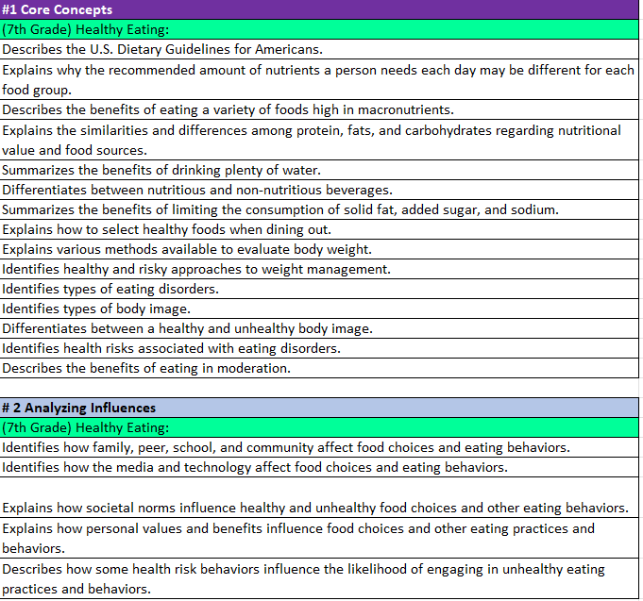
Health Education Outcomes
Dark Purple- Core Concepts
Light Blue-Health Literacy Skills
Rainbow Color – Health Content
White - Outcome

Slide 12
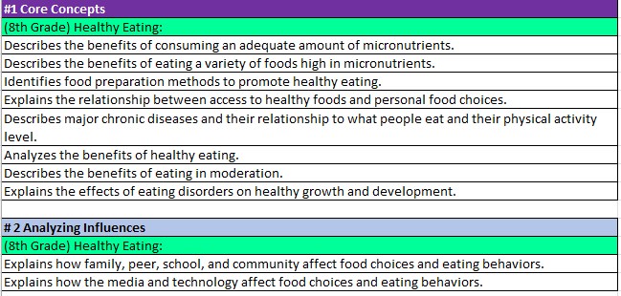
Health Education Outcomes
8th Grade Nutrition Core Concepts & Analyzing Influences
9th Grade Nutrition Benchmark Analyzing Influences

Slide 13
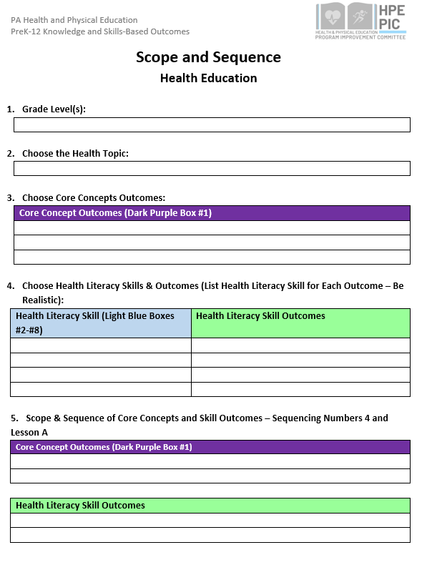
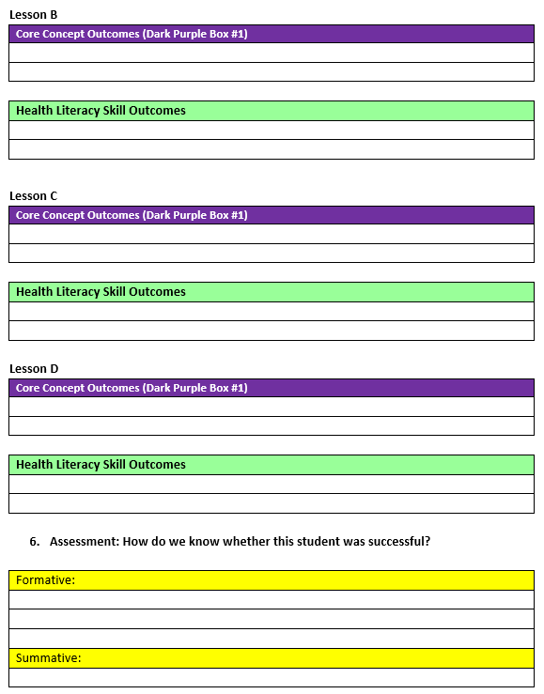
Scope and Sequence Health Education

Slide 14
Terms to Remember
Physical Education Terms | Definition
Physical Literacy Components | The physical literacy components are Motor Skills, Movement Concepts, Level of Fitness, Cooperative Skills, and Value of Physical Activity (Physical Literacy Components are written in bold within the gray box)
Physical Education Topic | Content that will help create physical education units. (Physical Education Topics are written in bold within the colored boxes on the left side of each grade level).
Skills | Building blocks in creating curriculum. Skills determine what outcomes will be taught. (Skills are only found in Physical Literacy Component #1 for grades K-6. The skills align to the topic area. They are not bolded after the Physical Education Topic within the colored boxes on the left side of each grade level).
Outcomes | Student expectations that will be assessed. (Learning Objectives) (White section in the outcome documents).

Slide 15
Physical Education Components
Physical Literacy Components | K-3 (PE Topics) | 4-6 (PE Topics) | 7-9 (PE Topics) | 10-12 (PE Topics)
Motor Skills | Locomotor, Nonlocomotor, and Manipulatives | Locomotor, Nonlocomotor, and Manipulatives | Dance and rhythms, Specialized skills and movement patterns, Application of specialized manipulative skills, outdoor pursuits, Individual performance activities | Combined movement skills and patterns, Specialized skill performance,
Movement Concepts and Performance | Space, Pathways, shapes, levels, Speed, direction, force and Strategies and tactics | Space, Pathways, shapes, levels, Speed, direction, force and Strategies and tactics | Tactics and principles and principles and critical elements | Strategies and tactics and Principles and critical elements
Level of Fitness | Physical activity knowledge, Engages in physical activity, Fitness knowledge, and Nutrition | Engages in physical activity, fitness knowledge, nutrition, and assessment of program planning | Physical activity knowledge, Engages in physical activity, Fitness knowledge, Nutrition, Assessment and program planning, and Healthy Habits in relation to fitness | Physical Activity knowledge, Engages in Physical, Fitness Knowledge, Nutrition, Assessment and program planning, Healthy Habits in relation to fitness, and Accessing information
Cooperative skills and positive behavior | Personal responsibility, Accepting feedback, Working with others, Rules and Etiquette, and Safety | Personal responsibility, Accepting feedback, Working with others, Rules and Etiquette, and Safety | Personal responsibility, Accepting feedback, Working with others, Rules and Etiquette, and Safety | Personal Responsibility, Cooperation, Rules and Etiquette, and Safety,
Value of Physical Activity | Health, Challenge, and Self expression and enjoyment | Health, Challenge, Self expression and enjoyment, and Social interaction | Health, Challenge, Self expression and enjoyment, and Social interaction | Health, Challenge, Self expression and enjoyment, and Social interaction

Slide 16
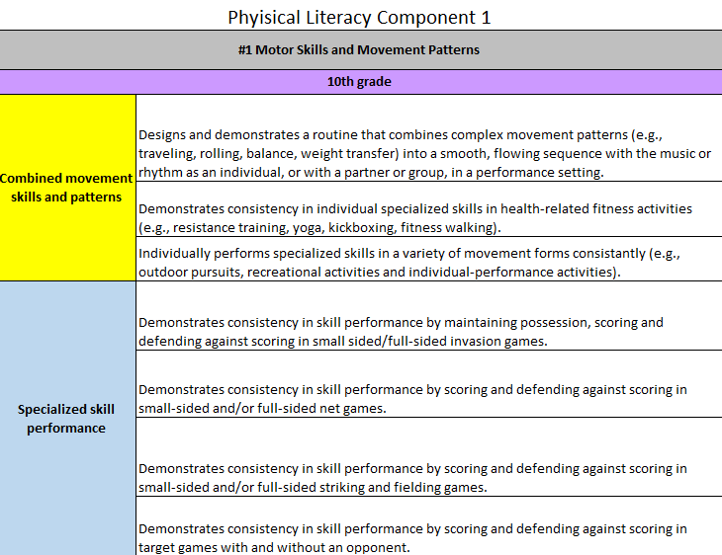
Physical Education Outcomes
Gray – Physical Literacy Component
Purple Box- Grade Level
Rainbow Color (Left Side)
Topics in Bold
Skills-Follow topics in Physical Literacy Skill #1 Motor Skills only in grades K-6.
White - Outcomes

Slide 17
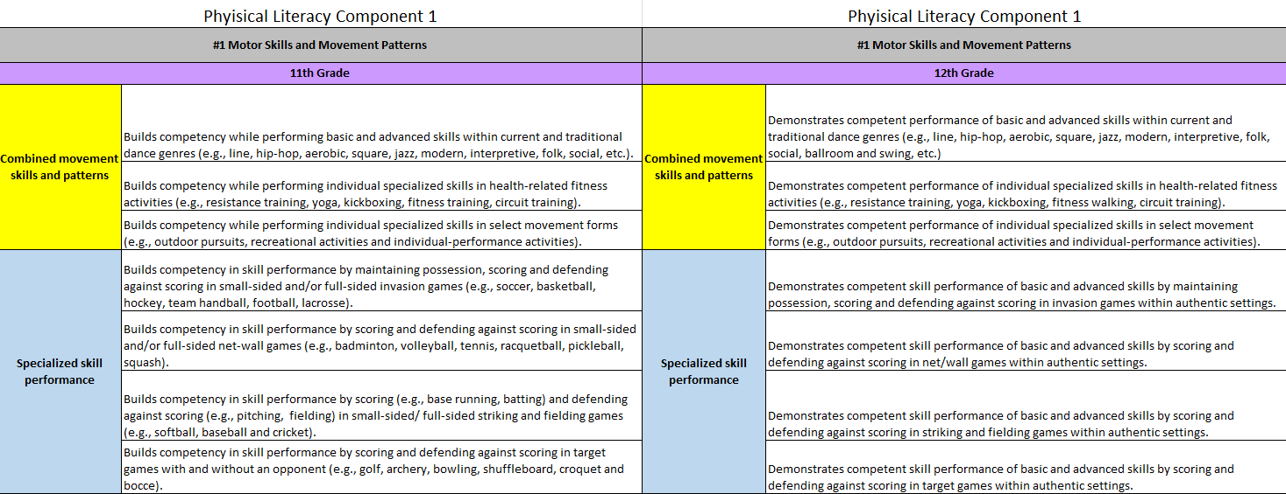
Physical Education Outcomes

Slide 18
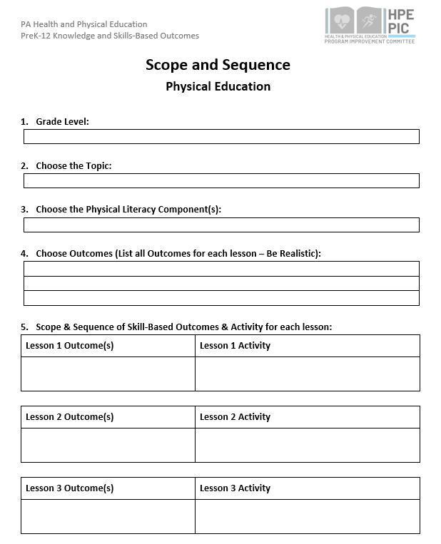
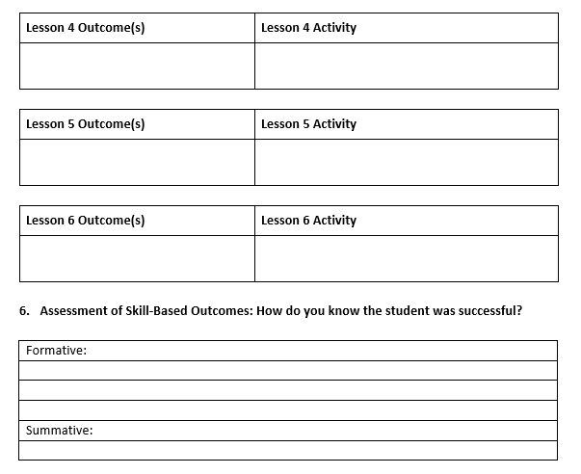
Scope and Sequence Physical Education

Slide 19
*Disclaimer
These outcomes are not the approved standards for PA currently.
We look to share this work with the State School Board Association once we are invited.
They can however be used to help keep your health and physical education programs more current to the forever changing health literacy and physical literacy climate.
PA Code 22, Chapter 4 also encourages the use of materials to expand or improve existing academic standards.

Slide 20
Support from Chapter 4 PA Code 22
§ 4.12. Academic standards.
(a) School entities may develop, expand or improve existing academic standards in the following content areas:
(6) Health, safety and physical education. Study of concepts and skills which affect personal, family and community health and safety, nutrition, physical fitness, movement concepts and strategies, safety in physical activity settings, and leadership and cooperation in physical activities.

Slide 21
Questions
Any questions?

Slide 22
Evaluation
We would love to hear your feedback!
Please use your phone to scan the QR code and take the survey.
https://forms.office.com/Pages/ResponsePage.aspx?id=QSiOQSgB1U2bbEf8Wpob3ugMoKJM0vtJhEN1a30P5hZUM1E5T0RGSUtZMTBBTkhONjdBNkpOT1YwUS4u

Slide 23
HPED PIC Committee Contact Information
Dr. Kim Razzano Professor East Stroudsburg University krazzano@esu.edu | Nick Slotterback Pennsylvania Department of Education Health and Physical Education Advisor nslotterba@pa.gov
Jeffrey Jacobs Retired HPED Teacher Methacton School District jjacobshpe@gmail.com | Dr. Jennifer Rudella Associate Professor Lock Haven University jlr1147@lockhaven.edu
Dr. Cindy Allen Emeritus Professor Lock Haven University callen2@lockhaven.edu | Dr. Jennifer Butz Elementary Physical Education Teacher Northern Lehigh School District jbutz@nlsd.org

