Slide 1
Curriculum Mapping for Health Education

Slide 2
Health Education
Part I
Number of classes in health
Part II
Identify Health Topics You Teach
Part III
Identify the health-literacy skills you teach
Part IV
Scope and Sequence
Part V
Block Plan

Slide 3
Curriculum Mapping: Part I
Part I: Number of lessons in health education
Write the number of lessons in health for each grade level.

Slide 4
Curriculum Map Grid – Part II
Part II: Identify Health Topics You Teach
Use an (X) to mark all areas of the graph below to indicate the health topics you implement (left column for each grade level – yellow column).
Put an (O) to mark all areas you would like to add to address the gaps in your curriculum (Left column for each grade level – yellow column).
List the number of lessons for each topic area in the graph below l (right column for each grade level – white column).

Slide 5
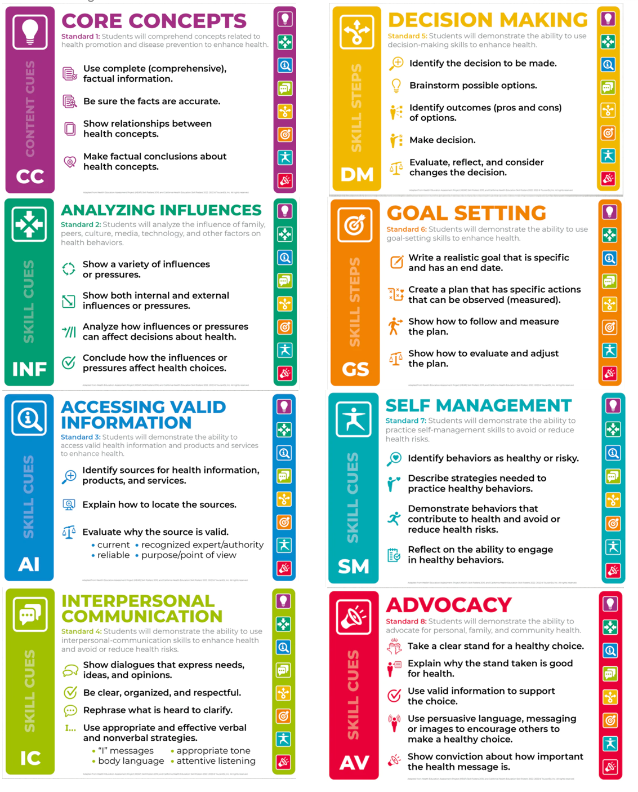

Slide 6
Curriculum Mapping - Part III
What Health Literacy Skills Do You Teach?
Directions: Put a “Y” to indicate the health-literacy skills you teach in each grade level.

Slide 7
Part IV: Scope and Sequence

Slide 8
Curriculum Mapping: Part IV
Part IV: Scope and Sequence
Directions: Complete one document per X and O from Part II in the Curriculum Map Grid (yellow column). You can add and subtract rows in the tables as needed. Choose the grade level(s) and topic.

Slide 9
Curriculum Mapping: Part IV
Choose the core concept outcomes. You can add and subtract rows in the tables as needed

Slide 10
Curriculum Mapping – Part IV
List the health-literacy skill(s) in the blue column.
List the health-literacy skill outcomes in the green column.
Health-Literacy Skills #2: Analyzing Influences # 3: Accessing Information # 4: Interpersonal Communication # 5: Decision-Making # 6: Goal-Setting # 7: Self-Management # 8: Advocacy

Slide 11
Curriculum Mapping – Part IV
List formative assessments you would like to implement.
List summative assessments to measure student achievement.

Slide 12
Block Plan
After Curriculum Mapping Process

Slide 13
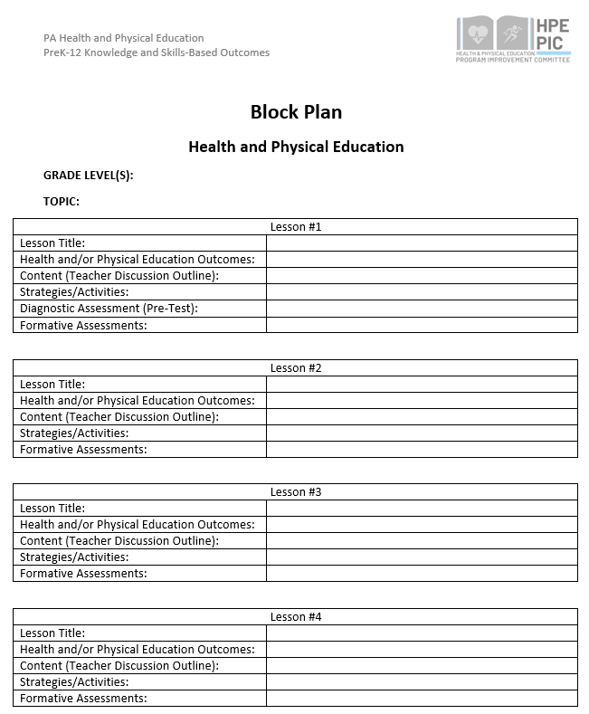
Block Plan

Slide 14
Block Plan
Block Plan Instructions and Examples
1. Grade Level (Decide which grade level will be used to write the unit of instruction)
Health Example: 10th Grade
2. Choose the Topic: (Select the name of the health of physical education topic)
Health Example: Alcohol and Other Drug

Slide 15
Block Plan
Block Plan Instructions and Examples
3. Lesson Title (Name your lesson)
Health Example: Bullying Prevention
4. Health and/of Physical Education Outcomes
Health Example: Core Concept Outcome Describes ways to express anger non-violently. Health Example: Health-Literacy Skill Outcome (Goal-Setting) Sets a realistic personal goal to prevent violence.
5. Content (Teacher Discussion Outline) You can include several questions for discussion such as national and state data, a shared resource (e.g. story of two people who are experiencing a conflict), putting students in scenarios to discuss rules and etiquette, etc.
Health Example: YRBS and PAYS Data and discuss the outcomes

Slide 16
Block Plan
Block Plan Instructions and Examples
6. Strategies and Activities: These can include teaching strategies (e.g. role-play, case studies, critical incidence, etc.) and activities students will participate in to demonstrate skills.
Health Example: Role-play - Students will participate in the role play activity (scenario, scripts, etc.) Teacher will utilize the scoring rubric to assess the students participating in the role play based on the established criteria.
7. Diagnostic Assessment (Pre/Post Test): used to measure student performance. Can also be used to test students on what they learned in previous year(s).
Pre/Post Test Self-Assessment Checklist
8. Formative Assessments: Should align to health and/or physical education outcomes for each lesson.
Bulls-eye, Red/Yellow/Green, 1-5 Rating, Exit Slip, Bell-Ringer, Peer Feedback Evaluation

Slide 17
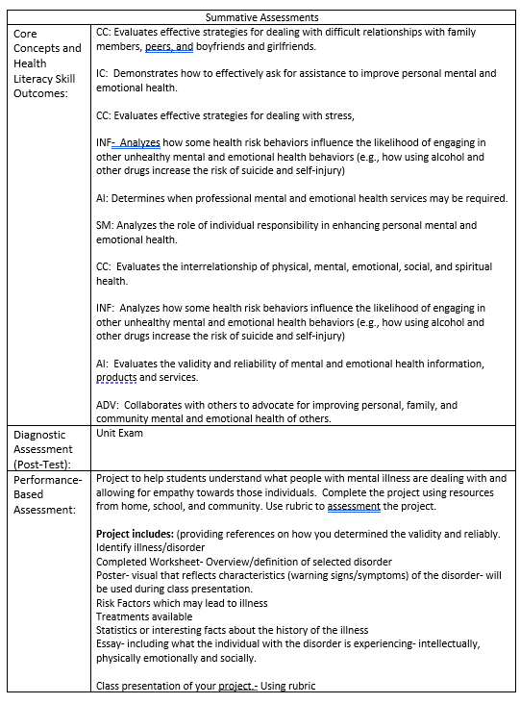
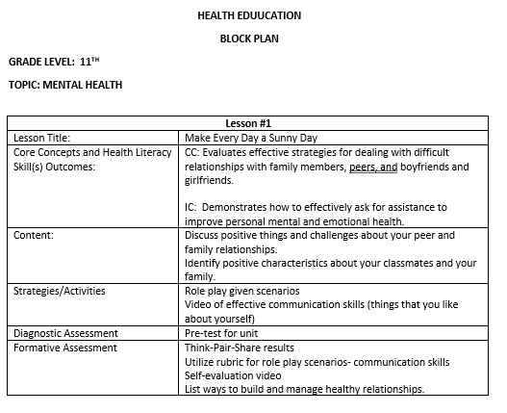
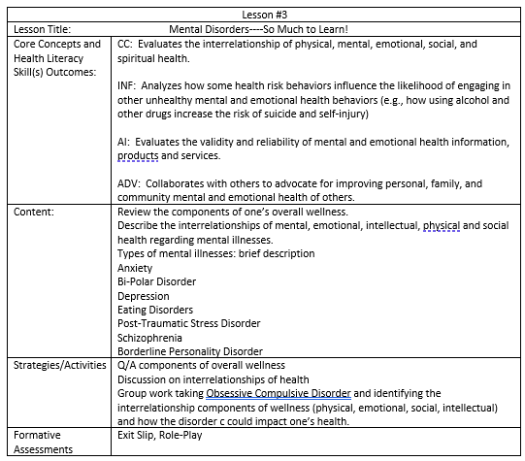
Block Plan Example

Slide 18
Health Education Lesson Plan

Slide 19
Health Education
Unit Topic: (Select one topic from the colored boxes, these topics areas of various colors and located on the left side of the outcomes document).
Lesson Title: (Select a name to your lesson. The name could be creative or based upon the skills and content being taught).
3. Grade Level: (Select the grade level for your Scope and Sequence)
Tobacco
Benefits of Being Tobacco Free
7th Grade

Slide 20
Health Education
Choose Outcomes (List all Outcomes for each lesson-Be Realistic): (List outcomes from each topics you want to include in your unit. You may choose outcomes from one topic or several topics. It may help to list the topic and the appropriate outcomes together)
CC: Summarizes the benefits of being tobacco and nicotine free. DM: Distinguishes when decisions related to tobacco and nicotine use should be made individually or with help of others. ADV: Persuades others to be tobacco and nicotine free and avoid exposure to second-hand smoke

Slide 21
Health Education
Assessment of Skill-Based Outcomes: How do you know the student was successful? (Provide examples of diagnostic, formative 0r summative assessments you may use for your selected unit).
Diagnostic: Pre/Post-test for skill development
Formative: Checklist, Bell Ringer, Exit Slip, Ticket Out the Door, Red/Yellow/Green
Summative: Performance-Based Assessments, Pre and Post Test

Slide 22
Health Education
Instructional Outline
Introduction: Include new skills, review current lessons or units, focus of the lesson
Content Outline: Include all new concepts and skills that will be taught during the class.
Learning Strategies and Activities
Skill Development (Explain the Importance of the Skill)
Today’s class will focus on the benefits of being tobacco free. You will learn how to make decisions related to tobacco, commit to being tobacco free, and persuade others to be nicotine free.
-Review effects of tobacco use -Review benefits of abstaining from using tobacco products -What are influencers of using tobacco. -Personal feelings about using tobacco products (family/friends/community)
Whole class discussion- whole class perceptions of classmates vaping. Individually writing self-evaluation of benefits of being tobacco/nicotine free.

Slide 23
Health Education
Introduction Outline
Skill Development
Explain the Importance of the Skill
Demonstrate Skill Steps
PAYS Survey Data During the past 30 days, how did you usually get your electronic vapor products? (Select only one response.) How wrong do your friends feel it would be for you to use tobacco?
Decision-Making Identify situation that requires a decision Analyze when to make it alone or with an adult List healthy options Predict the outcomes Choose a healthy option Defend and analyze the outcome of the decision | Advocacy Promote personal health by taking a stand on a health issue and support their position with relevant and accurate information. Advocate for healthy families, friends, and community Encourage peers to make healthy choices Model how to influence and support others Use social norms to develop a health message Adjust that viewpoint and communication strategy for different audiences

Slide 24
Health Education
Introduction Outline
Skill Application
Provide adequate time to demonstrate and practice skill
Formative Assessments
Peer interview of classmates on their personal feelings about people who use tobacco.
Self-evaluation of benefits of remaining tobacco free (including a commitment to be tobacco free). Submitted peer interview questions and answers.

Slide 25
Health Education
Closure
Modifications/Extensions
Review effects of tobacco us Review influences of using tobacco
Students can interview a parent or older sibling on their personal feelings about people who use tobacco.

Slide 26
Health Education
Vocabulary
Tobacco
Nicole
Toxic
Vaping Device
Aerosol
Carcinogens
Tar
Materials
List of ways to help someone to stop using tobacco products
Decision-making skill steps poster
Advocacy skill steps poster
Rubric or checklist for peer interview and/or self-evaluation
Resources
Comprehensive Health, PDE SAS

Slide 27
Questions
Any questions?

Slide 28
HPED PIC Committee Contact Information
Dr. Kim Razzano Professor East Stroudsburg University krazzano@esu.edu | Nick Slotterback Pennsylvania Department of Education Health and Physical Education Advisor nslotterba@pa.gov
Jeffrey Jacobs Retired HPED Teacher Methacton School District jjacobshpe@gmail.com | Dr. Jennifer Rudella Associate Professor Lock Haven University jlr1147@lockhaven.edu
Dr. Cindy Allen Emeritus Professor Lock Haven University callen2@lockhaven.edu | Dr. Jennifer Butz Elementary Physical Education Teacher Northern Lehigh School District jbutz@nlsd.org

