Slide 1
Creating Formative Assessments using the Pennsylvania PreK-12 Knowledge and Skills-Based Health and Physical Education Outcomes
Dr. Jennifer Rudella and Dr. Jennifer Butz
2023 SHAPE PA Conference Presentation

Slide 2
Objectives
Review the HPED Outcomes
Apply the HPED Outcomes to create formative assessments

Slide 3
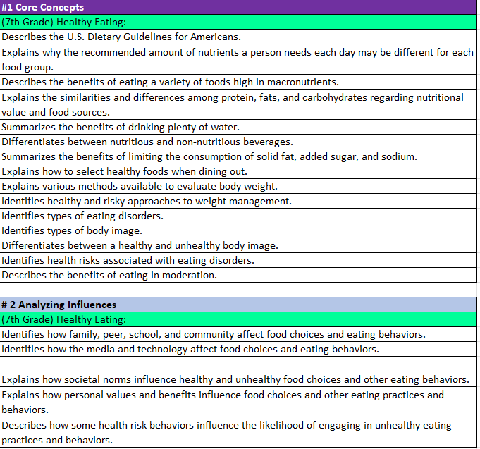
Health Education Outcomes
Dark Purple- Core Concepts
Light Blue-Health Literacy Skills
Rainbow Color – Health Content
White - Outcome

Slide 4
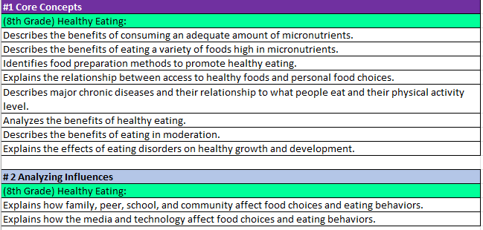
Health Education Outcomes
8th Grade Nutrition Core Concepts & Analyzing Influences
9th Grade Nutrition Benchmark Analyzing Influences

Slide 5
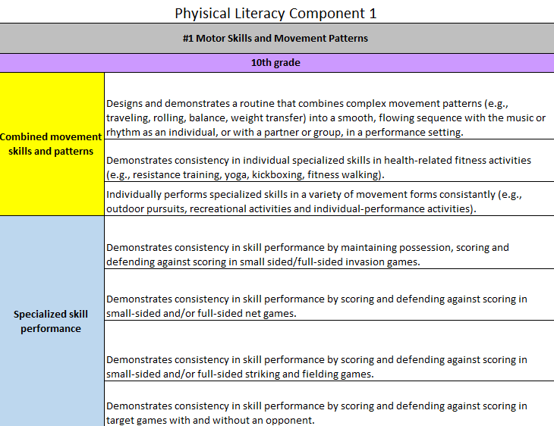
Physical Education Outcomes
Gray – Physical Literacy Component
Purple Box- Grade Level
Rainbow Color (Left Side)
Topics in Bold
Skills-Follow topics in Physical Literacy Skill #1 Motor Skills only in grades K-6.
White - Outcomes

Slide 6
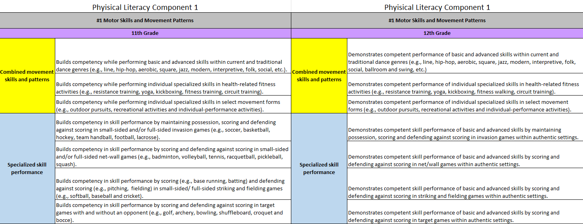
Physical Education Outcomes

Slide 7
Examples
Health Education
Elementary
Secondary
Physical Education
Elementary
Secondary

Slide 8
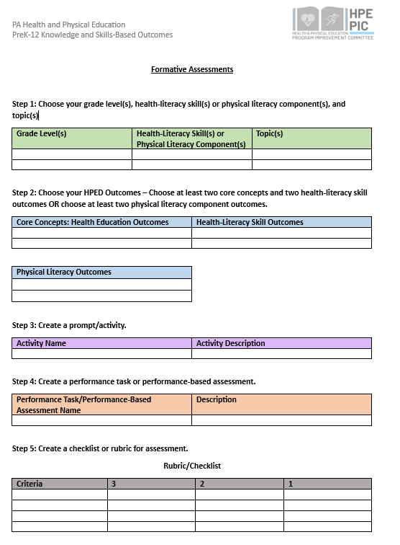
Steps
Choose your grade level(s), health-literacy skill(s) or physical literacy component(s), and topic(s)
Choose your HPED Outcomes
Create a prompt/activity
Create a performance task or performance-based assessment
Create a checklist or rubric for assessment

Slide 9
QR Code to Template

Slide 10
Health Education - Elementary
Step 1 - Choose your grade level(s) and topic(s), health-literacy skills
4th Grade Violence Prevention – Violence Prevention: Bullying Prevention
Health Literacy Skills: Analyzing Influences and Advocacy

Slide 11
Health Education - Elementary
Step 2 - Choose your HPED Outcomes
Core Concepts
Explains the difference between tattling and reporting aggression, bullying or violence.
Identifies helpful and unhelpful strategies when someone is being bullied.
Analyzing Influences
Practices the role of bystanders in bullying situations.
Advocacy
Provides factual information to others to prevent violence.

Slide 12
Health Education - Elementary
Step 3 Create a prompt/activity
Analyzing Role-play: Create a story where someone is being bullied and students create a solution. Have students identify the bully, victim, and bystander. Students will role play the story.

Slide 13
Health Education - Elementary
Step 4 - Create a performance task or performance-based assessment
Poster – create a poster to prevent bullying

Slide 14
Health Education - Elementary
Step 5 - Create a checklist or rubric for assessment
Poster Rubric
Criteria | 3 | 2 | 1
Helpful and Unhelpful Strategies | Identify at least one helpful and unhelpful strategy when someone is being bullied. | Identify one helpful or unhelpful strategy when someone is being bullied. | Incorrectly identified a strategy when someone is being bullied.
Facts to Prevent Violence | Provides at least two facts to others to prevent bullying. | Provides at least one fact to others to prevent bullying. | Incorrectly provided facts to others to prevent bullying.

Slide 15
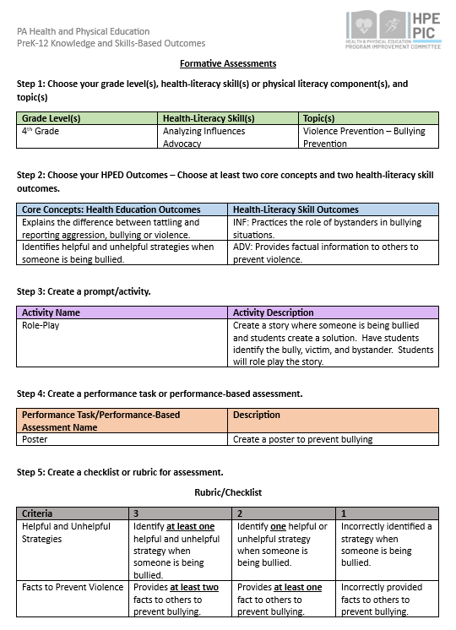

Slide 16
Health Education - Secondary
Step 1 - Choose your grade level(s) and topic(s) and health-literacy skills
8th Grade – Mental and Emotional Health – Dimensions of Health
Health Literacy Skills: Accessing Information and Self-Management

Slide 17
Health Education - Secondary
Step 2 - Choose your HPED Outcomes
Core Concepts
Explains the interrelationship of physical, mental, emotional, social and spiritual health (components of wellness).
Describes how mental and emotional health affects health-related behaviors
Accessing Information
Describes situations that call for professional mental and emotional health services.
Self-Management
Explains the importance of being responsible for personal mental and emotional health behaviors.

Slide 18
Health Education - Secondary
Step 3 Create a prompt/activity
Self-Assessment - Dimensions of Health: Have students take a dimensions of health self-assessment and identify their strengths and weaknesses. Then, students will explain at least two ways they can improve their dimensions of health and what they are currently doing to maintain their dimensions of health.

Slide 19
Health Education - Secondary
Step 4 - Create a performance task or performance-based assessment
All About Me Brochure

Slide 20
Health Education - Secondary
Step 5 - Create a checklist or rubric for assessment
All About Me Brochure
Criteria | 3 | 2 | 1
Improve Dimensions of Health | Explain at least one way how you maintain or improve each physical, mental, emotional, social and spiritual health (components of wellness).someone is being bullied. | Explain at least one way how you maintain or improve for at least 3 out of 5 components of wellness. | Explain at least one way how you maintain or improve for at least 2 out of 5 components of wellness.
Personal Mental and Emotional Health Behaviors | Explains at least two important reasons why they are responsible for personal mental and emotional health behaviors. | Explains at least two important reasons why they are responsible for personal mental and emotional health behaviors. | Incorrectly explains important reasons why they are responsible for personal mental and emotional health behaviors.

Slide 21
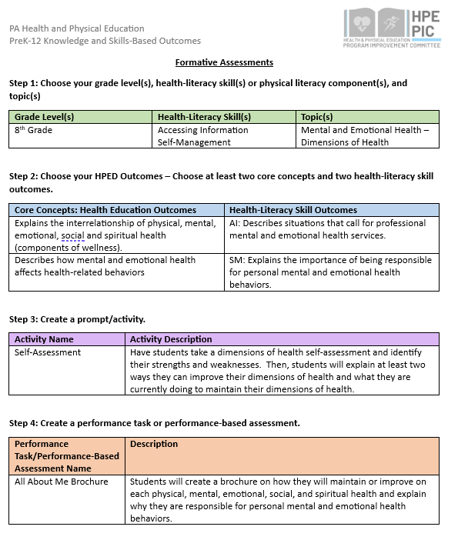
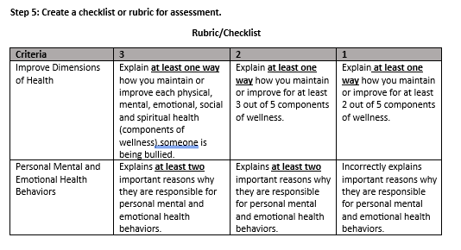

Slide 22
Physical Education
Steps to creating a formative assessment for Phys. Ed.
Choose your grade level(s) , physical literacy component(s) , & topic
Choose your HPED Outcomes
Create a prompt/activity
Create a performance task or performance-based assessment
Create a checklist or rubric for assessment

Slide 23
Physical Education – Elementary
Step 1 - Choose your grade level(s) , physical literacy skill, and topic(s)
2nd Grade Manipulative- Underhand Throw

Slide 24
Physical Education- Secondary
Step 2 - Choose your HPED Outcomes
Throws underhand using all critical elements.

Slide 25
Physical Education- Elementary
Step 3 Create a prompt/activity
Make it, Take it!- Students will underhand toss an item towards a polyspot of their choice. If they "make it" (meaning the item hits the spot), they will take the spot back to their hoop or bin. If they "miss", they can grab their item and try again. Students will keep dropping off their poly spots before their next throw.
by Derrick Biehl @mrbiehlspe

Slide 26
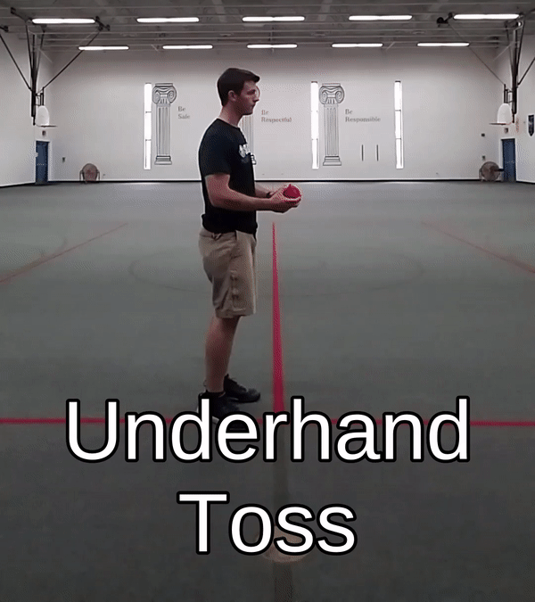
Make it, Take it!
Underhand Toss from a Poly Spot.
If you make it into the bin, take the spot back to your hoop.
If you miss, grab your bean bag and try again.
Drop off your Poly Spot before your next throw.
by Derrick Biehl @mrbiehlspe

Slide 27
Physical Education - Elementary
Step 4 - Create a performance task or performance-based assessment
"Stop Motion" Cue Photo Shoot or Check Sheet- Students will demonstrate an underhand throw by stopping at each of the 5 key cues (ready position, arm back, step, release, follow through).
Human Kinetics- Teaching Fundamental Motor Skills 4th Edition

Slide 28
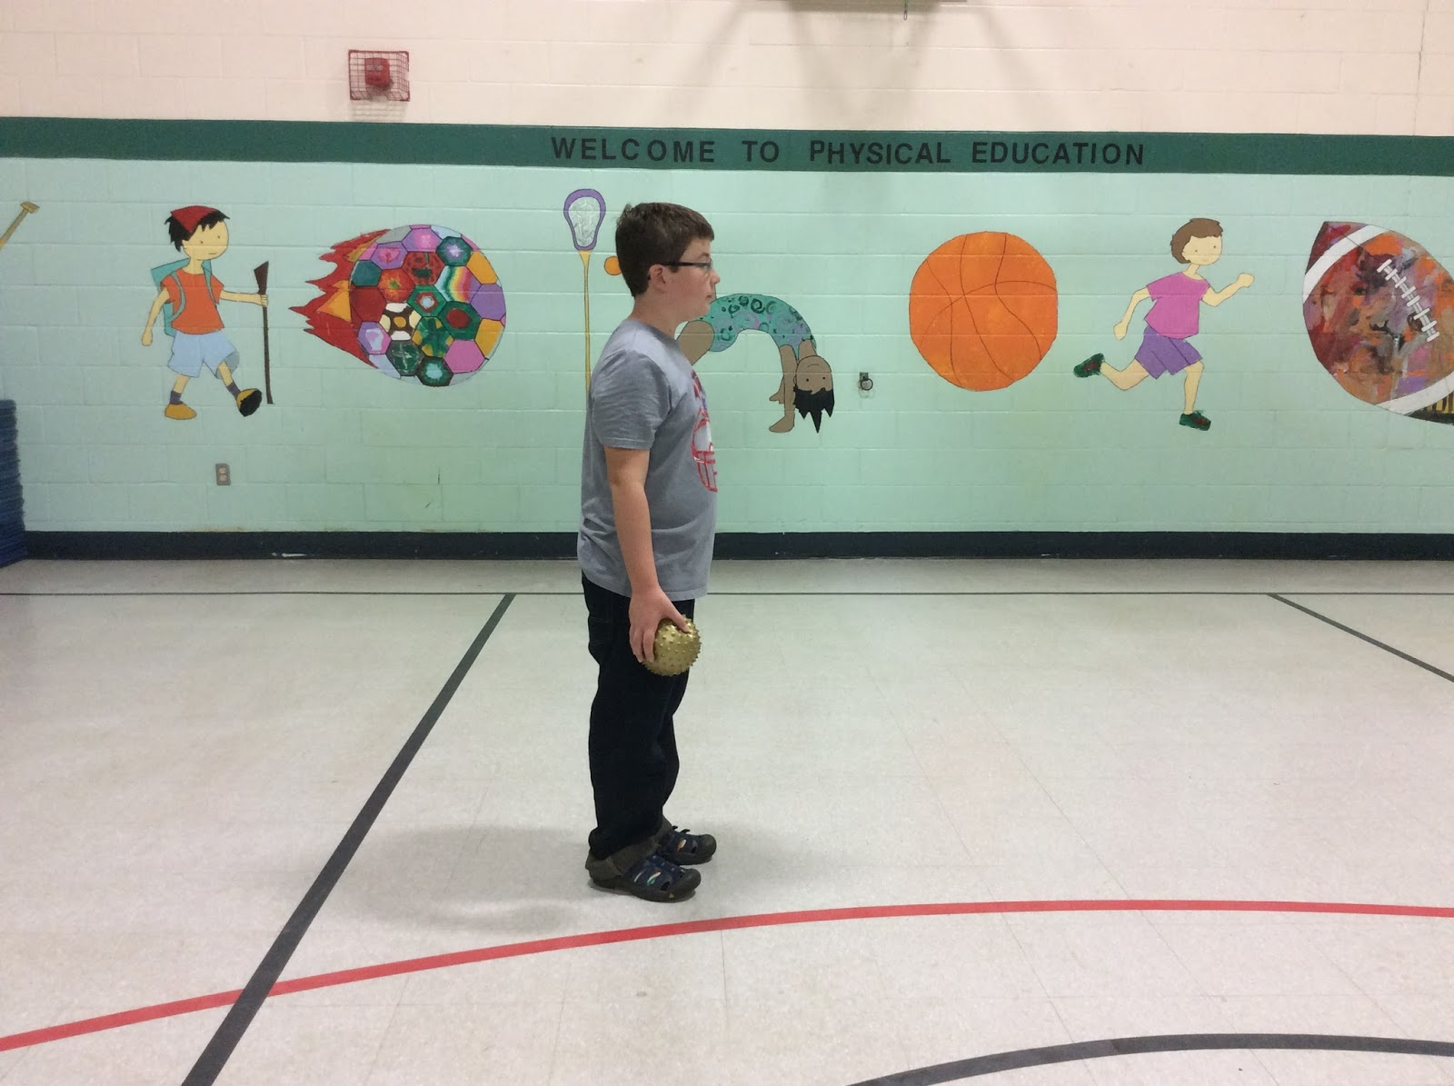
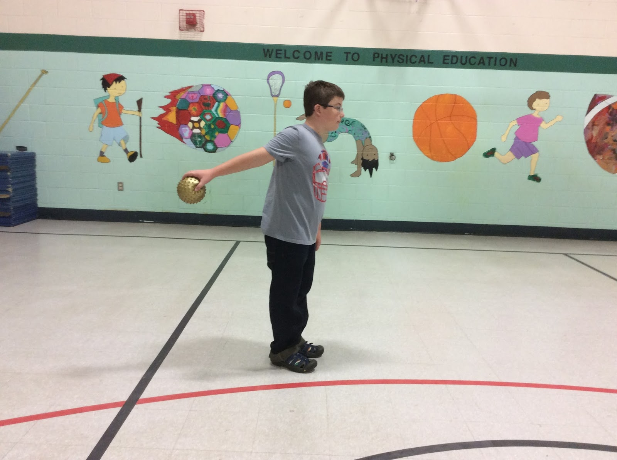
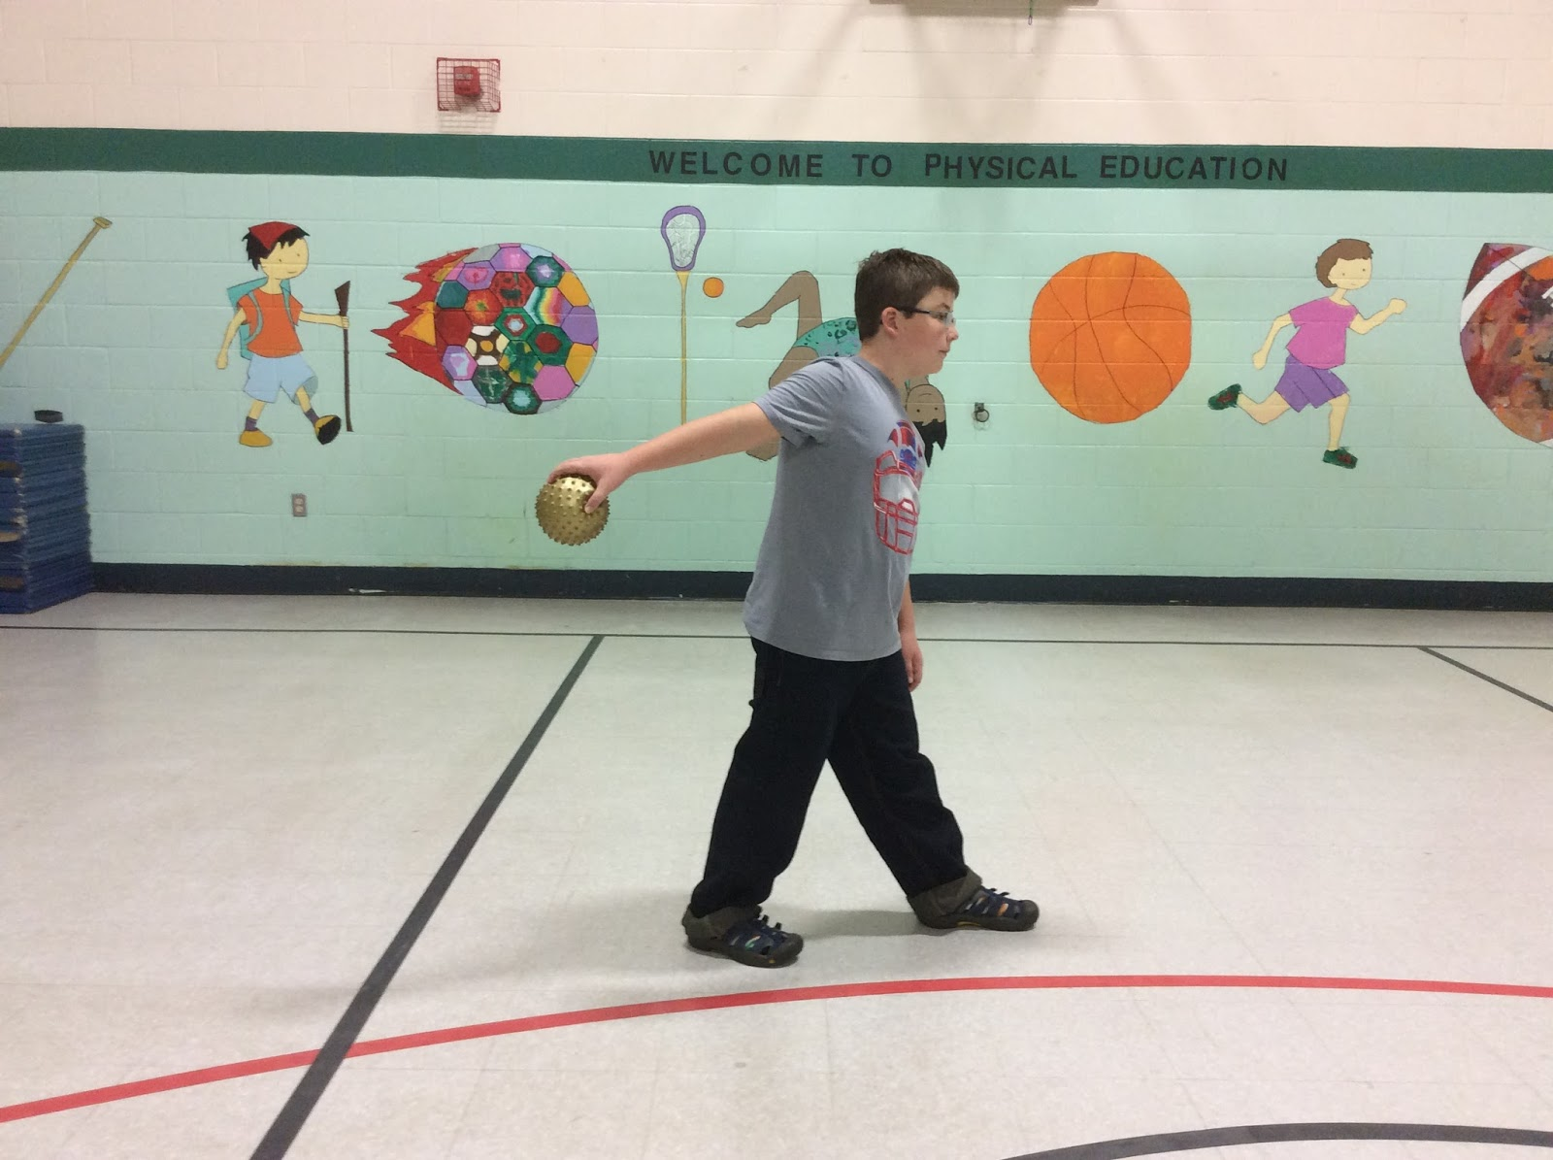
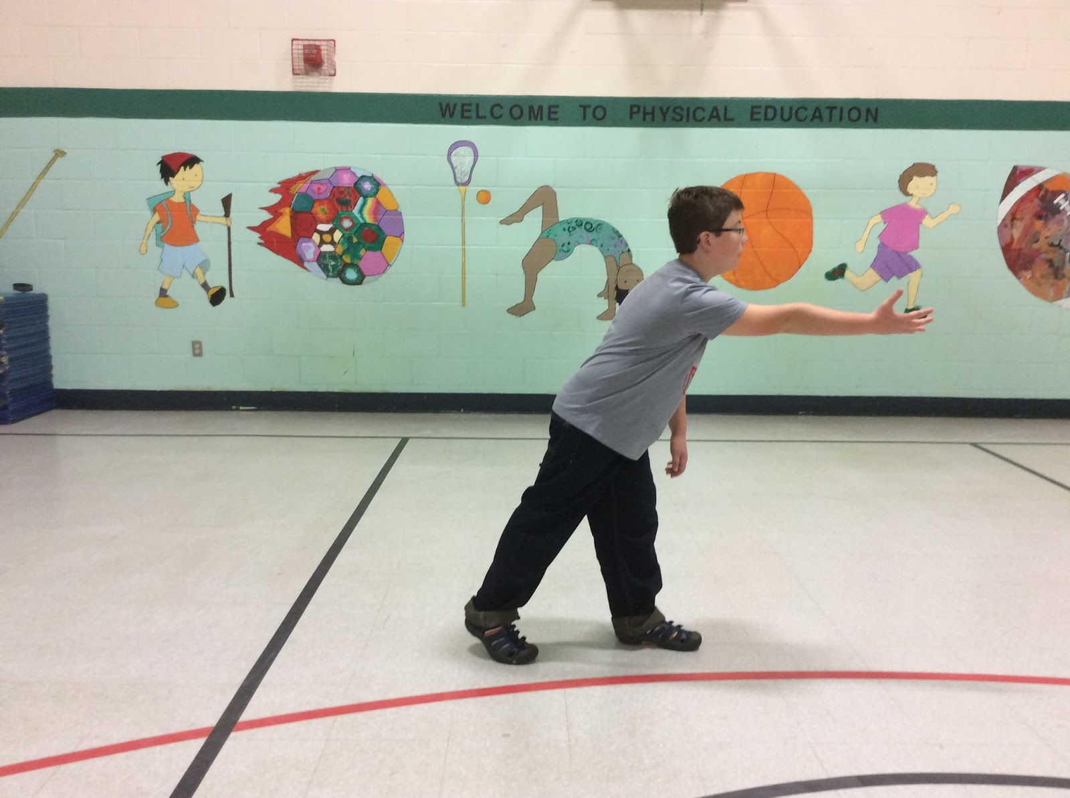
Physical Education - Elementary
Step 4 - Create a performance task or performance-based assessment
"Stop Motion" Cue Photo Shoot or Check Sheet
Photos- Brian Godfrey, 2015
Human Kinetics- Teaching Fundamental Motor Skills 4th Edition

Slide 29
Physical Education - Elementary
Step 5 - Create a performance task or performance-based assessment
"Stop Motion" Cue Photo Shoot or Check Sheet
Human Kinetics- Teaching Fundamental Motor Skills 4th Edition

Slide 30
Physical Education - Elementary
Step 6 - Create a checklist or rubric for assessment Example cue sequence checklist for underhand throwing.
 | Demonstrates Cue | Does NOT Demonstrate Cue
Ready -knees bent, facing target, feet shoulder-width apart, eyes on target, object held in preferred hand (palm up) in front of the body.
2. Arm Back -bring the throwing arm back at least to waist level.
3. Step with Opposite Foot -step forward with the opposite foot, bring the throwing arm forward, and release the ball between the knee and waist level. The arm is extended throughout the entire movement.
4. Let It Go- bring the throwing arm forward and release the ball below the waist. The arm is extended throughout the entire movement. The throwing hand continues toward the target in front of the body and finishes with palm facing upward.
5. Follow Through - the throwing hand continues toward the target in front of the body and finishes with palm facing upward.
Human Kinetics- Teaching Fundamental Motor Skills 4th Edition

Slide 31
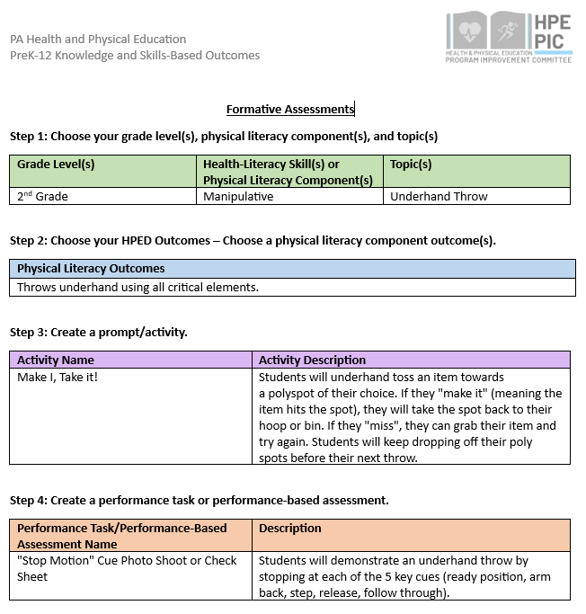
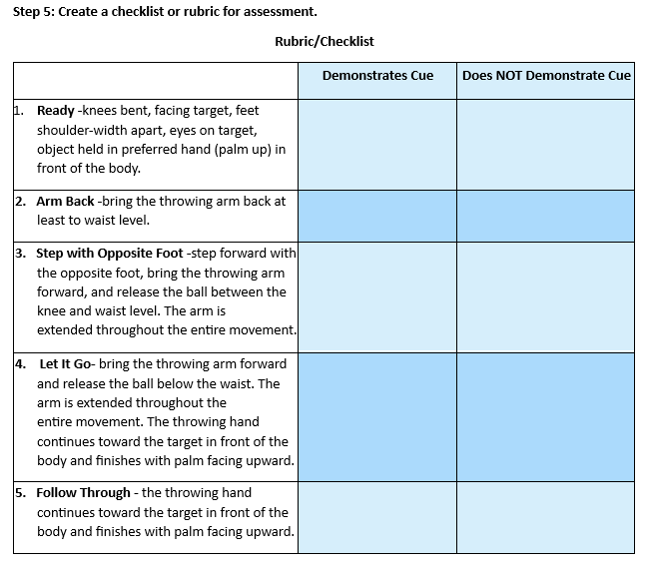

Slide 32
Physical Education – Secondary
Step 1 - Choose your grade level(s) , physical literacy skill, and topic(s)
8th Grade Motor Skills- Rhythm and Dance

Slide 33
Physical Education- Secondary
Step 2 - Choose your HPED Outcomes
Demonstrates a routine that includes a variety of movement patterns in dance, gymnastics or fitness (e.g., yoga, Zumba) with a partner or small group.
Performs a basic folk / square / line- dance sequence to music

Slide 34
Physical Education- Secondary
Step 3 Create a prompt/activity
Number Dance: Create a dance using the dance movement associated with your locker number. Show your locker number dance to a classmate. Make each movement 4 counts. Can they figure out your locker number, just by watching you move?

Slide 35
What's Your Number
Locker Number Dance​ ​ _____ _____ _____ _____​ ​
​
Decode your locker number using the numbered dance moves below. ​
Practice your dance until you are comfortable demonstrating it to others. ​
​
Show your number dance to a classmate.​
Make each movement 4 counts.​
​
Can they figure out your locker number, just by watching you move?

Slide 36
Example Dance Movements
0 = step forward left,
step forward right,
step backward left,
step backward right
1 = step, step, kick, kick
2 = punch upward 2 x with right fist,
2 x with left fist
3 = grapevine to the right
4 = twist down x 4
5 = walk forward x 3,​
knee lift on 4th count ​
​
6 = grapevine to the left​
​ 7 = diagonal slide 2 with the right, ​
2 times with the left​
​ 8 = dab 2 x with right, 2 x with left​
​ 9 = ¼ turn jump right then back to front, ​ ¼ turn jump left then back to front​ ​
(Mally, 2017)​
​

Slide 37
Example Dance Moves
Locker Number Dance
1 8 5 2
(Using the chart from the previous slide.)
1 = step, step, kick, kick
8 = dab 2 x with right, 2 x with left
5 = walk forward x 3, knee lift on 4th count
2 = punch upward 2 x with right fist, 2 x with left fist
**Each movement is a four count.

Slide 38
Physical Education - Secondary
Step 4 - Create a performance task or performance-based assessment
Tick Tock Dance

Slide 39
Physical Education - Secondary
Step 5 - Create a checklist or rubric for assessment Example rubric for Performance of Dance & Rhythm (Mally, 2017).
4 | Maintains rhythm throughout the performance. Visual focus is forward or at others, with no need to look at feet. Consistent movements - coordinated, fluid, balanced shift in weight. Adds personal style to the dance.
3 | Finds beat and maintains rhythm, and/or when off-beat, able to self-correct within 16 counts . Coordinated, fluid, balanced shift in weight from one movement to another, with very few choppy movements. Focus is forward, with few glances downward to check feet.
2 | Inconsistently moves to the correct beat and/or when off-beat, able to self-correct but requires more than one full phrase to regain the beat. At times, movements appear awkward, off balance, segmented, choppy movement and/or uses extraneous, unnecessary movements. Focus is often downward toward the feet, with minimal, momentary glances upward.
1 | Unable to move to the beat and/or can find it but unable to self-correct. Movement consistently appears awkward, stiff, rigid and choppy and use of extraneous, unnecessary movements, to the point where it negatively impacts enjoyment & willingness to participate. Looks down at feet almost the entire time.

Slide 40
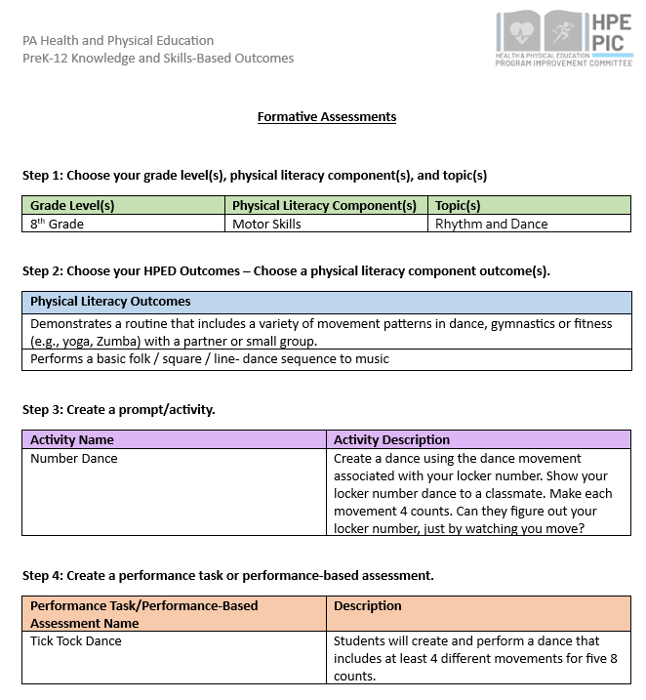
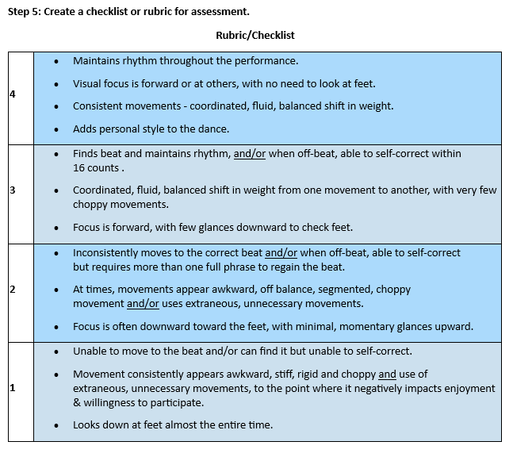

Slide 41
Contact Information
Dr. Jennifer Rudella Associate Professor Lock Haven University jlr1147@lockhaven.edu
Dr. Jennifer Butz Elementary Health & Physical Education Teacher Northern Lehigh School District jbutz@nlsd.org
Nick Slotterback Pennsylvania Department of Education Health and Physical Education Advisor nslotterba@pa.gov

