Slide 1
Overview of PreK-12 Knowledge and Skills-based Outcomes
Presentation by:
Cindy Allen, PhD
Jeff Jacobs, MEd
October 26, 2023
Jeff

Slide 2
Agenda
Welcome and Introductions
Introduce to PA Health and Physical Education PreK-12 Knowledge and Skills-based Outcomes
Accessing the Outcomes in the PDE SAS Portal
Question and Answers
Cindy

Slide 3
Session Objectives
Participants will be able to recognize and understand the terminology and components of the PreK-12 Knowledge and Skills-based Outcomes for Physical Education.
Participants will be able to recognize and understand the terminology, content and literacy skills of the PreK-12 Knowledge and Skills-based Outcomes for Health.
Participants will demonstrate a basic understanding of how to read and interpret the PreK-12 Knowledge and Skills-based Outcomes for Health and Physical Education.
Participants will demonstrate how to access the PreK-12 Knowledge and Skills-based Outcomes for Health and Physical Education and accompanying files on the SAS portal.
Cindy

Slide 4
Physical Education
5 Physical Literacy Components
Motor Skills
Movement Concepts
Level of Fitness
Cooperative Skills
Value of Physical Activity
Benchmarks 3, 6, 9, and 12
Planned outcomes for every grade level
Easy to follow the progression of outcomes from grade-to-grade
Does not include aquatics
Jeff

Slide 5
Terms to Remember
Physical Education Terms | Definition
Physical Literacy Components | The physical literacy components are Motor Skills, Movement Concepts, Level of Fitness, Cooperative Skills, and Value of Physical Activity (Physical Literacy Components are written in bold within the gray box)
Physical Education Topic | Content that will help create physical education units. (Physical Education Topics are written in bold within the colored boxes on the left side of each grade level).
Skills | Building blocks in creating curriculum. Skills determine what outcomes will be taught. (Skills are only found in Physical Literacy Component #1 for grades K-6. The skills align to the topic area. They are not bolded after the Physical Education Topic within the colored boxes on the left side of each grade level).
Outcomes | Student expectations that will be assessed. (Learning Objectives) (White section in the outcome documents).

Slide 6
Physical Education Components
Physical Literacy Components | K-3 (PE Topics) | 4-6 (PE Topics) | 7-9 (PE Topics) | 10-12 (PE Topics)
Motor Skills | Locomotor, Nonlocomotor, and Manipulatives | Locomotor, Nonlocomotor, and Manipulatives | Dance and rhythms, Specialized skills and movement patterns, Application of specialized manipulative skills, outdoor pursuits, Individual performance activities | Combined movement skills and patterns, Specialized skill performance,
Movement Concepts and Performance | Space, Pathways, shapes, levels, Speed, direction, force and Strategies and tactics | Space, Pathways, shapes, levels, Speed, direction, force and Strategies and tactics | Tactics and principles and principles and critical elements | Strategies and tactics and Principles and critical elements
Level of Fitness | Physical activity knowledge, Engages in physical activity, Fitness knowledge, and Nutrition | Engages in physical activity, fitness knowledge, nutrition, and assessment of program planning | Physical activity knowledge, Engages in physical activity, Fitness knowledge, Nutrition, Assessment and program planning, and Healthy Habits in relation to fitness | Physical Activity knowledge, Engages in Physical, Fitness Knowledge, Nutrition, Assessment and program planning, Healthy Habits in relation to fitness, and Accessing information
Cooperative skills and positive behavior | Personal responsibility, Accepting feedback, Working with others, Rules and Etiquette, and Safety | Personal responsibility, Accepting feedback, Working with others, Rules and Etiquette, and Safety | Personal responsibility, Accepting feedback, Working with others, Rules and Etiquette, and Safety | Personal Responsibility, Cooperation, Rules and Etiquette, and Safety,
Value of Physical Activity | Health, Challenge, and Self expression and enjoyment | Health, Challenge, Self expression and enjoyment, and Social interaction | Health, Challenge, Self expression and enjoyment, and Social interaction | Health, Challenge, Self expression and enjoyment, and Social interaction
Jeff

Slide 7
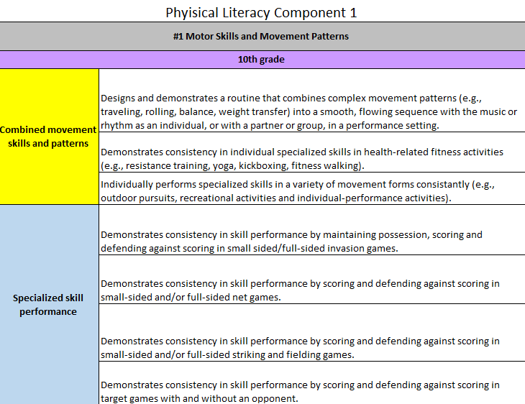
Physical Education Outcomes
Gray – Physical Literacy Component
Purple Box- Grade Level
Rainbow Color (Left Side)
Topics in Bold
Skills-Follow topics in Physical Literacy Skill #1 Motor Skills only in grades K-6.
White - Outcomes

Slide 8
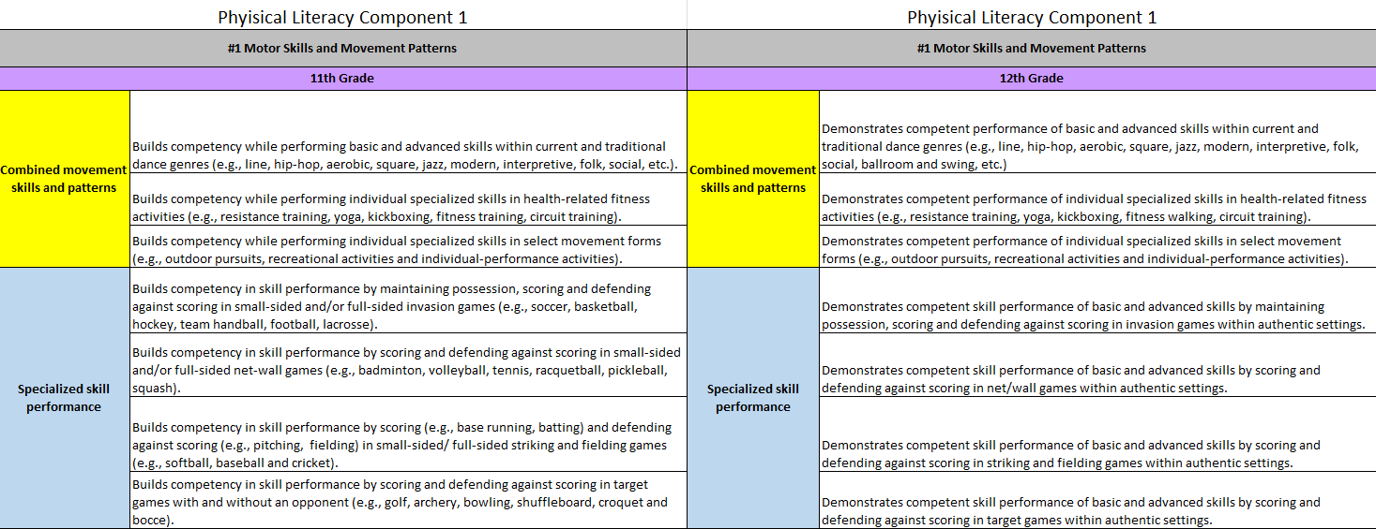
Physical Education Outcomes

Slide 9
Health Education
Core Concepts and 7 Health Literacy Skills
Core Concepts
Health-Literacy Skills
Benchmarks 3, 6, 9, and 12
Planned outcomes for every grade level
Easy to follow the progression of outcomes from grade-to-grade
Cindy

Slide 10
Terms to Remember
Health Terms | Definition
Core Concepts | Concepts that focus on both health promotion and risk reduction. Core Concepts are to be included in every health lesson it provides the content for each health topic area. (They are found in section #1).
Health Literacy Skills | Defined as a person's ability to find, understand and use information and services to make health-related decisions for themselves and others. Adopt and maintain healthy behaviors. (They are found in sections #2-#8).
Outcomes | Student expectations that will be assessed. (Learning Objectives) (White section in the outcome documents).
Health Topic | Topics of health that align with each core concepts and health-literacy skills outcome.

Slide 11
Content and Health Literacy Skills
Topic Areas | Content | Health-Literacy Skills
Alcohol and Other Drugs | Core Concepts not benchmark years | Analyzing Influences
Tobacco |  | Accessing Information
Healthy Eating |  | Interpersonal Communication
Mental and Emotional Health |  | Decision-Making
Personal Health |  | Goal-Setting
Physical Activity |  | Self-Management
Safety/Injury Prevention |  | Advocacy
Violence Prevention
Healthy Relationships (K-6)/Sexual Health (7-12)
Cindy

Slide 12
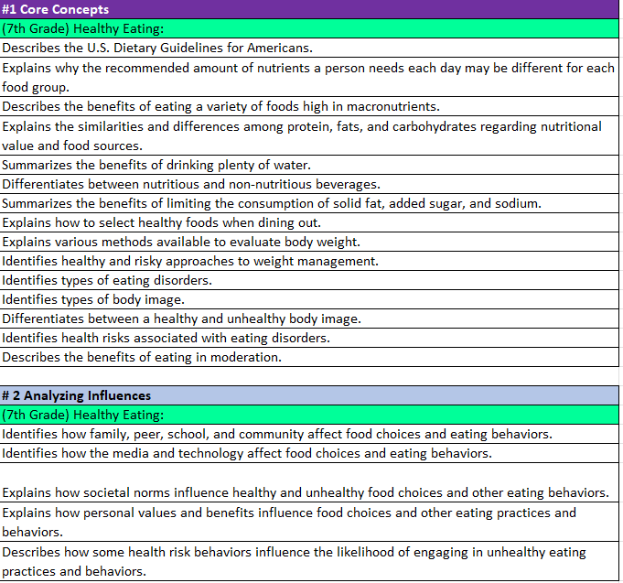
Health Education Outcomes
Dark Purple- Core Concepts
Light Blue-Health Literacy Skills
Rainbow Color – Health Content
White - Outcome

Slide 13
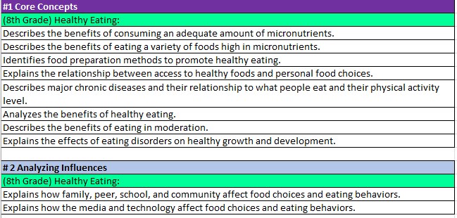
Health Education Outcomes
8th Grade Nutrition Core Concepts & Analyzing Influences
9th Grade Nutrition Benchmark Analyzing Influences

Slide 14
*Disclaimer
These outcomes are not the approved standards for PA currently.
We look to share this work with the State School Board Association once we are invited.
They can however be used to help keep your health and physical education programs more current to the forever changing health literacy and physical literacy climate.
PA Code 22, Chapter 4 also encourages the use of materials to expand or improve existing academic standards.
Jeff

Slide 15
Support from Chapter 4 PA Code 22
§ 4.12. Academic standards.
(a) School entities may develop, expand or improve existing academic standards in the following content areas:
(6) Health, safety and physical education. Study of concepts and skills which affect personal, family and community health and safety, nutrition, physical fitness, movement concepts and strategies, safety in physical activity settings, and leadership and cooperation in physical activities.
Jeff

Slide 16
Accessing the Outcomes on the SAS Portal
Although not officially adopted, they will be available on the SAS portal on the PDE website. They may be used as a resource for lessons and curriculum writing. You will first need to follow the instructions to register. Then.... In your browser go to www.pdesas.org
Here are the directions for accessing them:
At top right corner, click on the box that says "MySAS Tools"
Click on "Communities"
Click on "Find a Community“ (right side of page)
Search for "Physical Education Learning Community"
Click on "Health, Safety and Physical Education Learning Community"
Click on "Join this Community"
Scroll to bottom of page
Click on “Shared Content" button
Scroll to folder of interest
Click on ">" to access files
Jeff

Slide 17
These are the 3 files you will want to access:
K-12 Physical Education Knowledge and Skills Development Outcomes
K-12 Health Knowledge and Skills Development Outcomes (By grade level)
K-12 Health Knowledge and Skills Development Outcomes (By Health Topic
Jeff

Slide 18
Questions?
Cindy

Slide 19
Thank You
Dr. Cindy Allen
callens2@lockhaven.edu
Jeff Jacobs
jjacobshpe@gmail.com

