Slide 1
Chapter 9: Lesson Plan
After Curriculum Mapping Process

Slide 2
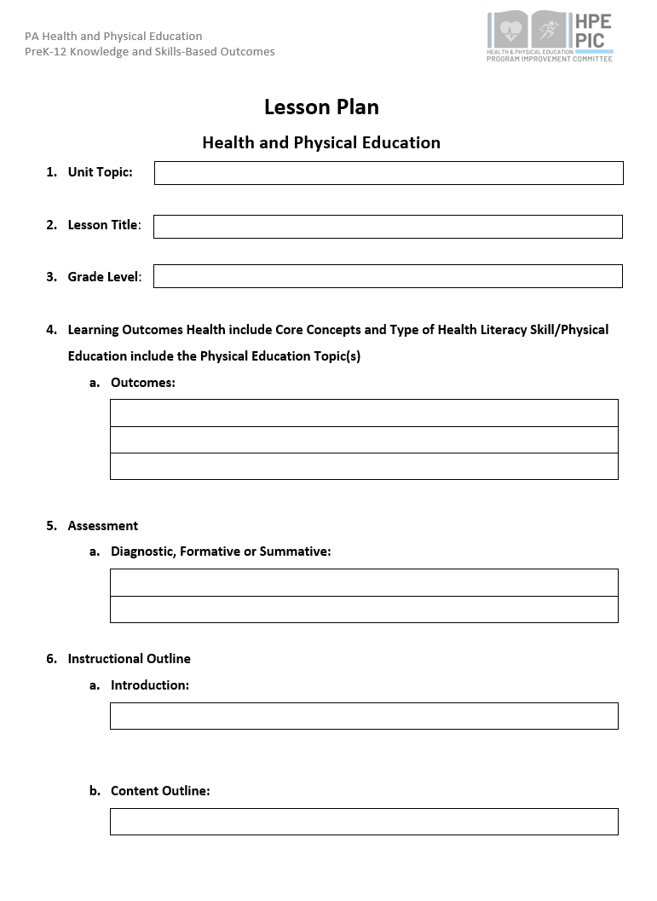
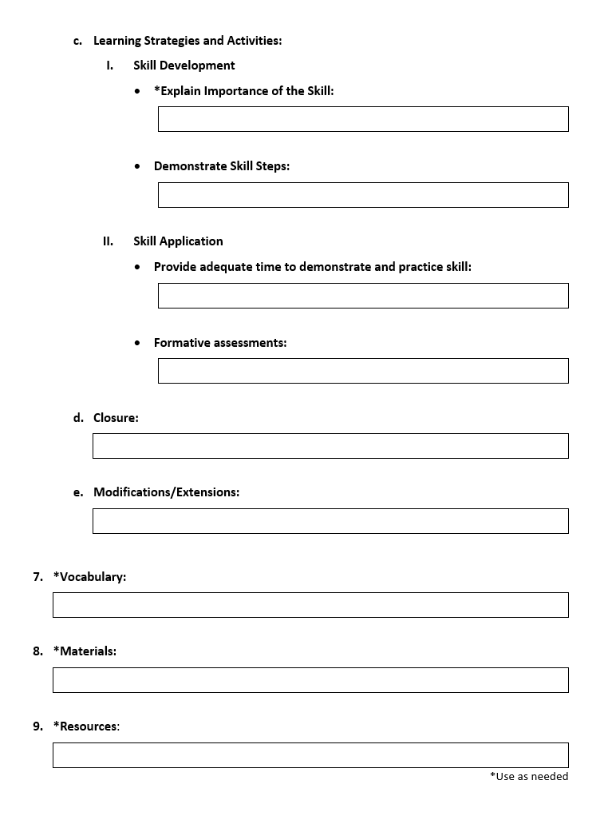
Lesson Plan Template

Slide 3
Health Education Lesson Plan

Slide 4
Health Education
Unit Topic: (Select one topic from the colored boxes, these topics areas of various colors and located on the left side of the outcomes document).
Lesson Title: (Select a name to your lesson. The name could be creative or based upon the skills and content being taught).
3. Grade Level: (Select the grade level for your Scope and Sequence)
Tobacco
Benefits of Being Tobacco Free
7th Grade

Slide 5
Health Education
Choose Outcomes (List all Outcomes for each lesson-Be Realistic): (List outcomes from each topics you want to include in your unit. You may choose outcomes from one topic or several topics. It may help to list the topic and the appropriate outcomes together)
CC: Summarizes the benefits of being tobacco and nicotine free. DM: Distinguishes when decisions related to tobacco and nicotine use should be made individually or with help of others. ADV: Persuades others to be tobacco and nicotine free and avoid exposure to second-hand smoke

Slide 6
Health Education
Assessment of Skill-Based Outcomes: How do you know the student was successful? (Provide examples of diagnostic, formative 0r summative assessments you may use for your selected unit).
Diagnostic: Pre/Post-test for skill development
Formative: Checklist, Bell Ringer, Exit Slip, Ticket Out the Door, Red/Yellow/Green
Summative: Performance-Based Assessments, Pre and Post Test

Slide 7
Health Education
Instructional Outline
Introduction: Include new skills, review current lessons or units, focus of the lesson
Content Outline: Include all new concepts and skills that will be taught during the class.
Learning Strategies and Activities
Skill Development (Explain the Importance of the Skill)
Today’s class will focus on the benefits of being tobacco free. You will learn how to make decisions related to tobacco, commit to being tobacco free, and persuade others to be nicotine free.
-Review effects of tobacco use -Review benefits of abstaining from using tobacco products -What are influencers of using tobacco. -Personal feelings about using tobacco products (family/friends/community)
Whole class discussion- whole class perceptions of classmates vaping. Individually writing self-evaluation of benefits of being tobacco/nicotine free.

Slide 8
Health Education
Introduction Outline
Skill Development
Explain the Importance of the Skill
Demonstrate Skill Steps
PAYS Survey Data During the past 30 days, how did you usually get your electronic vapor products? (Select only one response.) How wrong do your friends feel it would be for you to use tobacco?
Decision-Making Identify situation that requires a decision Analyze when to make it alone or with an adult List healthy options Predict the outcomes Choose a healthy option Defend and analyze the outcome of the decision | Advocacy Promote personal health by taking a stand on a health issue and support their position with relevant and accurate information. Advocate for healthy families, friends, and community Encourage peers to make healthy choices Model how to influence and support others Use social norms to develop a health message Adjust that viewpoint and communication strategy for different audiences

Slide 9
Health Education
Introduction Outline
Skill Application
Provide adequate time to demonstrate and practice skill
Formative Assessments
Peer interview of classmates on their personal feelings about people who use tobacco.
Self-evaluation of benefits of remaining tobacco free (including a commitment to be tobacco free). Submitted peer interview questions and answers.

Slide 10
Health Education
Closure
Modifications/Extensions
Review effects of tobacco us Review influences of using tobacco
Students can interview a parent or older sibling on their personal feelings about people who use tobacco.

Slide 11
Health Education
Vocabulary
Tobacco
Nicole
Toxic
Vaping Device
Aerosol
Carcinogens
Tar
Materials
List of ways to help someone to stop using tobacco products
Decision-making skill steps poster
Advocacy skill steps poster
Rubric or checklist for peer interview and/or self-evaluation
Resources
Comprehensive Health, PDE SAS

Slide 12
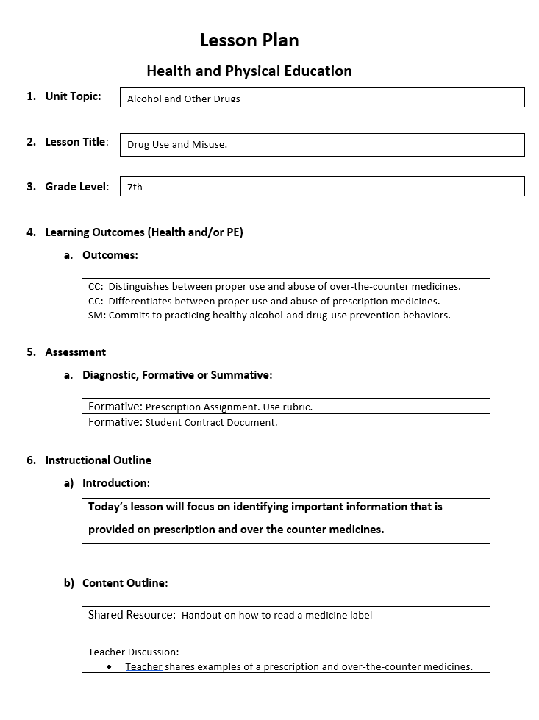
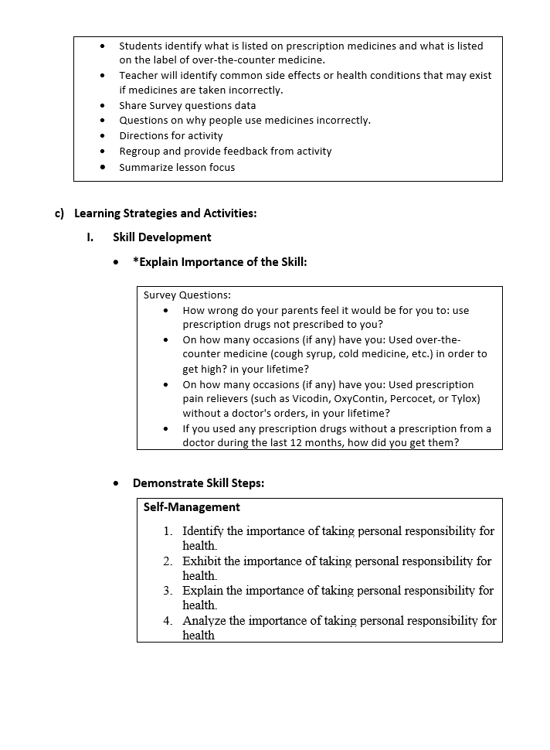
Health Education Lesson Plan Example

Slide 13
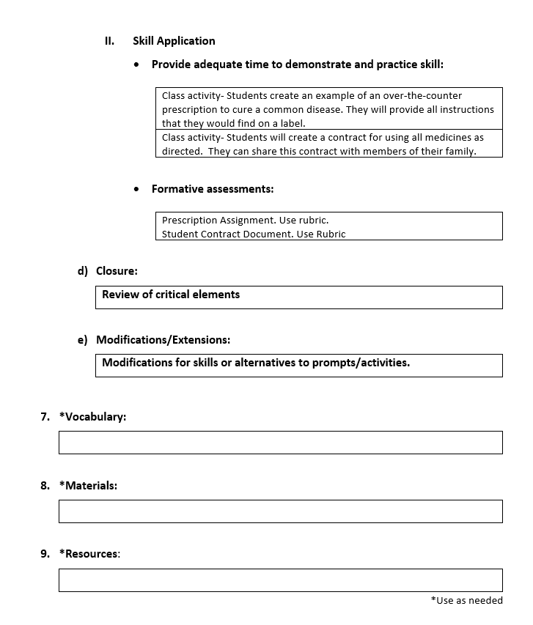
Health Education Lesson Plan Example

Slide 14
Physical Education Lesson Plan

Slide 15
Physical Education
Unit Topic: (Select one topic from the colored boxes, these topics areas of various colors and located on the left side of the outcomes document).
Lesson Title: (Select a name to your lesson. The name could be creative or based upon the skills and content being taught).
3. Grade Level: (Select the grade level for your Scope and Sequence)
Example: Locomotor Movements (from Standard Statement 1 Motor Skills K-6)
Example: Jumping and landing in a horizontal plane.
Example: 2nd Grade

Slide 16
Physical Education
Choose Outcomes (List all Outcomes for each lesson-Be Realistic): (List outcomes from each topics you want to include in your unit. You may choose outcomes from one topic or several topics. It may help to list the topic and the appropriate outcomes together).
Example: Locomotor - Jumping and landing, vertical plane: Demonstrates emerging elementary stage characteristics for jumping and landing in a horizontal plane using two-foot take-offs and landings.

Slide 17
Physical Education
Assessment of Skill-Based Outcomes: How do you know the student was successful? (Provide examples of diagnostic, formative 0r summative assessments you may use for your selected unit).
Diagnostic: Pre-test for skill development
Formative: Checklist, Bell Ringer, Lead up games
Summative: Fitness Journal, Pre and Post Test on Skills

Slide 18
Physical Education
Instruction Outline
Introduction: Include new skills, review current lessons or units, focus of the lesson
Content Outline: Include all new concepts and skills that will be taught during the class.
c) Learning Strategies and Activities
Skill Development (Explain the Importance of the Skill)
Example: Today’s class will introduce the locomotor skills to elementary students in grade 2. Today we will begin with a warm-up and stretch followed by a follow me activity to assess students on their current knowledge of the locomotor skills.
Example: New Skill: jumping and landing in a vertical plane. Students will learn how to take off and land with two feet.
Example: The importance of jumping and landing with two feet is crucial to skill development, safety, and the introduction to more complex movement combinations.

Slide 19
Physical Education
Skill Development
Demonstrate Skill Steps
Skill Application (Provide adequate time to demonstrate and practice skill)
Formative assessment
Example: Jumping – 1. Bend knees and hips 2. Swing arms hard 3. Push off the ground with the balls of feet 4. Lift both legs off the ground as you perform the jump. 5. Ease into landing by touching first with balls of feet and then touch each heal on the floor.
Tasks: 1. Jump forward, over the rope with both feet. (turn and repeat) 2. Jump backward, over the rope with both feet. (turn and repeat) 3. Quickly jump forward and backward over the rope with both feet.
Example: Skill assessment rubric, observation, checklist.

Slide 20
Physical Education
Closure (Provide information on what will be covered at the end of the lesson.
Modifications/Extensions:
Example: Today we learned how to jump and land with two feet using proper form. What are some reasons why it is good to practice jumping and landing with proper form? What activities can you think of that might include jumping and landing? Can you demonstrate how to jump and land with two feet using proper form?
Example: Teachers will adjust the skills and activities based on individual performances.

Slide 21
Physical Education
*Vocabulary
*Materials
Resources
Locomotor Movements, Horizontal Plane, Vertical Plane
Hula Hoops, Floor Poly Spots, Jump Ropes, Floor Tape
PE Central

Slide 22
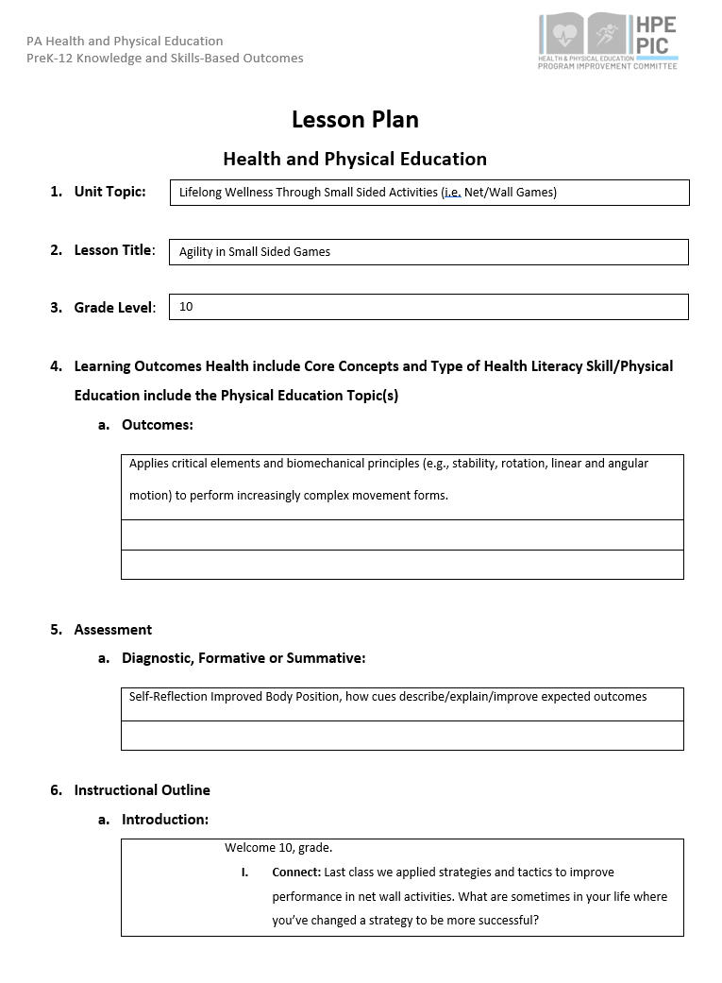
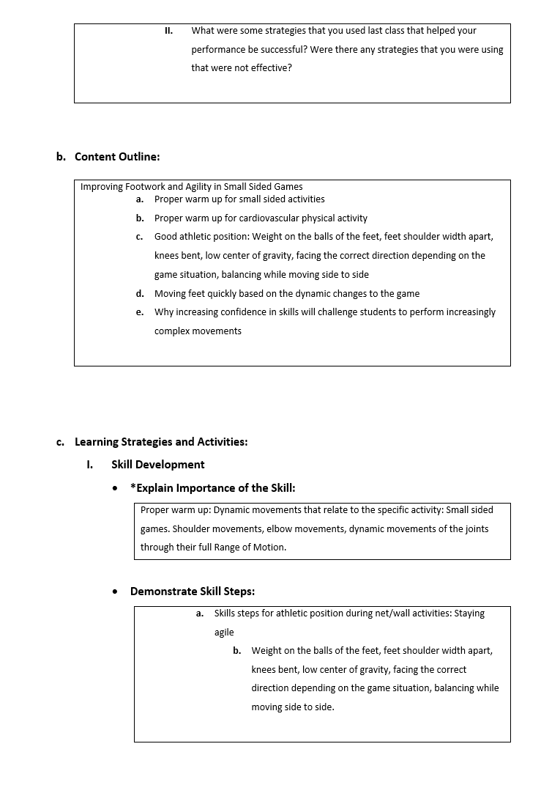
Physical Education Lesson Plan Example

Slide 23
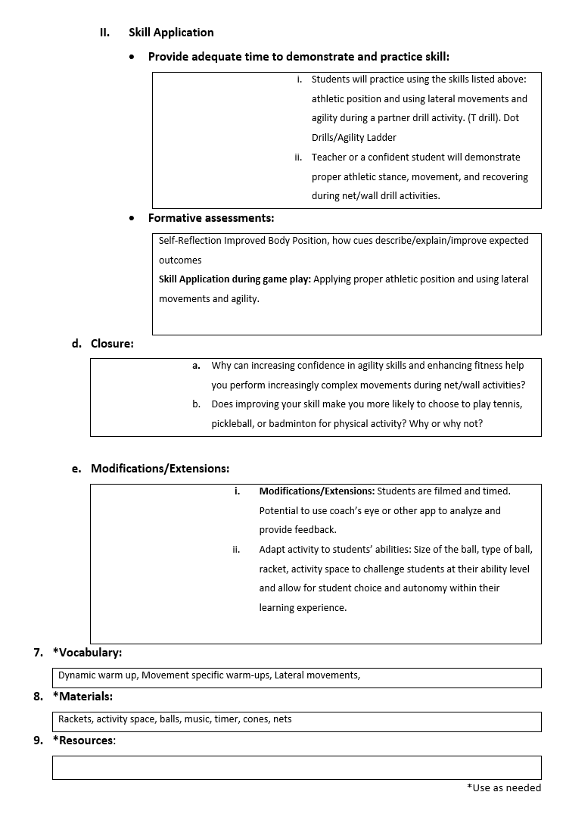
Physical Education Lesson Plan Example

Slide 24
HPED PIC Committee Contact Information
Dr. Kim Razzano Professor East Stroudsburg University krazzano@esu.edu | Nick Slotterback Pennsylvania Department of Education Health and Physical Education Advisor nslotterba@pa.gov
Jeffrey Jacobs Retired HPED Teacher Methacton School District jjacobshpe@gmail.com | Dr. Jennifer Rudella Associate Professor Lock Haven University jlr1147@lockhaven.edu
Dr. Cindy Allen Emeritus Professor Lock Haven University callen2@lockhaven.edu | Dr. Jennifer Butz Elementary Physical Education Teacher Northern Lehigh School District jbutz@nlsd.org

