Slide 1
Administrators Guide to Health and Physical Education in PA
Presentation by:
PA Health and Physical Education Program Improvement Committee

Slide 2
Presentation Description
This interactive training invites teachers and administrators alike to exhibit Health and Physical Education as you have never seen it before. Utilizing resources and curriculum building tools that reflect the importance of health-related student data from the Youth Risk Behavior Survey, School Climate Survey, and the Pennsylvania Youth Survey.
As a participant this training will illustrate strategies, activities, and lifelong skills to promote a healthier lifestyle for students for their educational career and beyond. This training includes an introduction to the Health, Safety, and Physical Education Professional Learning Community, answer questions regarding to Chapter 4 requirements, integrating health into elementary classrooms, and tour of the Knowledge and Skills Based Outcomes for Health and Physical Education.

Slide 3
Summary of Presentation
Chapter 1: State Policies and Procedures regarding Health and Physical Education
Chapter 2: K-12 Health and Physical Education Knowledge and Skills Based Outcomes Overview
Chapter 3: How The HPED Outcomes Address National and State-Wide Youth Survey Data
Chapter 4: Engage HPE in PA
Chapter 5: Health and Physical Education Professional Learning Community

Slide 4
Chapter 4 , Teacher Certification, and other state requirements for Health and Physical Education in PA
Chapter 1

Slide 5
§ 4.11. Purpose of public education.
(d) The academic standards describe the knowledge and skills that students will be expected to demonstrate before graduating from a public school.
(e) Achievement of high academic standards in public education is dependent upon the quality of instruction in schools and student effort supported by the involvement of family and community.
(f) Assessment in public education is designed to determine student attainment of State and local academic standards.
(g) Public schools provide instruction throughout the curriculum so that students may develop knowledge and skills in the following areas:
(8) Health, safety and physical education.

Slide 6
§ 4.11. Purpose of public education.
(h) Public education provides planned instruction to enable students to attain academic standards under § 4.12. Planned instruction consists of at least the following elements:
Objectives of a planned course, instructional unit or interdisciplinary studies to be achieved by all students.
Content, including materials and activities, and estimated instructional time to be devoted to achieving the academic standards. Courses, instructional units or interdisciplinary studies of varying lengths of time may be taught.
The relationship between the objectives of a planned course, instructional unit or interdisciplinary studies and academic standards specified under § 4.12 and any additional academic standards as determined by the school entity.
Procedures for measurement of the objectives of a planned course, instructional unit or interdisciplinary studies.

Slide 7
4.12. Academic standards.
(a) School entities may develop, expand or improve existing academic standards in the following content areas:
(6) Health, safety and physical education. Study of concepts and skills which affect personal, family and community health and safety, nutrition, physical fitness, movement concepts and strategies, safety in physical activity settings, and leadership and cooperation in physical activities.

Slide 8
4.12. Academic standards.
(b) In designing educational programs, school entities shall provide for the attainment of the academic standards under subsections (a) and (c) and any additional academic standards as determined by the school entity. Attaining the academic standards in this section requires students to demonstrate the acquisition and application of knowledge.
(c) School entities shall prepare students to attain academic standards in mathematics and English Language Arts in Appendix A-2 and incorporated here by reference and additional standards as may be adopted by the Board and promulgated as amendments to this chapter.
(d) A school entity’s curriculum shall be designed to provide students with planned instruction needed to attain these academic standards.
(e) School entities shall apply academic standards for students in all areas described under subsections (a) and (c). The local assessment plan under § 4.52 (relating to local assessment system) must include a description of how the academic standards will be measured and how information from the assessments is used to assist students having difficulty meeting the academic standards.

Slide 9
4.21. Elementary education: primary and intermediate levels.
(b) Curriculum and instruction in the primary program must be standards-based and focus on introducing young children to formal education, developing an awareness of the self in relation to others and the environment, and developing skills of communication, thinking and learning. Literacy skills, including phonemic awareness, phonological awareness, fluency, vocabulary and comprehension and developmental writing will begin in prekindergarten and kindergarten, if offered, and developed appropriately for the primary grade level.

Slide 10
4.21. Elementary education: primary and intermediate levels.
(e) Planned instruction aligned with academic standards in the following areas shall be provided to every student every year in the primary program. Planned instruction may be provided as separate course or other interdisciplinary activity.
(6) Health, safety and physical education, including instruction in concepts and skills which affect personal, family and community health and safety, nutrition, the prevention of alcohol, chemical and tobacco abuse, knowledge and practice of lifetime physical activities, personal fitness, basic movement skills and concepts, motor skill development, principles and strategies of movement, and safety practices in physical activity settings.
(f) Planned instruction in the following areas shall be provided to every student every year in the intermediate level program. Planned instruction may be provided as a separate course or as an instructional unit within another course or other interdisciplinary instructional activity:
(8) Health, safety and physical education, including instruction in concepts and skills which affect personal, family and community health and safety, nutrition, the prevention of alcohol, chemical and tobacco abuse, knowledge and practice of lifetime physical activities, personal fitness, basic movement skills and concepts, motor skill development, principles and strategies of movement and safety practices in physical activity settings.

Slide 11
4.22. Middle level education.
(a) The middle level planned instruction aligned with academic standards serves children who are approximately 11—14 years of age. School entities may modify the grouping of students based upon student needs identified by the school entity.
(b) Curriculum and instruction in the middle level program must be standards-based and focus on mastery of academic subjects, the development of critical and creative thinking, information literacy, good health and encourage active participation in the school and community.

Slide 12
4.22. Middle level education.
(c) Planned instruction aligned with academic standards in the following areas shall be provided to every student in the middle level program. Planned instruction may be provided as a separate course or as an instructional unit within a course or other interdisciplinary instructional activity:
(7) Health, safety and physical education, including instruction in concepts and skills which affect personal, family and community health and safety, nutrition, physical fitness, movement concepts, motor skill development, safety in physical activity settings, and the prevention of alcohol, chemical and tobacco abuse.

Slide 13
4.23. High school education.
(a) Instruction in the high school program must focus on the development of abilities needed to succeed in work and advanced education through planned instruction.
(b) Curriculum and instruction in the high school must be standards-based and provide all students opportunities to develop the skills of analysis, synthesis, evaluation and problem-solving and information literacy.

Slide 14
4.23. High school education.
(c) Planned instruction aligned with academic standards in the following areas shall be provided to every student in the high school program. Planned instruction may be provided as a separate course or as an instructional unit within a course or other interdisciplinary instructional activity:
(8) Health, safety and physical education, including instruction in concepts and skills which affect personal, family and community health and safety, nutrition, physical fitness, movement concepts, motor skill development, safety in physical activity settings, and the prevention of alcohol, chemical and tobacco abuse.

Slide 15
§ 4.27. Physical education and athletics.
(a) Physical education shall be taught as required under § § 4.21(e)(6) and (f)(8), 4.22(c)(7) and 4.23(c)(8) (relating to elementary education: primary and intermediate levels; middle level education; and high school education).
(b) The physical education program must be adapted for students who are medically unable to participate in the regular physical education program.
(c) The physical education program shall provide coeducational instruction, except that separation by sex may be permitted in courses involving contact sports. Separation by sex may not be used to exclude students of either sex from participating in any physical education instruction.

Slide 16
4.29. HIV/AIDS and other life-threatening and communicable diseases.
(a) Instruction regarding prevention of human immunodeficiency virus (HIV) infection/acquired immunodeficiency syndrome (AIDS) and other life-threatening and communicable diseases shall be given for primary, intermediate, middle school and high school education and shall follow the requirements of subsections (b) and (c).
(b) Educational materials and instruction shall be determined by the local school district and be appropriate to the age group being taught. The program of instruction must include information about the nature of the diseases, treatments and cures, methods of transmission and how infection can be prevented. The school district may omit instruction in the elementary grades on transmission of disease through sexual activity. Programs discussing transmission through sexual activity must stress that abstinence from sexual activity is the only completely reliable means of preventing sexual transmission. Programs must stress that avoidance of illegal drug use is the only completely reliable means of preventing transmission of disease through shared drug paraphernalia.

Slide 17
4.29. HIV/AIDS and other life-threatening and communicable diseases.
(c) A school entity shall excuse a pupil from HIV/AIDS instruction when the instruction conflicts with the religious beliefs or principles of the pupil or parent or guardian of the pupil and when excusal is requested in writing. Prior to the commencement of instruction, a school district shall publicize that detailed curriculum outlines and curricular materials used in conjunction with the instruction are available to parents and guardians during normal school hours or at teacher-parent conferences. Curricular materials, if practical, shall be made available by the school entity for home instructional use by a parent or guardian if the student has been excused from the school entity’s HIV/AIDS instruction.

Slide 18
Teacher Certification
​CSPG 47 - Health and Health and Physical Education (K-12) (pa.gov)
Health and Physical Education (pa.gov)

Slide 19
Health and Physical Education Teacher Certification
Grade Level Scope of Certificate
A person holding a valid Pennsylvania certificate for health education or health and physical education is qualified to teach all courses in grades PK-12.

Slide 20
Health and Physical Education Teacher Certification
Certification Assignment
An educator holding a valid Pennsylvania certificate for Health and Physical Education (Code 4805) is qualified to teach: health; kinesiology; motor skill development and motor learning; group interactions; personal fitness; principles of exercise and training; the effects of physical activity on the body systems; games and sports; lifetime leisure skills; dance and rhythmic activities; outdoor skills and activities; and adaptive physical education and swimming/aquatics.
An educator holding a valid Pennsylvania certificate for Health (Code 4810) is qualified to teach: human anatomy and physiology; human growth and development; human sexuality; personal health; nutrition, weight control and eating disorders; alcohol, tobacco and chemical substance abuse; mental and emotional health; personal hygiene; consumer health related information, products, services, and consumer choices; first aid, safety and prevention; diseases and disorders, HIV/AIDS education; community health; and violence prevention.

Slide 21
No Waivers
Health and Physical Education (pa.gov)
**Please Note: Neither the Pennsylvania School Code nor the State Board of Education allows for waivers for students from the requirements of health and physical education due to participation in a physical activity, such as interscholastic sports, band or ROTC. Physical activity is only one component of physical education and physical activity does not meet all of the requirements and standards of physical education.

Slide 22
24 P.S. §15-1547
Section 1547 requires each public school student to receive instruction in alcohol, chemical and tobacco abuse in every year in every grade from kindergarten to grade 12. While the law requires universal instruction for all students, it does not prescribe the curriculum, methodology or content of the courses of study. The law requires that the instruction be age appropriate, sequential, discourage use of tobacco, alcohol and other drugs, and communicate that the use of illicit drugs and the improper use of legally obtained drugs is wrong. The law does not require local schools to set up an independent course of study but rather to integrate the instruction in health or other appropriate courses of study.

Slide 23
Act 7 of 2019, formerly Senate Bill 115,
Section 1528. Cardiopulmonary Resuscitation Education.—
(a) In accordance with the academic standards for health, safety and physical education for grades nine through twelve and not later than the beginning of the 2019-2020 school year,
the department, in consultation with the Department of Health and at least one organization recognized under section 1205.4,
shall IDENTIFY OR develop a model curriculum and curriculum guidelines for instruction on cardiopulmonary resuscitation for public school students in grades nine through twelve.

Slide 24
K-12 Health and Physical Education Knowledge and Skills Based Outcomes Overview
Chapter 2

Slide 25
Outcomes Brief History
Process began in January of 2016
Draft of Outcomes was developed by 2017
Reviewed by State Agencies, Administrators, Higher Education, and K-12 teachers
Added additional content, especially for health, to include mandated and current topics

Slide 26
Tried to Accomplish the Following:
GOALS
Make more up-to-date and relevant | Develop helpful and appropriate resources
Shift from content to developmentally age-appropriate lifelong skills | Supports updates to completing a curriculum framework for health and physical education
Provide greater scope and depth for each outcome | Teacher-friendly- easy to understand and use
Remove outcomes that were no longer relevant | Made accessible for teachers, administrators, parents and students

Slide 27
Terms to Remember
Health Terms | Definition
Core Concepts | Content to be taught to students in non-benchmark years. (The Know)
Health Literacy Skills | Defined as a person's ability to find, understand and use information and services to make health-related decisions for themselves and others. Adopt and maintain healthy behaviors. Skills to be taught (The Do)
Outcomes | Student expectations that will be assessed. (Learning Objectives)
Health Topic | Topics of health that align with each standard statement and outcome.

Slide 28
Health Education Changes
Added additional content (for health: Mental health, COVID-19, organ tissue donation awareness, food allergies, diabetes, Lyme disease, suicide prevention, vaping/ E-Cigarettes/Juuling, Lead poisoning, CPR, etc.)
Shift from content to developmentally age-appropriate life-long skills

Slide 29
Elementary Health Education Support
Integrating Health into Physical Education (Nutrition, Safety, Personal, Mental Health)
Supporting Health in regular Classroom (Story time: Books with Health Content (Berenstain Bears, Arthur, Dr. Seuss, etc.)
Guest Speakers (Presentations from Health Professional from Community, Bully/Violence Prevention Companies, Alcohol and Other Drug, Safety Violence Prevention: Police and/or Fire Department, etc.)
Staff Support (School Nurse: Puberty/Hygiene/Personal Health, Guidance Counselor: Mental Health/Conflict Resolution/Decision-Making, and Administrator: Violence Prevention/Bully Prevention/Alcohol and other Drugs)
Virtual Classroom (HPE teacher teaches to entire grade while they are in the regular classroom)

Slide 30
Content and Health Literacy Skills
Topic Areas | Content | Health-Literacy Skills
Alcohol and Other Drugs | Core Concepts not benchmark years | Analyzing Influences
Tobacco |  | Accessing Information
Healthy Eating |  | Interpersonal Communication
Mental and Emotional Health |  | Decision-Making
Personal Health |  | Goal-Setting
Physical Activity |  | Self-Management
Safety/Injury Prevention |  | Advocacy
Violence Prevention
Healthy Relationships (K-6)/Sexual Health (7-12)

Slide 31
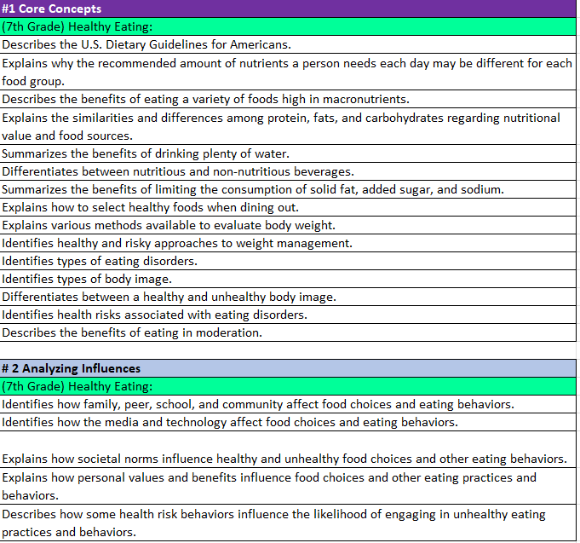
Health Education Outcomes
Dark Purple- Core Concepts
Light Blue-Health Literacy Skills
Rainbow Color – Health Content
White - Outcome

Slide 32
Terms to Remember
Physical Education Terms | Definition
Physical Literacy Components | The physical literacy components are Motor Skills, Movement Concepts, Level of Fitness, Cooperative Skills, and Value of Physical Activity (Physical Literacy Components are written in bold within the gray box)
Physical Education Topic | Content that will help create physical education units. (Physical Education Topics are written in bold within the colored boxes on the left side of each grade level).
Skills | Building blocks in creating curriculum. Skills determine what outcomes will be taught. (Skills are only found in Physical Literacy Component #1 for grades K-6. The skills align to the topic area. They are not bolded after the Physical Education Topic within the colored boxes on the left side of each grade level).
Outcomes | Student expectations that will be assessed. (Learning Objectives) (White section in the outcome documents).

Slide 33
Physical Education Components
Physical Literacy Components | K-3 (PE Topics) | 4-6 (PE Topics) | 7-9 (PE Topics) | 10-12 (PE Topics)
Motor Skills | Locomotor, Nonlocomotor, and Manipulatives | Locomotor, Nonlocomotor, and Manipulatives | Dance and rhythms, Specialized skills and movement patterns, Application of specialized manipulative skills, outdoor pursuits, Individual performance activities | Combined movement skills and patterns, Specialized skill performance,
Movement Concepts and Performance | Space, Pathways, shapes, levels, Speed, direction, force and Strategies and tactics | Space, Pathways, shapes, levels, Speed, direction, force and Strategies and tactics | Tactics and principles and principles and critical elements | Strategies and tactics and Principles and critical elements
Level of Fitness | Physical activity knowledge, Engages in physical activity, Fitness knowledge, and Nutrition | Engages in physical activity, fitness knowledge, nutrition, and assessment of program planning | Physical activity knowledge, Engages in physical activity, Fitness knowledge, Nutrition, Assessment and program planning, and Healthy Habits in relation to fitness | Physical Activity knowledge, Engages in Physical, Fitness Knowledge, Nutrition, Assessment and program planning, Healthy Habits in relation to fitness, and Accessing information
Cooperative skills and positive behavior | Personal responsibility, Accepting feedback, Working with others, Rules and Etiquette, and Safety | Personal responsibility, Accepting feedback, Working with others, Rules and Etiquette, and Safety | Personal responsibility, Accepting feedback, Working with others, Rules and Etiquette, and Safety | Personal Responsibility, Cooperation, Rules and Etiquette, and Safety,
Value of Physical Activity | Health, Challenge, and Self expression and enjoyment | Health, Challenge, Self expression and enjoyment, and Social interaction | Health, Challenge, Self expression and enjoyment, and Social interaction | Health, Challenge, Self expression and enjoyment, and Social interaction

Slide 34
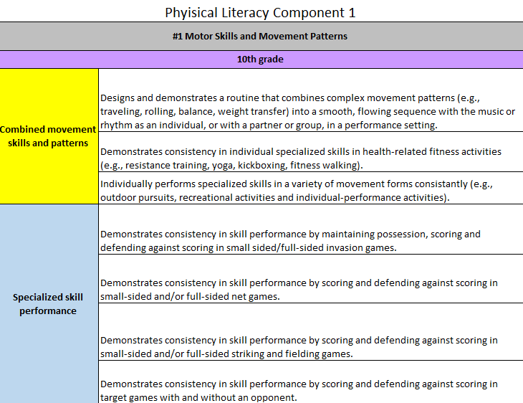
Physical Education Outcomes
Gray – Physical Literacy Component
Purple Box- Grade Level
Rainbow Color (Left Side)
Topics in Bold
Skills-Follow topics in Physical Literacy Skill #1 Motor Skills only in grades K-6.
White - Outcomes

Slide 35
*Disclaimer
These outcomes are not the approved standards for PA currently.
We look to share this work with the State Board of Education once we are invited.
They can however be used to help keep your health and physical education programs more current to the forever changing health literacy and physical literacy climate.
PA Code 22, Chapter 4 also encourages the use of materials to expand or improve existing academic standards.

Slide 36
Support from Chapter 4 PA Code 22
§ 4.12. Academic standards.
(a) School entities may develop, expand or improve existing academic standards in the following content areas:
(6) Health, safety and physical education. Study of concepts and skills which affect personal, family and community health and safety, nutrition, physical fitness, movement concepts and strategies, safety in physical activity settings, and leadership and cooperation in physical activities.

Slide 37
How The HPED Outcomes Address National and State-Wide Youth Survey Data
Chapter 3

Slide 38
Overview
The state-wide data set the foundation of the revised outcomes to determine student needs. For example, there is a need to help students improve and maintain their dimensions of health, mental, emotional, social, physical, and intellectual in students today and these topics were added to the content areas in the revised health and physical outcomes. The current HPE standards do not address these crucial health elements that students are struggling with, and therefore, need additional support. We helped counter that through developing these health and physical literacy outcomes to ultimately help students adopt and maintain healthy behaviors to improve quality of life.
The charts in the preceding slides illustrate a need for support around multiple youth health risk behaviors. The HPE Outcomes refer to specific topics that promote lifelong, positive healthy behaviors. The purpose of the HPE Outcomes are to help students adopt and maintain healthy behaviors and decrease risk behaviors. These charts demonstrate how the health-literacy skills and physical literacy components address the Career Ready Skills and School Climate Survey Domains. Furthermore, these charts display how the health and physical education topics align with the Centers for Disease Control Youth Risk Behavior Survey and proposed questions that address the health concerns and behaviors of the Pennsylvania Youth Survey.

Slide 39
School Climate
School Climate Domains | Health Literacy Skills | Physical Literacy Components
Student Support | Analyzing Influences Accessing Information Interpersonal Communication Decision-Making Goal-Setting Self-Management Advocacy | Motor Skills Movement Concepts and Performance Cooperative Skills and Positive Behavior Level of Fitness Value of Physical Activity
Social/Emotional Learning | Analyzing Influences Accessing Information Interpersonal Communication Decision-Making Goal-Setting Self-Management Advocacy | Movement Concepts and Performance Cooperative Skills and Positive Behavior Motor Skills Level of Fitness Value of Physical Activity
School Safe and Respectful Climate | Analyzing Influences Accessing Information Interpersonal Communication Decision-Making Goal-Setting Self-Management Advocacy | Motor Skills Movement Concepts and Performance Level of Fitness Cooperative Skills and Positive Behavior Value of Physical Activity

Slide 40
YRBS
CDC Youth Risk Behaviors | 2019 Data | Topics
Behaviors that contribute to unintentional injuries and violence | 39% Texted or Emailed While Driving a Car or Other Vehicle 35% felt sad or hopeless | Health Violence Prevention Safety Mental Health Healthy Relationships (K-5) Sexual Health (6-12) PE Safety Rules and Etiquette Cooperation Personal Responsibility
Sexual behaviors related to unintended pregnancy and sexually transmitted diseases, including HIV infection | 72% did not use birth control pills before last sexual intercourse 88% did not use both a condom during last sexual intercourse and birth control pills 89% were never tested for HIV 89% were not tested for an STD other than HIV | Health Healthy Relationships (K-5) Sexual Health (6-12) Personal Health Violence Prevention
Alcohol and other drug use | 39% usually obtained the alcohol they drank by someone giving it to them 37% Ever used marijuana | Health Alcohol and Other Drugs

Slide 41
PAYS
PAYS Categories | 2021 Data | Topics
Alcohol, Tobacco and Other Drug Use | Drank alcohol in their lifetime/during the past 30 days 55% of 12th grade students 43% of 10th grade students Used Nicotine when Vaping 69% of 12th grade students 61% of 10th grade students Did not know what substance was in vaping 69% of 6th grade students Mandate of Opioid Education in (Act 124 of 2017) there is a large decline in use and access of opioids amongst students in grades 6th-12th | Health Alcohol and Other Drug Use Tobacco
Antisocial Behavior | Been drunk or high at school 10% of 6th-12th grade students Given the hybrid learning environment, students were still suspended at school 5% of 6th – 12th grade students | Health Healthy Relationships (K-6) PE Cooperation Rules and Etiquette Social Interaction Working with Others
Community, School Climate, and Safety | Feel school is important for later life 65% of 6th grade students 32% of 12th grade students Feel they have lots of chances to be part of class discussions and activities 85% of 6th through 12th grade students Feel safe at school 89% of 6th grade students 82% of 12th grade students | Health Violence Prevention Safety PE Rules and Etiquette Safety

Slide 42
ENGAGE HPE in PA
Chapter 4

Slide 43
ENGAGE Health and Physical Education
Pennsylvania Department of Education
PA HPE Program Improvement Committee (PIC)
State Agencies
Higher Education
SHAPE PA
IUs

Slide 44
State Agency Partners
(DOH) Department of Health
(PCCD) PA Commission on Crime/Delinquency
(OMHSAS) Office of Mental Health and Substance Abuse Services
(PDE) Pennsylvania Department of Education (Office for Safe Schools/Division of Food and Nutrition
(DDAP) Department of Drug and Alcohol Programs
(DOA) Department of Agriculture
(LCB) Liquor Control Board
(PSP) State Police

Slide 45
Higher Education
Department Chair
Edinboro University
Slippery Rock University
Indiana University of Pennsylvania
Lock Haven University
East Stroudsburg University
West Chester University

Slide 46
ENGAGE Health and Physical Education: Purpose
Develop and share resources, trainings, funding opportunities, and toolkits.
Communicate health and physical education needs and support at a state-wide and local level.
Streamline all health and physical education materials to all Health and Physical Education professionals.

Slide 47
Health and Physical Education Professional Learning Community
Chapter 5

Slide 48
Accessing the Outcomes on the SAS Portal
Although not officially adopted, they will be available on the SAS portal on the PDE website. They may be used as a resource for lessons and curriculum writing. You will first need to follow the instructions to register. Then.... In your browser go to www.pdesas.org
Here are the directions for accessing them:
At top right corner, click on the box that says "MySAS Tools"
Click on "Communities"
Click on "Find a Community“ (right side of page)
Search for "Physical Education Learning Community"
Click on “PDE Health, Safety and Physical Education Learning Community"
Click on "Join this Community"
Scroll to bottom of page
Click on “Shared Content" button
Scroll to folder of interest
Click on ">" to access files

Slide 49
SAS Professional Learning Community
Upcoming Events
Grant opportunities
Discussion Panels
Curriculum Assessment Tools
Updated articles for classroom discussion
Classroom Resources
Share professional best practices

Slide 50
These are the 4 files you will want to access:
K-12 Physical Education Knowledge and Skills Development Outcomes
K-12 Health Knowledge and Skills Development Outcomes (By grade level)
K-12 Health Knowledge and Skills Development Outcomes (By Health Topic
2022-2023 K-12 Knowledge and Skills Based Outcomes Professional Development Documents

Slide 51
HPED PIC Committee Contact Information
Dr. Kim Razzano Professor East Stroudsburg University krazzano@esu.edu | Nick Slotterback Pennsylvania Department of Education Health and Physical Education Advisor nslotterba@pa.gov
Jeffrey Jacobs Retired HPED Teacher Methacton School District jjacobshpe@gmail.com | Dr. Jennifer Rudella Associate Professor Lock Haven University jlr1147@lockhaven.edu
Dr. Cindy Allen Emeritus Professor Lock Haven University callen2@lockhaven.edu | Dr. Jennifer Butz Elementary Physical Education Teacher Northern Lehigh School District jbutz@nlsd.org

